Slide 1
NAME : JUNAID AHMAD
ID : 6872
SECTION : B
SUBJECT : GIS
SUBMITTED TO : ENGR. HAMZA MUSTAFA

Slide 2
LAND USE OF MARDAN CITY KPK, PAKISTAN

Slide 3
INTRODUCTION
Globally, the ongoing urbanization is considered to be one of the foremost threats for sustaining urban ecosystems. Like other developing countries, in Pakistan the urban population has been increasing at a rapid pace and the World Bank has estimated that half of the country’s total population will become urban by the year 2020. By way of increasing urban population, the prime agriculture land is being encroached by housing, infrastructure, industrial, educational and commercial uses This study focused on Mardan city, Pakistan. Geographically, Mardan city stretches from 34° 9’ 4″ to 34°13' 21″ N latitude and 72° 3' 11″ to 72° 14' 48″ E longitude covering an area of 32 sq km (Fig. 1). It is located 64 km away from Peshawar, the provincial capital of Khyber Pakhtunkhwa (KP) and 148 km west of Islamabad, the federal capital of Pakistan. In the present study, GIS and remote sensing techniques were employed to detect changes in the land use pattern. Within Khyber Pakhtunkhwa province, Mardan is the 2nd largest and fastest growing city after capital city district Peshawar.
During the past few decades, there has been significant urban expansion over the peri-urban agricultural land of this city. Likewise, the construction of District Headquarters Hospital, Government Postgraduate College Mardan, Premier Sugar Mills Mardan and Tobacco industry were the other major developments that have attracted a large population to settle in the proximity to of old Mardan city. Since the 1990s, Mardan city has experienced a rapid growth both in terms of population and spatial extent. The urban area has expanded on the fringes at the cost of prime agricultural and waste land. The rich agricultural products in neighborhood of the city have made it a thriving market and have enabled development of agro-based industries in the new vicinities. In addition, there are several bazaars, markets, shopping malls and plazas of commercial importance. A number of new markets and plazas

Slide 4
This study focused on Mardan city, Pakistan. Geographically, Mardan city stretches from 34° 9’ 4″ to 34°13' 21″ N latitude and 72° 3' 11″ to 72° 14' 48″ E longitude covering an area of 32 sq km (Fig. 1). It is located 64 km away from Peshawar, the provincial capital of Khyber Pakhtunkhwa (KP) and 148 km west of Islamabad, the federal capital of Pakistan.
In the present study, GIS and remote sensing techniques were employed to detect changes in the land use pattern. Within Khyber Pakhtunkhwa province, Mardan is the 2nd largest and fastest growing city after capital city district Peshawar.

Slide 5
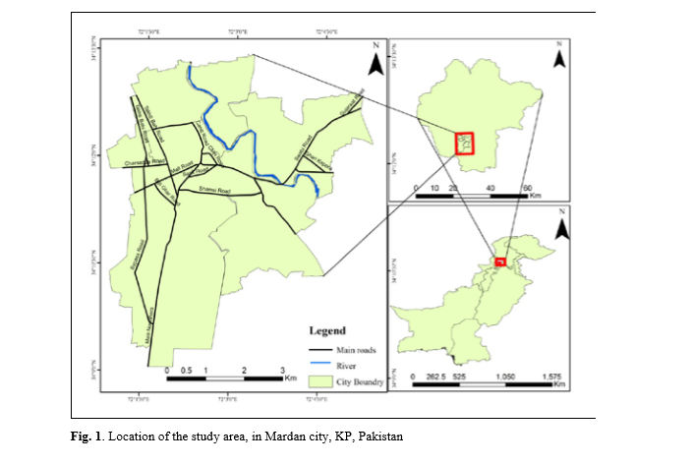
LOCATION OF STUDY AREA IN MARDAN CITY, PAKISTAN

Slide 6
PROBLEM STATEMENT
In this study GIS and remote sensing techniques have been applied for assessing the increasing trend of farmland conversion of Mardan city, Pakistan into impervious surfaces. The study area was a part of the fertile and productive land of Peshawar vale. The analysis was undertaken using Landsat 30 m of 1990 and SPOT 2.5 m of 2010. The datasets were interpreted with Maximum Likelihood supervised classification approach in ArcGIS environment.

Slide 7
OBJECTIVE
The present study focused on digging out the expansion of built-up area and its impacts on farmland and food production. The analysis revealed that in Mardan city population growth over the time period has caused great changes in the available land use.

Slide 8
METHODOLOGY
The data were collected both from primary and secondary sources. The primary data includes satellite imageries (Landsat 30 m for the year 1990 and Spot 2.5 m for 2010) of Mardan city were obtained from SUPARCO office, Peshawar (Fig. 2). In order to investigate the causes of urban expansion focused group discussions (FGDs) were conducted with the officials of urban authorities, District Revenue Office, politicians, landlords, elderly people and estate agents. In addition to this, secondary data were obtained from related Government departments. Similarly, maps of Mardan city were obtained from Mardan municipal committee, whereas population data were acquired from the Population Census Organization of Pakistan. Land use and crops statistics were obtained from the Bureau of Statistics and land records of the revenue office, Mardan.
The satellite images enabled us to quantify the changes in land use and soil sealing over the last two decades. Two images (Landsat 30 m for the year 1990 and Spot 2.5 m for 2010) of 20 years apart were chosen. Image classification technique helped to extract information about the land use and land cover type from the remotely sensed data. Both supervised and unsupervised classification approaches were used for processing the satellite images. The analyzed data were checked for quantitative and qualitative accuracy assessment for the final classified images of 1990 and 2010. The qualitative assessment is based on visual interpretation techniques and the same was tallied with the open source Google Earth, whereas, the quantitative assessment was carried out through a standard technique of error matrix [24]. A stratified random sampling approach was applied to validate samples and the resultant thematic layer classes. Approximately 50 reference points were then generated for each land use class. Most of the sample reference points were checked during field surveys. Overall accuracy, user's accuracy, producer's accuracy and Kappa coefficient were calculated for 1990 and 2010
classified maps. The resultant maps met the overall minimum 85% accuracy as specified by the Anderson classification scheme [25]. As a result the quantified data for all the land use changes between 1990 and 2010 were compiled and tabulated. The land use maps of Mardan city for 1990 and 2010 were generated, which helped in comparing the changes in land use pattern and the growing pace of urban expansion over the farmlands.

Slide 9
ANALYSIS
The analysis revealed that, during the last two decades, both negative and positive changes have occurred in the land use and land cover pattern of Mardan City (Table 1; Fig. 3). The built environment has more than doubled as it has increased from 953 ha in 1990 to 1994 ha in 2010. The increase in built up area accounts for 52% of the total area. This increase in built-up environment was occurred as a result of rapid growth in urban population and creation of better transport facilities and other amenities within the city.
The comparative analysis revealed that a gradual decrease has occurred in the farmland from 1,339 ha in 1990 to 1,109 ha in 2010, which is 17% of the total area. The main reason behind this decline in cropped land was the increase in land prices which encouraged the poor rural households to sell their land at higher prices. Having small parcels of land, they could not meet their family needs; therefore, with better price offers they sold their farmlands and opted out for alternative sources of income. Similarly, the cultivable waste land has decreased drastically, from 827 ha in 1990 to mere 16 ha in 2010. Most of this waste land has been transformed into builtup areas. However, the area under water bodies remained same during the two decades (1990 2010).

Slide 10
To understand land encroachment in different land use categories, a change detection matrix (Table 2; Fig. 5) was prepared which revealed that during the two decades (1990-2010), the farmland within the city limits has been gradually transformed. The highlights of these transformations in Mardan City over 1990-2010 period are given in Table 2. The largest consumer of farmland was built-up environments.
A total 613 hectare of waste land was lost to built-up uses over the study period of 1990-2010. This means that 52% of the newly built environment was developed over the waste land. However, almost 33% of farmland was also lost to built-up area during this period. Nevertheless, there was also gain in the agricultural land mainly by bringing around 141 hectares of cultivable waste land under plough. The spatial pattern of these changes has been shown in Fig. 5.

Slide 11
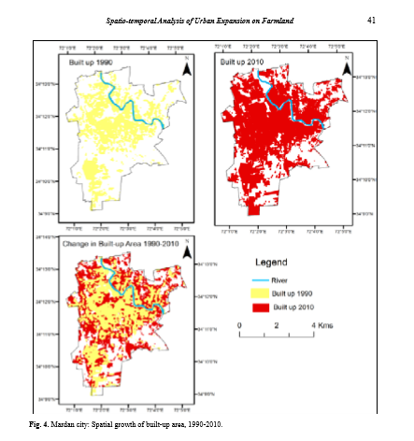

Slide 12
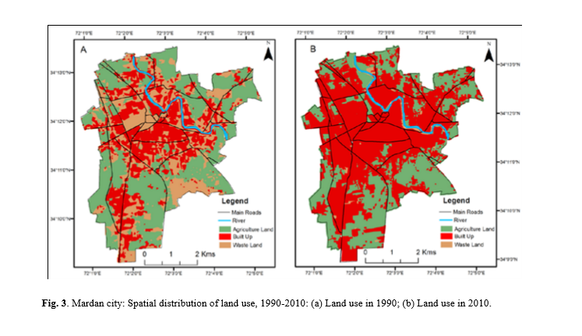

Slide 13
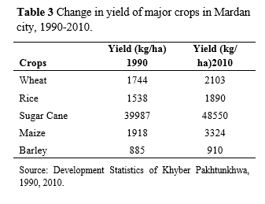

Slide 15
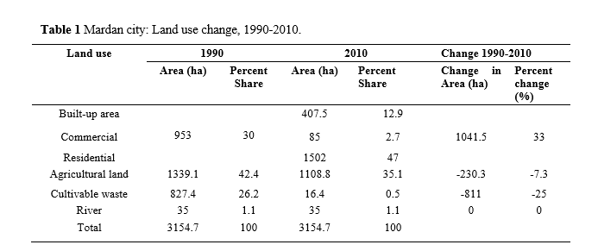

Slide 16
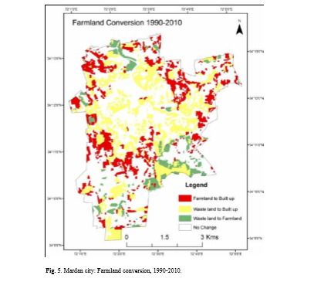
Trend of Cereal Production in Mardan City since 1990

Slide 17
RESULT
The results were classified into major land use categories of built-up area, farmland and cultivable waste. The analysis revealed that rapid increase in population has resulted in haphazard urban expansion particularly after 1990. During the study period, the built-up area has been doubled from 30% of the total city area in 1990 to over 63% in 2010, thereby has doubled the impervious surfaces. Consequently, the prime agricultural land has shrunk from 1,339 ha (42%) to 1,109 ha (35%) during the two decades. Similarly, the share of cultivable waste was decreased from 827 ha (26%) in 1990 to 16 ha (0.5%) in 2010. It was found that the increasing demand for housing and other infrastructure was fulfilled by conversion of fertile agricultural and cultivable waste. The study further revealed that Mardan city is expanding haphazardly in all directions without strategic land use regulations and planning and thus is posing serious threats to the fragile environment.

Slide 18
CONCLUSION
The present study demonstrated the effectiveness of remote sensing and Geographic Information System as a tool in analyzing land use changes. The analysis revealed that Mardan city has experienced a rapid growth during the last two decades (1990-2010). The area under built environment has increased from 953 ha to 1,994 ha over the study period. The city has expanded in all directions over the peri-urban farmland. Most of this expansion is haphazard and unplanned mainly following ribbon sprawl along the roads and radiating out of the city. Over the period, the agricultural land has been lost to built-up area. The cultivable waste land which covered a big chunk (827 ha) in 1990 has been reduced to mere 16 ha in 2010. During 1990-2010 about 613 ha of cultivable waste land and 371 ha of farmland were lost to built-up uses.
Though, there was also a gain in farmland, about 141 ha of cultivable waste land was transformed to farmland. In order to sustainably utilize the urban land, the government must promote agriculture and encourage, establish and reinforce farmer organizations in Mardan city and or in peri-urban areas. . Monitoring urban expansion is also necessary to make the city’s expansion is accordance with the urban planning standard. GIS and Remote Sensing techniques could be used to monitor urban expansion in and around Mardan city. The government should also initiate awareness programs on the negative implications of haphazard urban sprawl.

