Slide 1
Paper: PATHOLOGY
Name:
SUBHANULLAH
ID
SEMESTER:
DEP:
SECTION:
16161
2nd
BS MLT
B

Slide 2
QUESTION: 1

Slide 3
QUESTION : 1
Definition:
The physiological process of reabsorption of tissues, involving apoptosis or
Atrophy is a decreqde in cell size or shrinkage in the size of the cell by the loss of cell organalies is callad atrophy
Examples:
Physiological:
Loss of hormone stimulation in menopause due to decreas level of estrogen hormone and then shout down the reproductive system.
inervation
pathological
denervation
charcot marie tooth disease
poliomyelitis
ANSWER:
A:ATROPHY:

Slide 4
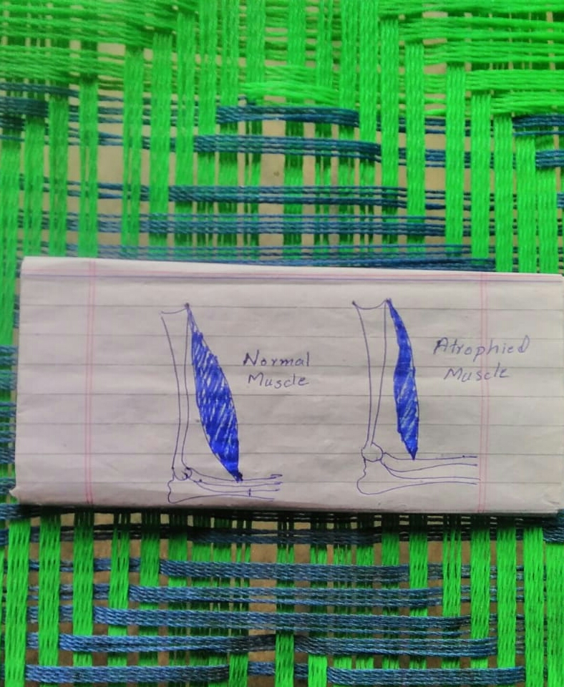
ATROPHY:

Slide 5
QUESTION:1
Definition: Hypertrophy is in the increas in the volume of in cell or organ or tissue due to the enlargment of component of cells
Or
Hypertrophy is in increas in cell size or organ or tissue due to increas in cell size.
it is distingguished from hyperplasia in which the cell remain approximatly the same sizr but increase in number.
In hypertrophy there is no new cell, just bigger cells contaning increas amounts of structureproteins and organelies.
EXAMPLES:
PHYSIOLOGICAL:
Mostly when a person do more work or exercise so the body parts of this person will be enlarge mean skeletal muscle.
more use of museles
PATHOLOGICAL:
Cardiac muscle is a reasult of sion
B:HYPERTROPHY

Slide 6
Hypertrophy:

Slide 7
QUESTION:1
Definition:Hyperplasia is an incrase in the number of cells which result increase the sizeof in organ.
or
The enlargment of an organ or tissue caused by an increase in the reproduction rate of its cells.
Whin the hyperplasia more occure in the body in initial stage then the development of cancer will be occure.
EXAMPLES:
PHYSIOLOGICAL:
HORMONAL HYPERPLASIA :In puberty and also during pregnancy the proliferation ouccer in the glandular epithelium inside the female breast.
COMPENSATORY HYPERPLASIA: When part of the liveris resected.
PATHOLOGICAL:After a normal menstrual peroid there is a broust of uterine epithelial proliferation that is normaly.pituitary hormone and ovarianestrogen to inhibit progesterone.
C: HYPERPLASIA:

Slide 8
HYPERPLASIA:

Slide 9
QUESTION: 1
Definition:The change from one type of cellto another may be part of the normal maturation process or caused by some sort of abnormal stimulus
OR
Metaplasia is the reversible replacement of one differentiated cell type with another mature differentiated cell type.
EXAMPLES.
PATHOLOGICAL and PHYSIOLOGICAL
BARRETTS ESOPHAGUS:IT IS due to smoking
in airways the normal pseudostratifieo columnar epithelium is converted due to metaplasia to squamous epithelium
In urinary bladder transitional eithelium is converted to squamous epithelium due to metaplasia.
In esophagus squamous epithelium is converted in to columnar epithelium (barretts esophagus).
D:METAPLASIA:

Slide 10
MATAPLASIA:

Slide 11
QUESTION: 2

Slide 12
QUESTION: 2 ANSWER:
When the calcium is inter to the cytosol of the cell from the extracellular fluid and then this calcium is now stores in mitochondria and endoplasmic reticulum of the cell and they show the following effects.
1: Calcium++ activates a special type of enzyme mean prpduce phospholipases and the function of phospholipases is that to damage cell membrane.
EFFECTS OF CALCIUM ON THE CELL:

Slide 13
2: proteases enzyme is also produce and the function of protease enzyme is that to damage cell membrane and cytoskeleton.
3:Endonuclease enzymes is also produce inside the cytosol and function of this type enzymes is to damage DNA
So when calcium level is increase inside the cytosol so the cell death will be occure and this is the main mechanisms of cell death.
The cell death occure due to the severe damage of lysosomal membrane .when the lysosmale membrane damage the enzyme which is present in lysosome out to cytosol and destry the cell organelies so the cell cell do not work perfectly and as a result cell death will be occure.

Slide 15
QUESTION: 3

Slide 16
QUESTION: 3 ANSWER:
Definition:Uncharged molecule (typically highly reactive and short lived)having an unpaired valence electron.
OR
Free radicald have a single unpaired electron in the outer orbit.
we also use for free radical term ROS (reactive oxygen species).
FREE RADICAL:

Slide 17
Explenation:
ROS are usually derived from oxygen to produce reactive oxygen species .superoxide, hydroxyle radicals, H2o2 etc.
Free radical normaly produce during cellular respiration.
With the help of normal physiological reduction oxidation reaction, due to ultravoilet , X rays , druge etc free free redical is produce.

Slide 18
QUESTION: 3 Answer:
When free radical is produced in excess form they react and damage proteins , lipids, carbohydrates,and nucleic asids.
thes damage molecules may themselves be reactive species with a chain reaction being set up with widespread damage.
EFFECTS OF FREE RADICAL ON THE CELL:

Slide 19
.
Free radicale causes lipid peroxidation in cell membrane.As a result of this cellular and mitochandrial damage will be occure.oxidation of amino acids and protein as due to fragmentaion . Altered proteins do further damage .
.

Slide 20
FREE RADICAL:

Slide 21
QUESTION: 4

Slide 22
Question:4 ANSWER: DIFFERENCE BETWEEN APOPTOSIS AND NECROSIS
APOPTOSIS
PROGRAMMED CELL DEATH IS CALLED APOPTOSIS,Is a form of cell death that is genrally trggered by normal healthy process in the body.
NECROSIS
Is the premature death of cells and living tissue caused by external factors to the cell or tissue such is infection, toxins or trauma.

Slide 23
Which can also occure as a defence meechanism during healing process and almost always normal and beneficial to an organism.
Necrosis is always abnormal and harmful though necrosis is being researched as possible form of programmed cell death.That is some time callun natural process.

Slide 24
Difference between on the basis of nature:
Apoptosis : It is a natural proscess it mean it occure due to natural function of the body.
Necrosis :It is caused by external factures to the cell or tissue such is infection yoxin or trauma.

Slide 25
Difference between on the basis of effects:
APOPTOSIS:apoptosis is usually beneficial only abnormal when cellular process that keep the body in balance cause too many cell death or too few.
NECROSIS: It is always determental process.

Slide 26
Difference between on the basis of process:
Apoptosis:membrane blebbing shrinkage of cell. Nuclear collapes (nuclear fragmentaion , chromatin con densation,chromosomal DNA fragmentation) apoptopic body formation , then enqulf by white.
NECROSIS: Membrane disruption occure respiratory poisons and hypoxia. Which cause ATP deplefion, metabolic collapse cell swelling and rupture leading to inflammation.

Slide 27
DIFFERENCE BETWEEN ON THE BASIS OF MEDICAL TREATMRNT:
APOPTOSIS: Apoptosis very rarely needs treatment.
NECROSIS:Necrosis always required medical treatment. Untrated necrosis is dangerous and can lead to death.

Slide 28
Apoptosis:

Slide 29
NECROSIS:

Slide 30
QUESTION: 5

Slide 31
Question: 5 Answer:
Definition: air embolism also know as gas embolism, is a blood vessels blockage caused by one or more nubbles of air or other gas in the circulatory system.
AIR EMBOLISM:

Slide 32
Explenation:Air can introduce in to the circulation during surgical procedures,lung overexpansion injury, decompression, and a few other causes.divers can suffer from arterial gas embolisms as a consequence of lung over expansion injury.breathin gas introduce into the venous system of the lungs due to pulmonary barotrauma.

Slide 33
SYMPTOMS:
HYPOTENSION
SHORTNESS OF BREATH
LOSS of consciousness
Cessation of breathing
Vertigo
Convulsion
Tremors
Loss of coordination
Loss of controle of body function
Extreme fatigue
Weakness in the extremities
Area of abnormal sensation
Visual abnormalities
Personality changes
Nausea or vomiting

Slide 34
CAUSES:
SURGERY:Small amount of air often get into the blood circulation accidentaly during surgery and other medical procedures
DECOMPRESSION ILLNESS: Gas embolism is adiving disorder suffered by under water divers who breathe gases at ambint pressure and can happen in two distinct ways.

Slide 35
CAUSES:
PULMONARY BAROTRAUMA:Air bubblescan enter the blood stream as a result of gross traumato the liining of the lung after the meachanism the lung brust
DECOMPRESSION SICKNESS
DIRECT INJECTION

Slide 36
RISK FACTORS:
Patent foramen ovale in underwater divers is considered a risk factor for arterial gas embolism due shunt of what would otherwise be asymptomatic venous bubbles in to the systemic arteries.

Slide 37
MECHANNIMS:

Slide 38
MECHANISM:

Slide 39
TREATMENT:

Slide 40
TREATMENT:

Slide 41
AIR EMBOLESIM:

Slide 42
THE END

