Slide 1
Modification of Existing Water Supply Scheme in Tarbela
Presented by: Syed Anas Bacha
Reg No: 7648
Teacher: Hamza Mustafa

Slide 2
ABSTRACT:-
The main idea was to know how GIS can help us in daily routine by saving time, labor and providing more accurate and reliable results.

Slide 3
Introduction:
The project was the case study of modification of water system in Sobra City, a small colony in Tarbela with a population of 4,000. The existing water scheme in Tarbela is under the Civil-II Department, Tarbela Dam. The water scheme is based on the intermittent water supply system, which is operational for 12 hours in a day.

Slide 4
Problem statement
The main problem is the point, where the pumping station is located at a low elevation relative to the destination, i.e. different blocks of the colony. The pumping station works continuously for 4 hours. During these hours, the elevated blocks are not only deprived of water supply in early period of operation, but also receive water at a low pressure in the later stages of the operation. Also due to the downward slope of the pipe, the water goes back from its destination to the pumping station. In order to overcome this problem, the Authorities have decided to build water storage tank at a point of elevation higher than that of the elevated blocks of the colony.

Slide 5
Methodology:
In order to obtain the topography of the area, the Google hybrid plugin tool of the GIS was used. The co-ordinate system used by the Google hybrid was EPSG3857. In order to convert it into WGS84 method of re-projection is used.
The srtm file of the area was downloaded by providing the co-ordinates of the study area, from the source “cigar-csi-srtm”.
The srtm file was loaded into the QGIS.
The elevation of the study area was obtained by using the contouring tool in the QGIS.

Slide 6
Methodology:
The pumping station was marked by creating a new polygon layer and its elevation was noted from contour map.
Different blocks of the colony were joined to the pumping station by the line layer; the highest block ED is at elevation of 385m, also the elevations of the blocks A, C, K and D are greater than elevation of the pumping station.
The whole map of the area was loaded into the canvas of the QGIS along with the contour map.

Slide 7
Methodology:
While searching for different locations, which were accessible as well as at higher elevations than the pumping station; Hill-Club was the only point which is accessible, nearest to the pumping station and at higher elevation than all the blocks.
By constructing tank over the Hill-Club will not only provide a sufficient head but also will have a continuous supply of water.

Slide 8
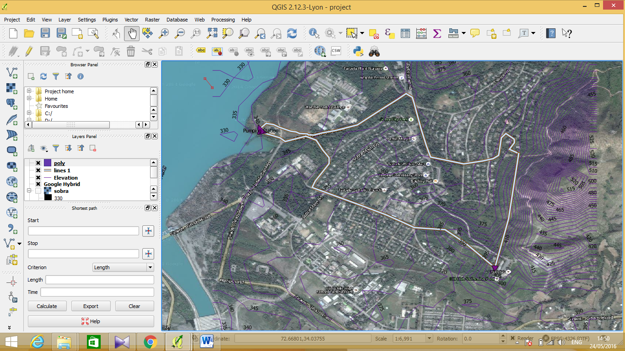
Location of Pumping Station and Pipe Lines

Slide 9
Conclusion:
In the current intermittent water supply system for Sobra, fourteen pumps are operational, each for the respective block. Since the capacity of each pump is to work for four hours only, so the water supply can be provided continuously for four hours.
Instead of going for the above system, a new tank should be built at the Hill Club Site as shown in the figure above, which can provide a sufficient head for each block. If the pumping station can be managed in such a way that five pumps simultaneously feed the tank, while the rest are not operational; the level of head in the tank will be maintained, after the four hours the first five pumps are closed and the next five will feed the tank. In this manner, only ten pumps will be required for the continuous supply. Since there are fourteen pumps in the system, the remaining four can be used for the emergency situations to have an un-interrupted water supply to Sobra.

Slide 10
References:
cgiar-csi srtm
Water Supply System of Tarbela Dam

