Slide 1
NAME: AISHA IHSAN ID : 16250 ANATOMY ASSIGNMENT RADIOLOGY 2ND SEMESTER SECTION A

Slide 2
GLANDS:
An organ in the human or animal body which secretes particular chemical substances for use in the body or for discharge into the surroundings.
OR
An organ which secretes particular chemical substances for use in the body or for discharge into the surroundings
There are two types of glands in our body:
Endocrine glands
Exocrine glands

Slide 3
EXOCRINE GLANDS:
Exocrine glands are glands that secrete their products into ducts
EXAMPLE:
Sweat glands
Salivary glands
Liver

Slide 4
ENDOCRINE GLANDS:
Glands that secrete their product (hormones) directly into the blood rather than through a duct.
EXAMPLE:
Pituitary gland
Thyroid gland
Adrenal glands

Slide 5
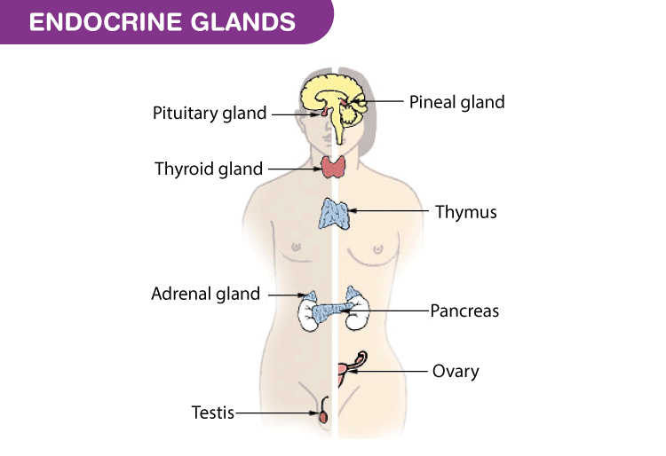

Slide 6
Pituitary Gland:

Slide 7
Pituitary gland hormones:
Anterior Lobe: Anterior lobe contains 6 hormones.
Growth hormone
Thyroid stimulating hormone
Adrenocorticotrophic hormone
Follicle stimulating hormone
Luteinizing hormone
Prolactin
Posterior lobe: Posterior lobe stores 2 hormones.
Antidiuretic hormone
2. Oxytoxin

Slide 8
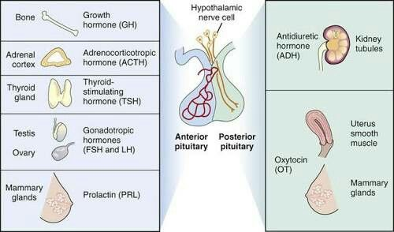

Slide 9
Growth Hormone
It stimulates the growth of bones, cartilage and connective tissues.
Increase calcium absorption from GIT.

Slide 10
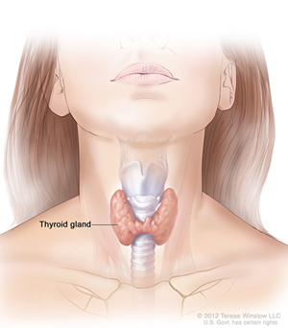
2. Thyroid Stimulating Hormone
It stimulates the thyroid gland to produce
Thyroxin T4
Triiodothyronine T3

Slide 11
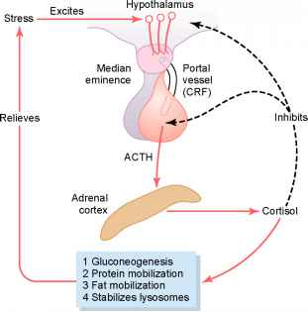
3. Adrenocorticotrophic Hormone:
It acts on adrenal cortex and stimulates the secretion of glucocorticoids and androgens.
It is often produced in response to biological stress.

Slide 12
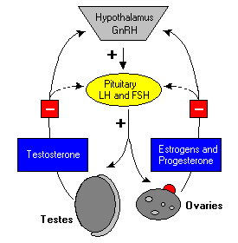
4. Follicle Stimulating Hormone
In females it stimulates maturation of ovarian follicle and estrogen production.
In males it stimulates the development of germinal epithelium and sperm production.

Slide 13
5. Luteinizing Hormone
In Females its target site is ovary. It triggers ovulation and ovarian production estrogen and progesterone.
In males it is also known as interstitial cell stimulating hormone. It promotes testosterone production in testes.

Slide 14
6. Prolactin
During pregnancy, secretion of prolactin cause enlargement of the mammary glands and prepare for the production of milk.
It inhibits menstrual cycle in lactating women.

Slide 15
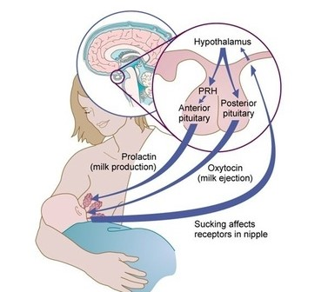

Slide 16
Posterior lobe Hormones:
a. Antidiuretic hormone:
Antidiuretic is any substance that inhibits urine formation.
To retain water in the body.

Slide 17
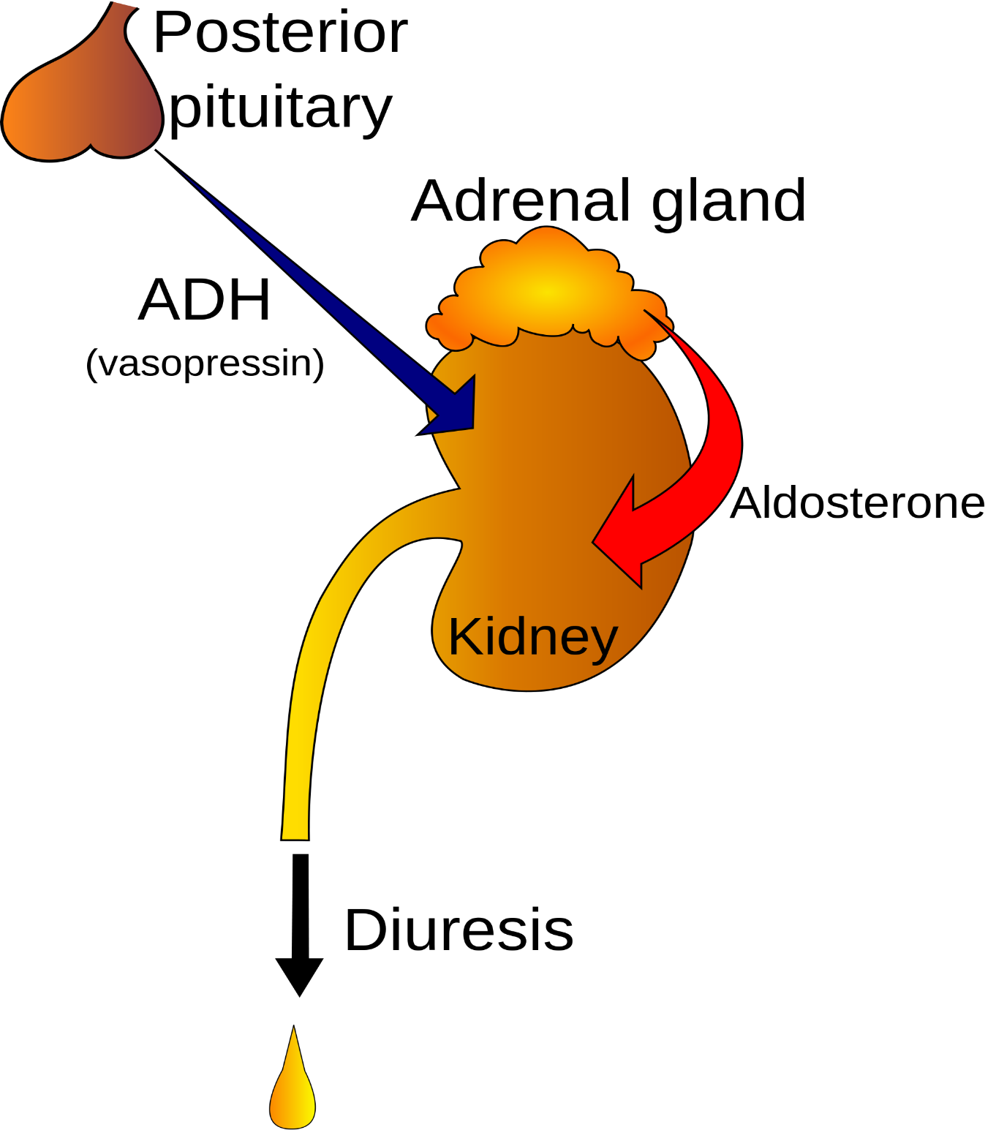

Slide 18
b. Oxytocin
It is released during childbirth and in nursing women.
Stretching of uterus and cervix during parturition is a strong stimulas for release of oxytocin.

Slide 19
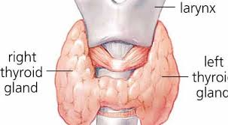
THYROID GLAND

Slide 20
Thyroid Gland Hormones
Triiodothyronine T3:
It affects almost every physiological process in the body:
Growth
Development
Metabolism
Body temperature
Heart rate
2. Thyroxin T4:
Controls development and maturation
Excess = rapid development
Deficiency = delayed development

Slide 21
3. Calcitonin:
It is a hormone secreted by the c cells of thyroid gland.
It increase bone calcium .
It works against the parathyroid hormone

Slide 22
Parathyroid Gland:
In humans there are 4 parathyroid glands.
Main function of parathyroid is to increase the blood calcium level.

Slide 23
Adrenal Glands

Slide 24
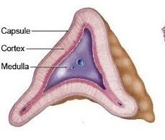
Adrenal Gland
There are two adrenal glands, one above each kidney.
It has two parts :
Adrenal cortex
Adrenal medulla

Slide 25
Difference between adrenal cortex and adrenal medulla
Adrenal Cortex
It produces many steroid hormones collectively known as corticosteroids or corticoids.
Three are the main hormones :
1.Glucocortcoids
2.Mineralocorticoids
3.Sex hormones (androgens)

Slide 26
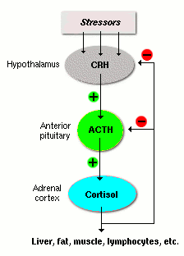
1. Glucocorticoids
Cortisol is the main glucocorticoids.
They are essential for life
Regulating metabolism
stress

Slide 27
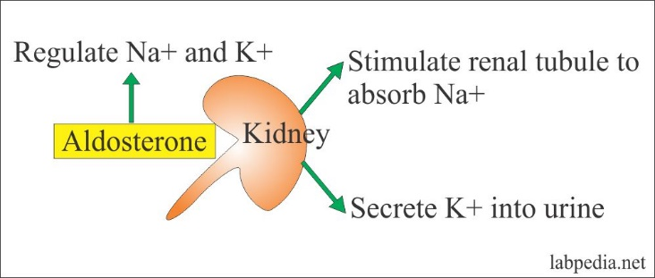
2.Mineralocorticoids
Aldosterone is the main mineralocorticoids.
It maintains water and electrolyte balance.
It is essential for sodium conservation in kidney , salivary glands, sweat glands and colon.

Slide 28
3.Sex hormones
Androgens are the main sex hormones.
They contribute to the onset of puberty.
In females , androgen in the ovary produces estrogen and progesterone.
In males androgen in testes produces testosterone.

Slide 29
Difference between adrenal cortex and adrenal medulla
Adrenal Medulla :
Adrenal medulla consists of modified ganglionic sympathetic neurons that produces two hormones:
Epinephrine
Norepinephrine
Epinephrine :
It is the more potent stimulator of:
Metabolic activities
Bronchial dilation
Increased blood flow to skeletal muscle and heart

Slide 30
Continue…..
Norepinephrine :
It has greater influence on vasoconstriction
Blood pressure

Slide 31
THE END

