Slide 1
Name : Muhammad Owais Khan
ID Card No : 16802
Program : BS(MLT) Section (B)
2nd Semester
Paper : Basic Hematology (Theory)
Instructor : Mr. Adnan Ahmad
Exam : Final Term
Date : 24/ June / 2020

Slide 2
Q1: Discus development stage of erthropoiesis.
Erythropoiesis:•
In normal state, the balance of production and destruction is maintained at remarkably constant rate
Both endocrine and exocrinehormones make important contaibutions to this dynamic well balance mechanism.
The earliest recognizable erythroid precurosor seen in the bone marrow is large basophilic staining cell, 15-20um

Slide 3
Contains asingle large well defined , rounded nucleus . Ribosomes, mitochondria and golgi apparatus .
As the early precursor cell matures:•
Its nucleus increase in size , As maturation goes an cell becomes smaller and more eosinophillic in dicating hemoglobin .

Slide 4
During Intermediate stages of maturation :•
Cytoplasm becomespolychromatic indicating mixture of basophilic proteins and eosinophilic hemoglobin .
Further Maturation:
Hemoglobin synthesis containue and ctoplasm become s entirely eosinophillic.

Slide 5
Late stages of maturation:
Homoglobin is abundant are present nucleus is small dense and well circum scribed.
Number is constant normally as their life span is no day appronimately .
1-2 day of further maturation is synthemic circulation and spleen reticulocytes lase membrane coated transferrin

Slide 6
Differentiation and maturation from a basophillic erythroblast occurs in 5 to 7 days 10-15% of erythroid presursors never mature and are destroyed.

Slide 7
Q2: Enlist common causes of poor blood filam (blood smear)•

Slide 8
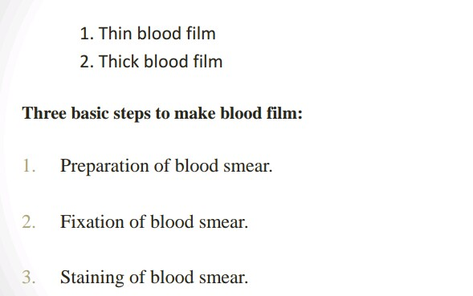
The peripheral blood film (PBF) is of two types.

Slide 9
Q3: Briefly explain Granulupoiessis in detail.
Granulupoiessis:•
Under the stimulation of cytokines GM.CSF, G.CSF and CFU-GEMM differentiates into the CFU-GM the common precursor for both neutrophils and monocytes .
this then further differentiatues is to CFU-G.

Slide 10
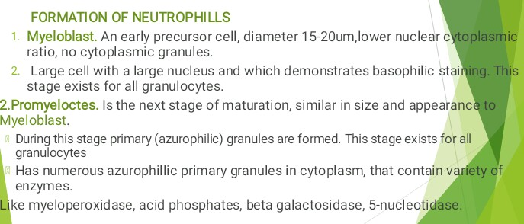

Slide 11
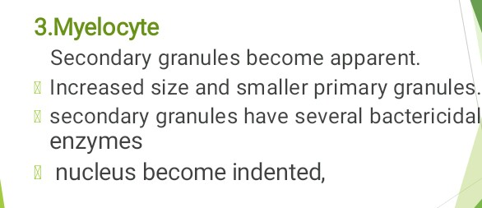

Slide 12
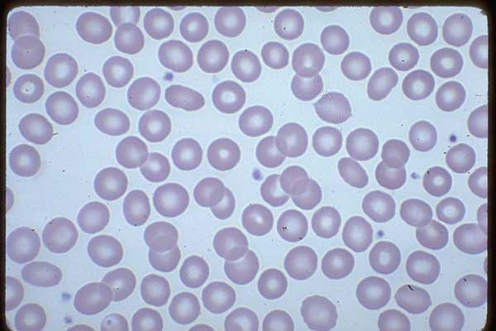

Slide 13
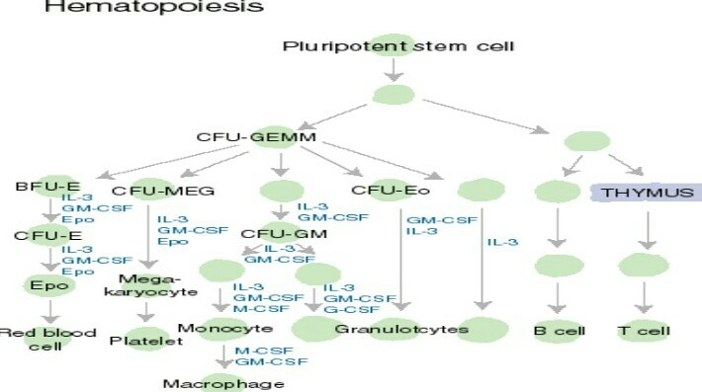

Slide 14
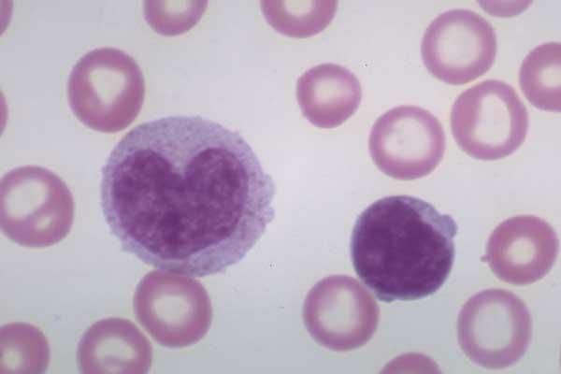
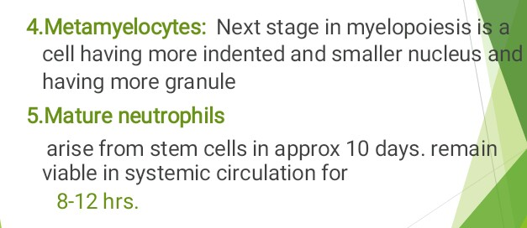

Slide 15
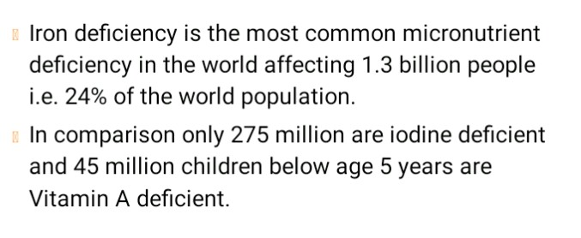
Q4: what is iron deficiency Anemia ? Also discuss its causes.
Iron Deficiency Anemia :•

Slide 16
Iron Deficiency Anemia :•

Slide 17
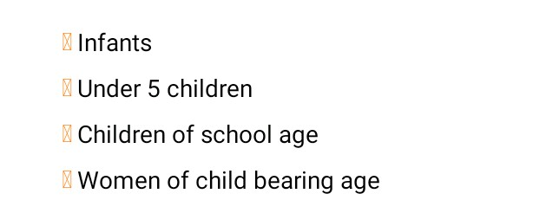
AT Risk Groups:•

Slide 18
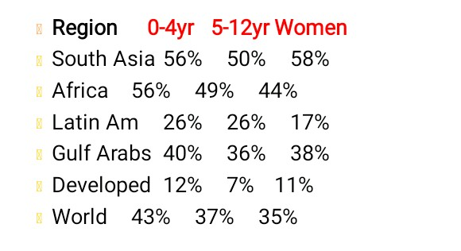
Prevalence of id:•

Slide 19
Q5: Classify anemia on the basis of morphology with examples.
Classification Of Anemia :

Slide 21
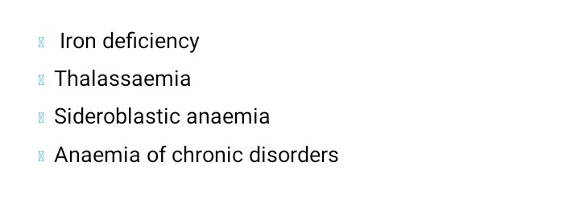

Slide 25
Morphology :•
Considerable number of small basophillic inclusions in red cells .
Found In,
Thalassaemia
-Megaloblastic.
-hemolytic anemia.

Slide 26
-Liver disease.
-Heavy metal poisoning.
THANK
YOU•

Slide 27
THE
END •

