Slide 1
NAME : AFAQ AHMAD SHAH
IDE :15715
SECTION: BS(SE) , A
OBJECT ORIENTED PROGRAM
INSTRUCTOR: M.AYUB KHAN

Slide 2
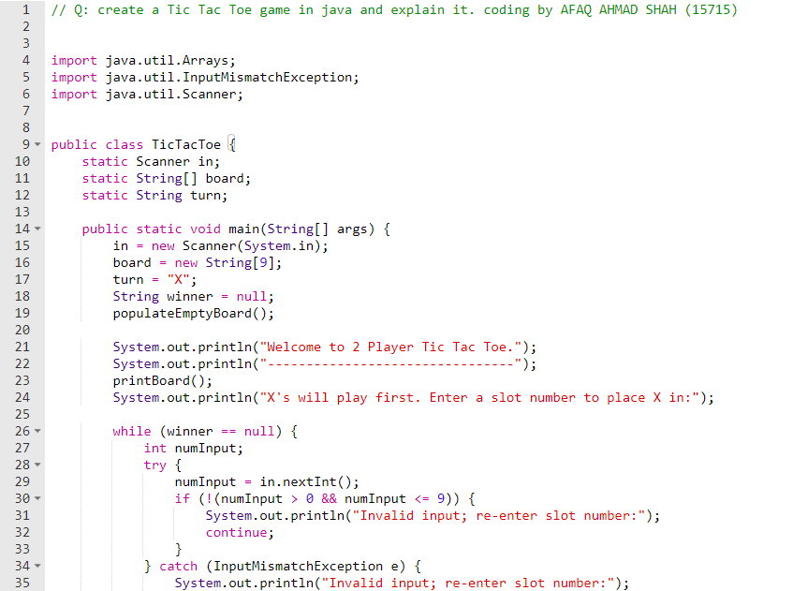

Slide 3
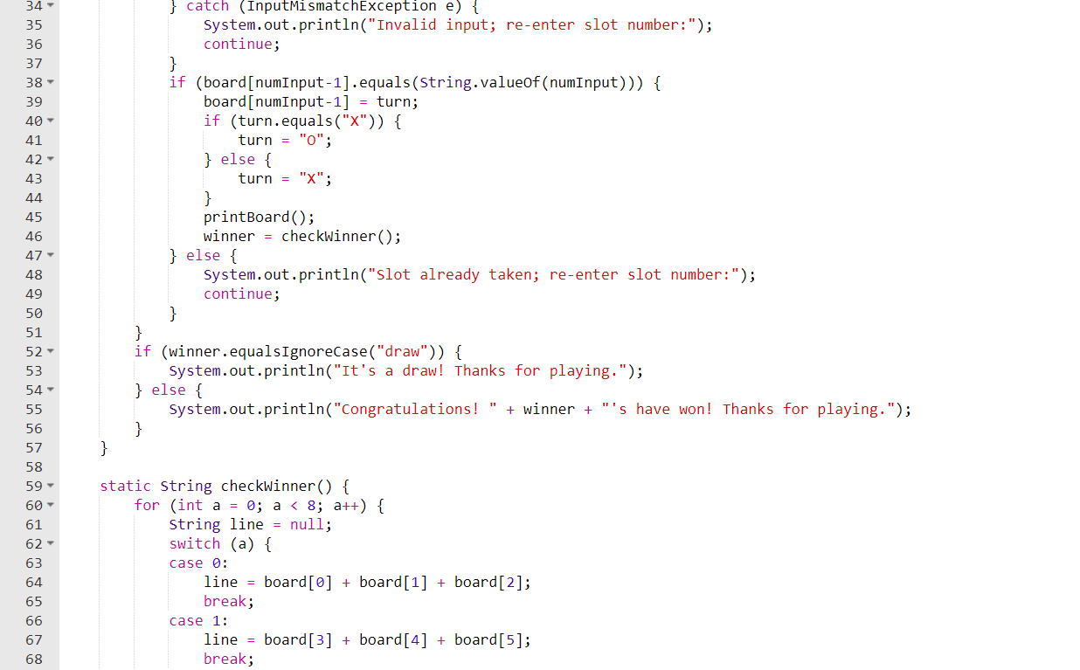

Slide 4
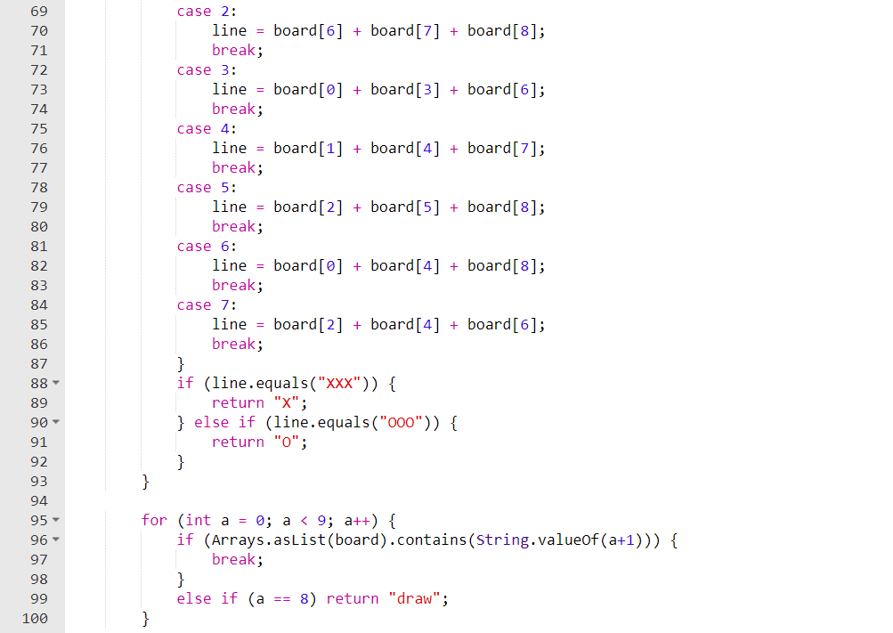

Slide 5
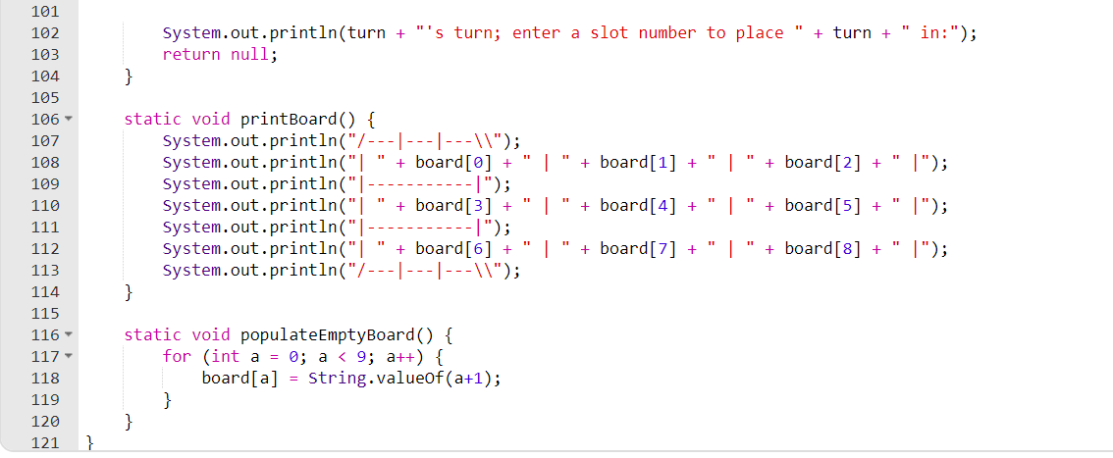

Slide 6
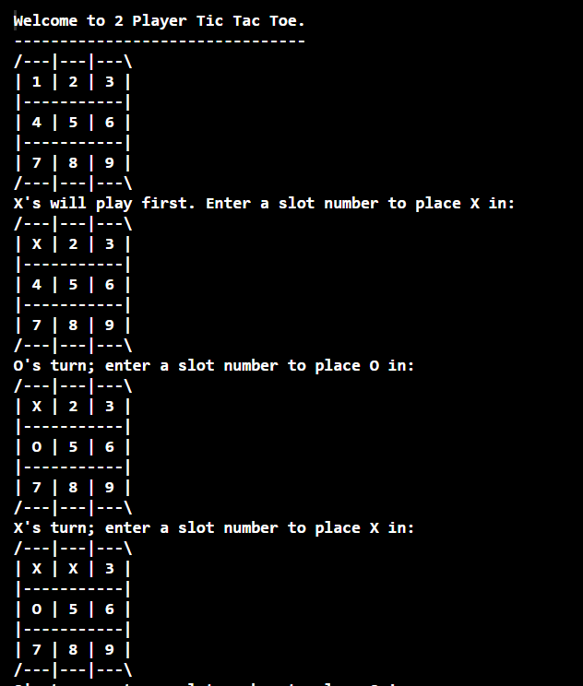

Slide 7
