Slide 1
Anatomy paper
By moieez tariq

Slide 2
Section A mcqs…. Answers
C
C
A
B
D
A
B
C
C

Slide 3
C
D
B
C
A
C

Slide 4
Hip joint anatomy
The hip joint is a ball and socket synovial joint, formed by an articulation between the pelvic acetabulum and the head of the femur.
It forms a connection from the lower limb to the pelvic girdle, and thus is designed for stability and weight-bearing rather than a large range of movement.

Slide 5
Structure of hip joint
ARTICULATING SURFACES
. The hip joint consists of an articulation between the head of femur and acetabulum of the pelvis. The acetabulum is a cup-like depression located on the inferolateral aspect of the pelvis. Its cavity is deepened by the presence of a fibrocartilaginous collar – the acetabular labrum The head of femur is hemispherical, and fits completely into the of the acetabulum.
Both the acetabulum and head of femur are covered in articular cartilage, which is thicker at the places of weight bearing.
The capsule of the hip joint attaches to the edge of the acetabulum proximally. Distally, it attaches to the intertrochanteric line anteriorly and the femoral neck posteriorly.

Slide 6
Ligaments of hip joint
The ligaments of the hip joint act to increase stability. They can be divided into two groups – intracapsular and extracapsular:
Intracapsular
The only intracapsular ligament is the ligament of head of femur. It is a relatively small structure, which runs from the acetabular fossa to the fovea of the femur.
encloses a branch of the obturator artery (artery to head of femur), a minor source of arterial supply to the hip joint.

Slide 7
EXTRACAPSULAR
There are three main extracapsular ligaments, continuous with the outer surface of the hip joint capsule
Iliofemoral ligament – arises from the anterior inferior iliac spine and then bifurcates before inserting into the intertrochanteric line of the femur.
It has a ‘Y’ shaped appearance, and prevents hyperextension of the hip joint. It is the strongest of the three ligaments.
Pubofemoral – spans between the superior pubic rami and the intertrochanteric line of the femur, reinforcing the capsule anteriorly and inferiorly.
It has a triangular shape, and prevents excessive abduction and extension

Slide 8
Ischiofemoral– spans between the body of the ischium and the greater trochanter of the femur, reinforcing the capsule posteriorly.
It has a spiral orientation, and prevents hyperextension and holds the femoral head in the acetabulum

Slide 9
Stability of hip joint
The primary function of the hip joint is to weight bear There are a number of factors that act to increase stability of the joint.
The first structure is the acetabulum. It is deep, and encompasses nearly all of the head of the femur. This decreases the probability of the head slipping out of the acetabulum (dislocation).
There is a horseshoe shaped fibrocartilaginous ring around the acetabulum which increases its depth, known as the acetabular labrum The increase in depth provides a larger articular surface, further improving the stability of the joint.
The iliofemoral, pubofemoral and ischiofemoral ligaments are very strong, and along with the thickened joint capsule, provide a large degree of stability. These ligaments have a unique spiral orientation; this causes them to become tighter when the joint is extended.

Slide 10
the muscles and ligaments work in a reciprocal fashion at the hip joint:
Anteriorly, where the ligaments are strongest, the medial flexors (located anteriorly) are fewer and weaker.
Posteriorly, where the ligaments are weakest, the medial rotators are greater in number and stronger – they effectively ‘pull’ the head of the femur into the acetabulum.

Slide 11
Blood and nerve supply
The arterial supply to the hip joint is largely via the medial and lateral circumflex femoral arteries– branches of the profunda femoris artery (deep femoral artery). They anastomose at the base of the femoral neck to form a ring, from which smaller arteries arise to supply the hip joint itself.
The medial circumflex femoral artery is responsible for the majority of the arterial supply (the lateral circumflex femoral artery has to penetrate through the thick iliofemoral ligament). Damage to the medial circumflex femoral artery can result in avascular necrosis of the femoral head.
The artery to head of femur and the superior/inferior gluteal arteries provide some additional supply.
The hip joint is innervated primarily by the sciatic, femoral and obtrutor nerves. These same nerves innervate the knee, which explains why pain can be referred to the knee from the hip

Slide 12
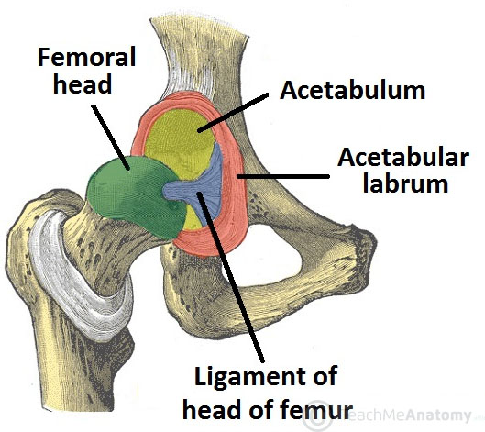
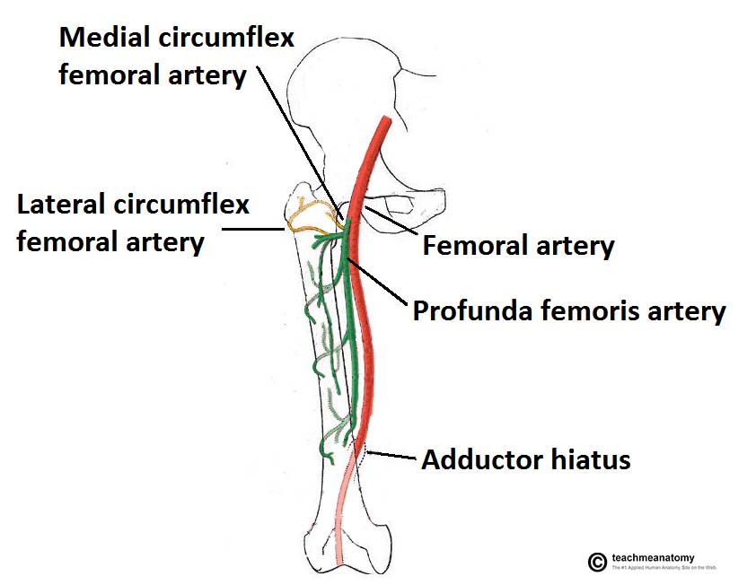

Slide 13
Answer no 2
CRUCIATE LIGAMENT
. Cruciate ligaments (also cruciform ligaments) are pairs of ligaments arranged like a letter X. They occur in several jointsof the body, such as the knee joint and the atlanto axial joint.
The cruciate ligaments of the knee are the anterior cruciate ligament (ACL) and the posterior cruciate ligament (PCL). These ligaments are two strong, rounded bands that extend from the head of the tibia to the intercondyloid notch of the femur.

Slide 14
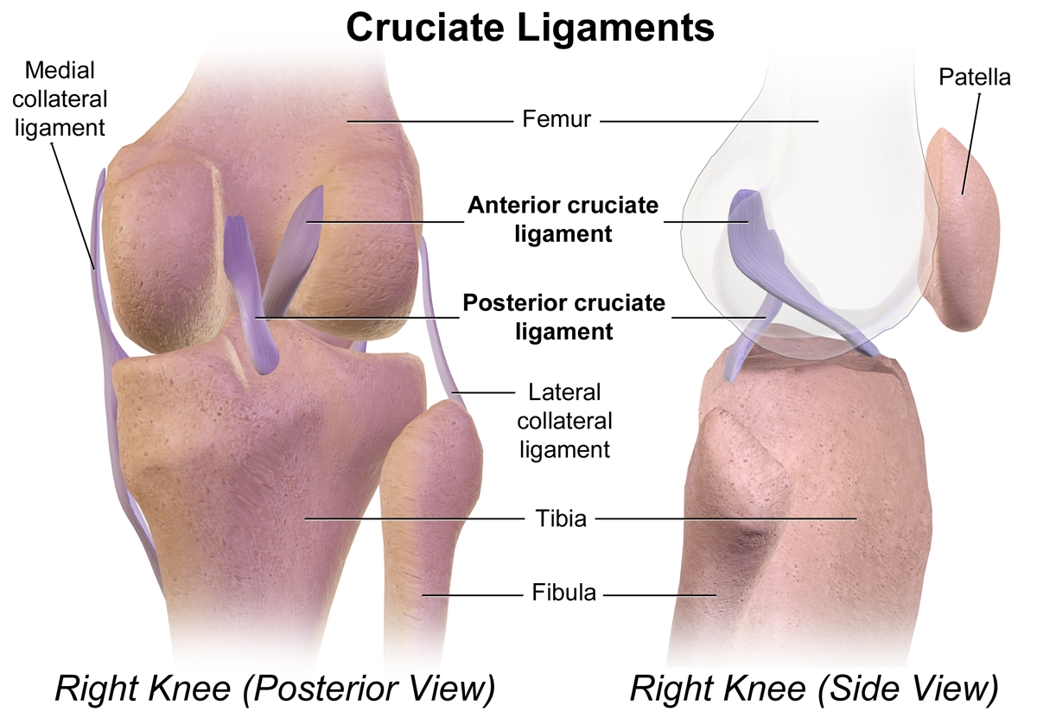

Slide 15
Anterior cruciate ligament
The anterior cruciate ligament (ACL) is one of the key ligaments that help stabilize your knee joint.
The ACL connects your thighbone (femur) to your shinbone (tibia).
The purpose of the ACL is to resist the motions of anterior tibial translation and internal tibial rotation; this is important in order to have rotational stability.
This function prevents anterior tibial subluxation of the lateral and medial tibiofemoral joints, which is important for the pivot-shift
The ACL has been proven to have mechanoreceptors that detect changes in direction of movement, position of the knee joint, changes in acceleration, speed, and tension
A key factor in instability after ACL injuries is having altered neuromuscular function secondary to diminished somatosensory information

Slide 16
Posterior cruciate ligament
The PCL is broader and stronger than the ACL and has a tensile strength of 2000 N. Injury most often occurs when a force is applied to the anterior aspect of the proximal tibia when the knee is flexed. Hyperextension and rotational or varus/valgus stress mechanisms also may be responsible for PCL tears.
FUNCTION
The function of the PCL is to prevent the femur from sliding off the anterior edge of the tibia and to prevent the tibia from displacing posterior to the femur. The posterior cruciate ligament is located within the knee. Ligaments are sturdy bands of tissues that connect bones.

Slide 17
2. menisci
meniscus is a piece of cartilage found where two bones meet (joint space).
Menisci protect and cushion the joint surface and bone ends.
is a crescent-shaped fibrocartilagenous anatomical structure that, in contrast to an articular disc, only partly divides a joint cavity. In humans they are present in the knee, wrist, acromioclavicular, sternoclavicular, and temporomandibular joints.
FUNCTIONS
The menisci act to disperse the weight of the body and reduce friction during movement. Since the condyles of the femur and tibia meet at one point (which changes during flexion and extension), the menisci spread the load of the body's weight.

Slide 18
MEDIAL MENISCI
The medial meniscus is a fibrocartilage semicircular band that spans the knee joint medially, located between the medial condyle of the femur and the medial condyle of the tibia
LATERAL MENISCI
The lateral meniscus (external semilunar fibrocartilage) is a fibrocartilaginous band that spans the lateral side of the interior of the knee joint. It is one of two menisci of the knee, the other being the medial meniscus. It is nearly circular and covers a larger portion of the articular surface than the medial.

Slide 19
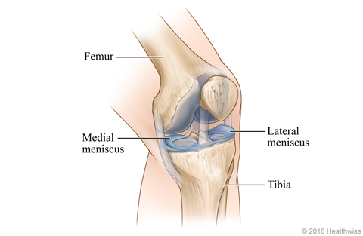

Slide 20
3. Medial ligament of ankle joint
The Deltoid ligament (or the medial ligament of talocrural joint) is a strong, flat and triangular band. It is attached above to the apex and anterior and posterior borders of the medial malleolus. The Deltoid ligament is composed of superficial and deep components.
The superficial components:
The tibiocalcaneal ligament,
The tibionavicular ligament
The posterior superficial tibiotalar ligament
The tibiospring ligament

Slide 21
The deep components:
The anterior tibiotalar ligament (ATTL)
The posterior deep tibiotalar ligament (PDTL)
The deltoid ligament attaches the medial malleolus to multiple tarsal bones. Unlike the superficial layer of this ligament, the deep layer is intraarticular and is covered by synovium. Anatomically, in general, the superficial components arise from the anterior colliculus of the medial malleolus, and the deep components arise from the intercollicular groove (malleolar groove) and the posterior colliculus of the medial malleolus.

Slide 22
The superficial deltoid originates from the anterior & inferior aspects of medial malleolus fanning out & sending 3 bands to navicular and along plantar calcaneonavicular (spring) ligament, to sustenaculum tali of calcaneus and to medial tubercle. It is also partially covered by tendon sheaths & crural fascia. It primarily resists eversion of hindfoot; Tibionavicular portion suspends spring lig & prevents inward displacement of head of talus, while tibiocalcaneal portion prevents valgus displacement.
The deep deltoid originates on posterior border of anterior colliculus, intercollicular groove, & posterior colliculus. It is oriented transversely & inserts into the entire nonarticular surface of medial talus. Deep deltoid extends the function of the medial malleolus, prevents lateral displacement of talus & prevents external rotation of the talus (this is mostly significant in plantar flexion, when deep deltoid tends to pull talus into internal rotation).

Slide 23
Medial ankle stability is provided by the strong deltoid ligament, the anterior tibiofibular ligament and the bony mortise. Because of the bony articulation between the medial malleolus and the talus, medial ankle sprains are less common than lateral sprains. In medial ankle sprains, the mechanism of injury is excessive eversion and dorsiflexion.

Slide 24
Lateral collateral ligament of ankle joint
The lateral collateral ligament (complex) of the ankle is a set of three ligaments that resist inversion of the ankle joint. They are more commonly injured than the medial collateral (deltoid) ligament of the ankle. They run from the lateral malleolus of the fibula to the talus and calcaneus.
The lateral ligaments of the ankle, composed of the anterior talo-fibular ligament (ATFL), the calcaneo-fibular ligament (CFL) and the posterior talo-fibular ligament. The medial (deltoid) ligaments is much stronger than the lateral ligament and is therefore injured much less frequently.

