Slide 1
Bakhti yousaf zai I'd :13614 Papr:oral histology

Slide 2
Q1 :what are the functions of sailva ?
Ans: function of sailva :The digestive functions of saliva include moistening food, and helping to create a food bolus, so it can be swallowed easily. Saliva contains the enzyme amylase that breaks some starches down into maltose and dextrin. Thus, digestion of food occurs within the mouth, even before food reaches the stomach.

Slide 3
Chemical digestion: breaks down starch by the function of “salivary amylase”
Helps chewing and swallowing.
Lubricating effect: moisturizes the inside of the mouth and creates smoother speech.
Solvent effect: dissolves food and allows the tongue to taste food.
Digestion;The digestive functions of saliva include moistening food, and helping to create a food bolus, so it can be swallowed easily. Saliva contains the enzyme amylase that breaks some starches down into maltose and dextrin. Thus, digestion of food occurs within the mouth, even before food reaches the stomach.

Slide 4
Role in taste :
Its main role includes transport of taste substances to and protection of the taste receptor. In the initial process of taste perception, saliva acts as a solvent for taste substances; salivary water dissolves taste substances, and the latter diffuse to the taste receptor sites.

Slide 5
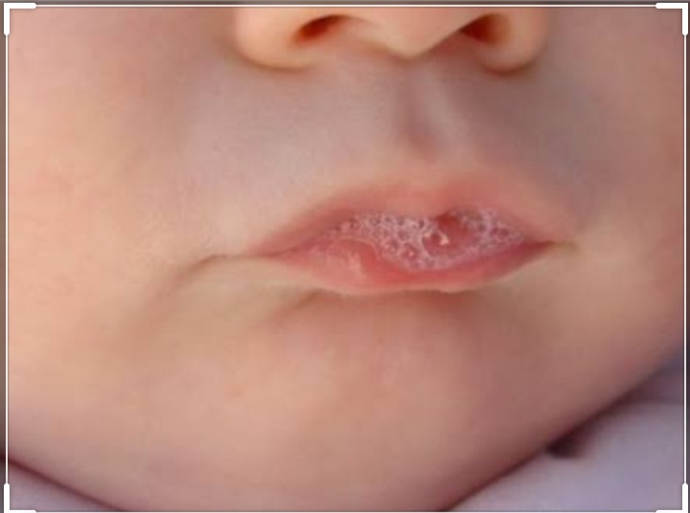

Slide 6
Q2:Define tempormandibular joint ?
Ans:inanatomy, the temporomandibular joints (TMJ) are the two joints connecting the jawbone to the skull. It is a bilateral synovial articulation between the temporal bone of the skull above and the mandible below; it is from these bones that its name is derived.
Nerve: Auriculotemporal nerve, masseteric nerve
Artery: Superficial temporal artery
Latin: Articulatio temporomandibularis

Slide 7
Temporomandibular joint
The temporomandibular (tem-puh-roe-man-DIB-u-lur) joint (TMJ) acts like a sliding hinge, connecting your jawbone to your skull. You have one joint on each side of your jaw.
Each temporomandibular joint is classed as a "ginglymoarthrodial" joint since it is both a ginglymus (hinging joint) and an arthrodial (sliding) joint. The condyle of the mandible articulates with the temporal bone in the mandibular fossa.

Slide 8
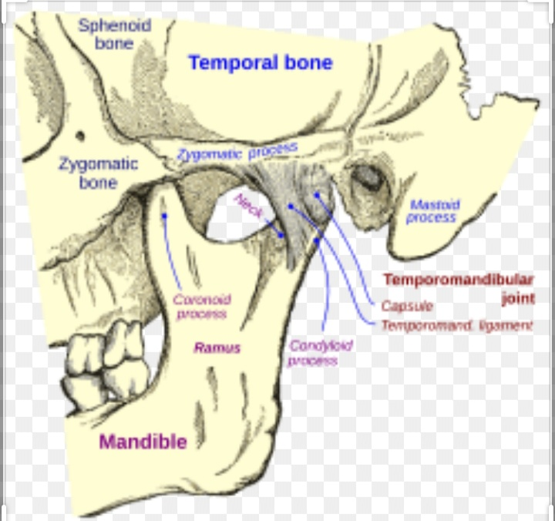

Slide 9
B: what is TMJ unique?
Ans. The temporomandibular joint (TMJ) is the most unusual joint in the whole body as it is two joints in one. The two joints, one on each side of the head, are connected by the jawbone. One joint may influence the function of the other joint.

Slide 10
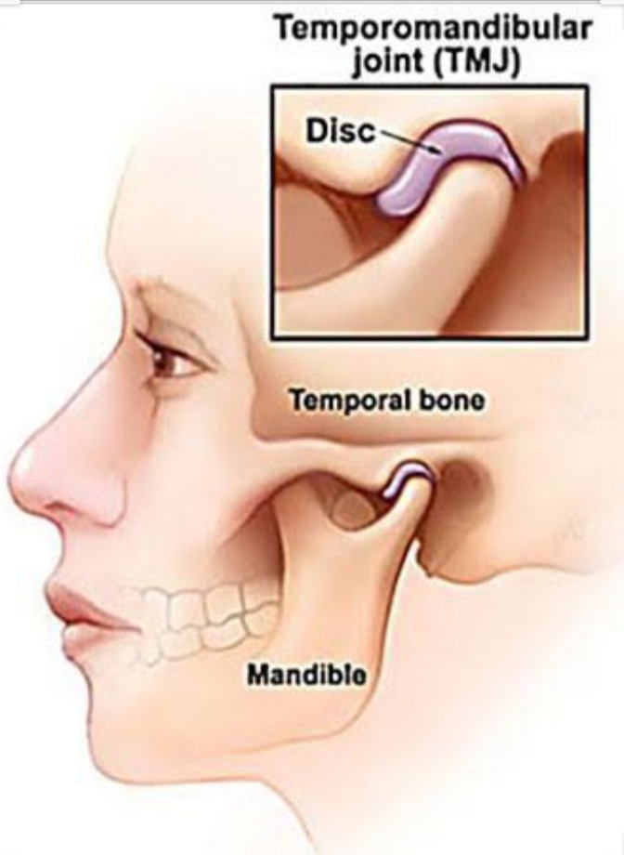

Slide 11
C: enurmerate the nerves and vessel supplying to its.
And: theTMJ is supplied by three arteries. The main supply comes from the deep auricular artery (from the maxillary artery) and the superficial temporal artery (a terminal branch of the external carotid artery). In addition the joint is provided by the anterior tympanic artery (also a branch of the maxillary artery).

Slide 12
The TMJ is closely associated with the trigeminal nerve, which innervates approximately 40 percent of the head and face. This nerve has three branches and is involved with the following functions: Chewing functions of upper and lower
TMJ is related to different muscles that have the function to move and protect the joint itself. The muscles that function to close the jaw are masseter, temporal, lateral or external pterygoid. The muscles that open the jaw are medial or internal pterygoid, geniohyoideus, mylohyoideus; digastric.

Slide 13
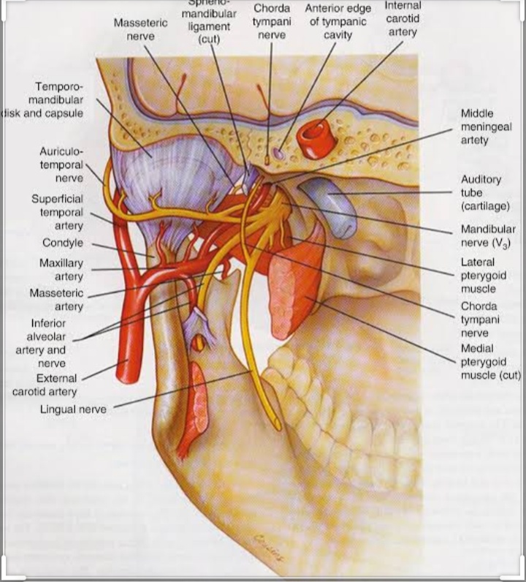

Slide 14
D:what is the resting position of TMJ ?
Ans The resting position of the TMJ is with the mouth slightly open, the lips together and the teeth not in contact. This is in contrast to the closed-pack position in which the teeth are tightly clenched.

Slide 15
The standard resting position has the teeth not touching each other; when the mouth is closed the teeth are slightly apart

Slide 16
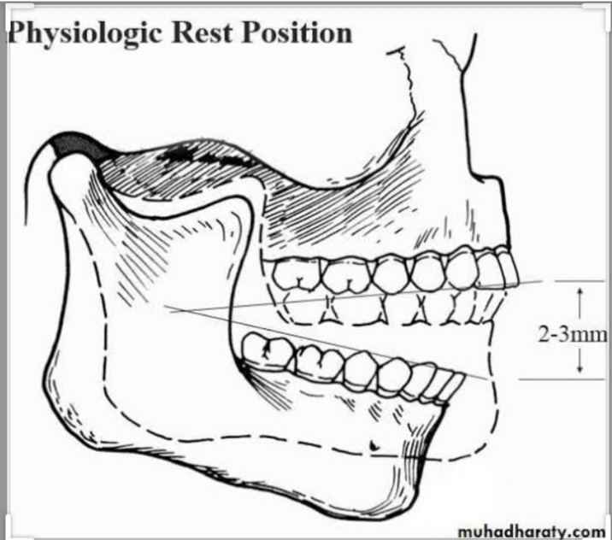

Slide 17
Q3: Enumerate three sailvary gland ?
Ans:There are three pairs of major salivary glands: the parotid glands, the submandibular glands, and the sublingual glands.
There are three pairs of major salivary glands: the parotid glands, the submandibular glands, and the sublingual glands.
Parotid Glands. The parotid glands are the largest salivary glands. ...
Submandibular Glands. About the size of a walnut, the submandibular glands are located below the jaw. ...
Sublingual Glands.

Slide 18
Most animals have three major pairs of salivary glands that differ in the type of secretion they produce:
parotid glands produce a serous, watery secretion.
submaxillary (mandibular) glands produce a mixed serous and mucous secretion.
sublingual glands secrete a saliva that is predominantly mucous in character.

Slide 19
The major salivary glands, three pairs in total, are found in and around your mouth and throat. The major salivary glands are the parotid, submandibular, and sublingual glands. The parotid glands are located in front and beneath the ear
Symptoms of salivary gland infection
a constant abnormal or foul taste in your mouth.
inability to fully open your mouth.
discomfort or pain when opening your mouth or eating.
pus in your mouth.
dry mouth.
pain in your mouth.
face pain.

Slide 20
B:what are myeopithelial cell?
Ans:Myoepithelial cells (sometimes referred to as myoepithelium) are cells usually found in glandular epithelium as a thin layer above the basement membrane but generally beneath the luminal cells. They are found in the sweat glands, mammary glands, lacrimal glands, and most importantly in salivary glands.

Slide 21
Myoepithelioma is a benign tumor of the oral cavity, arising predominantly from major and minor salivary glands, and accounting for 1–1.5% of all glandular tumors.[1] Benign myoepitheliomas are mainly composed of myoepithelial cells, which are ectodermally derived cells located between the basal surface of acinar units ...

Slide 22
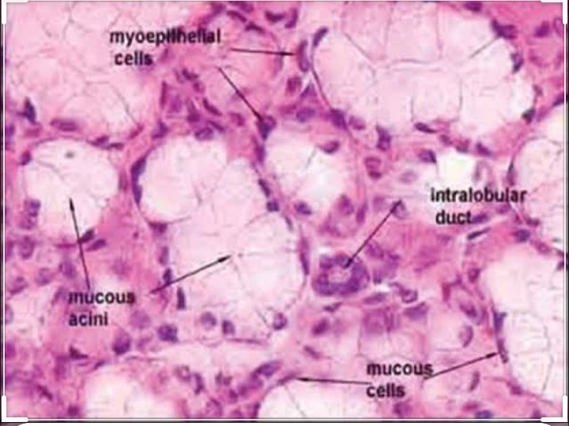

Slide 23
C:define eruption ?
AndAn eruption is an explosion of steam and lava from a volcano. This word is also used for other explosions, such as "an eruption of emotions." If there's an eruption of a volcano, you don't want to be anywhere near it. When a volcano erupts, it spews a huge amount of lava, ash, and steam into the air.

Slide 24
Explain ereuption:
volcanic eruption occurs when hot materials from the Earth's interior are thrown out of a volcano. Lava, rocks, dust, and gas compounds are some of these "ejecta". ... Some eruptions are terrible explosions that throw out huge amounts of rock and volcanic ash and can kill many people. Some are quiet outflows of hot lava.

Slide 25
Types of eruptions
Hydrothermal eruption. An eruption driven by the heat in a hydrothermal systems. ...
Phreatic eruption. An eruption driven by the heat from magma interacting with water. ...
Phreatomagmatic eruption. ...
Lava. ...
Strombolian and Hawaiian eruptions. ...
Vulcanian eruptions. ...
Subplinian and Plinian eruptions.

Slide 26
Phases of eruption:
Tooth eruption may be divided into three phases according to bony crypt movements: 1) pre-eruptive; 2) eruptive, or pre-functional; and 3) post-eruptive, or functional. Fully formed enamel is covered with reduced enamel epithelium.

