Slide 1
Name.
Ahmad Sher
Id card no.
16824
Defortment. Bs Rad Section B
Paper. Anatomy.
Instructor Dr. Arooba.

Slide 2
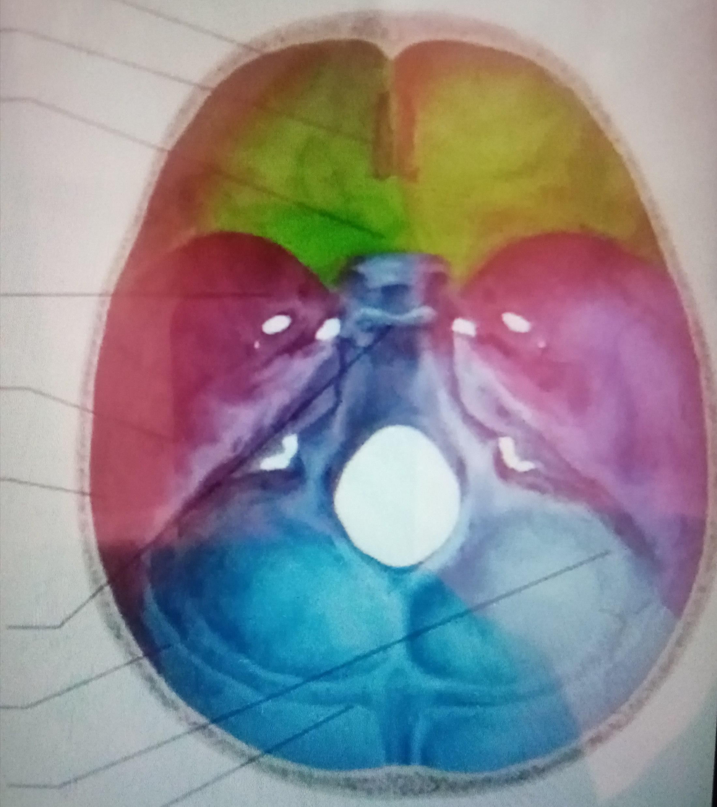
Questions no.. 1. What Are the major features of intracranial Possae of the skull?
Ans. Interior cranial fossae.
Prontal
Ethmoid
Spenoid.
Middle cranial Fossae.
Spenoid
Tempral
Parintal
Posterior cranial Fossae.
Spenoid
Pariteal
Temporal
Occipital.
Pto..

Slide 3
The feature is a part of the face a quality a special attraction article or major film showing is the theatere
The make shape form or appearance of a person or thing’s.
Attractive appearance of a person or physical beauty. The form or look of the face facial appearance.

Slide 4
Questions no. 2. Write not on the cranial nurves?
Ans. Cranial nurves. I through 12.
1. Olfactory nerve.
Sense Of smell Damage Couses Impaired Sense of smell.
2 optic nerve.
Provides vision damage Couses blindness in visual field.
3 Ocolomotor nerve.
Somatic and autonomic motor function eye moments superior inperior Medial rectus muscle and inperior oblique muscles open eye lids. Cillary muscles and a commendation. Damage Couses dropin eyelids dilated Pupils double vision to move in certain directions.

Slide 5
4.nerve.ssensation ymoment superior oblique muscles
Damage Couses double vision and inability to rotate eye infernolatrally
5.Trigeminal nerve.
Ophthalmic branch sencaton from nasal cavity skins of forehead.Damage produces Loss of sensation impaird chewing.
6. Abduces nerve.
Provides eye moments Latral rectus. Damage results in inability to rotate eye latrally and rest eye rotate medially.

Slide 6
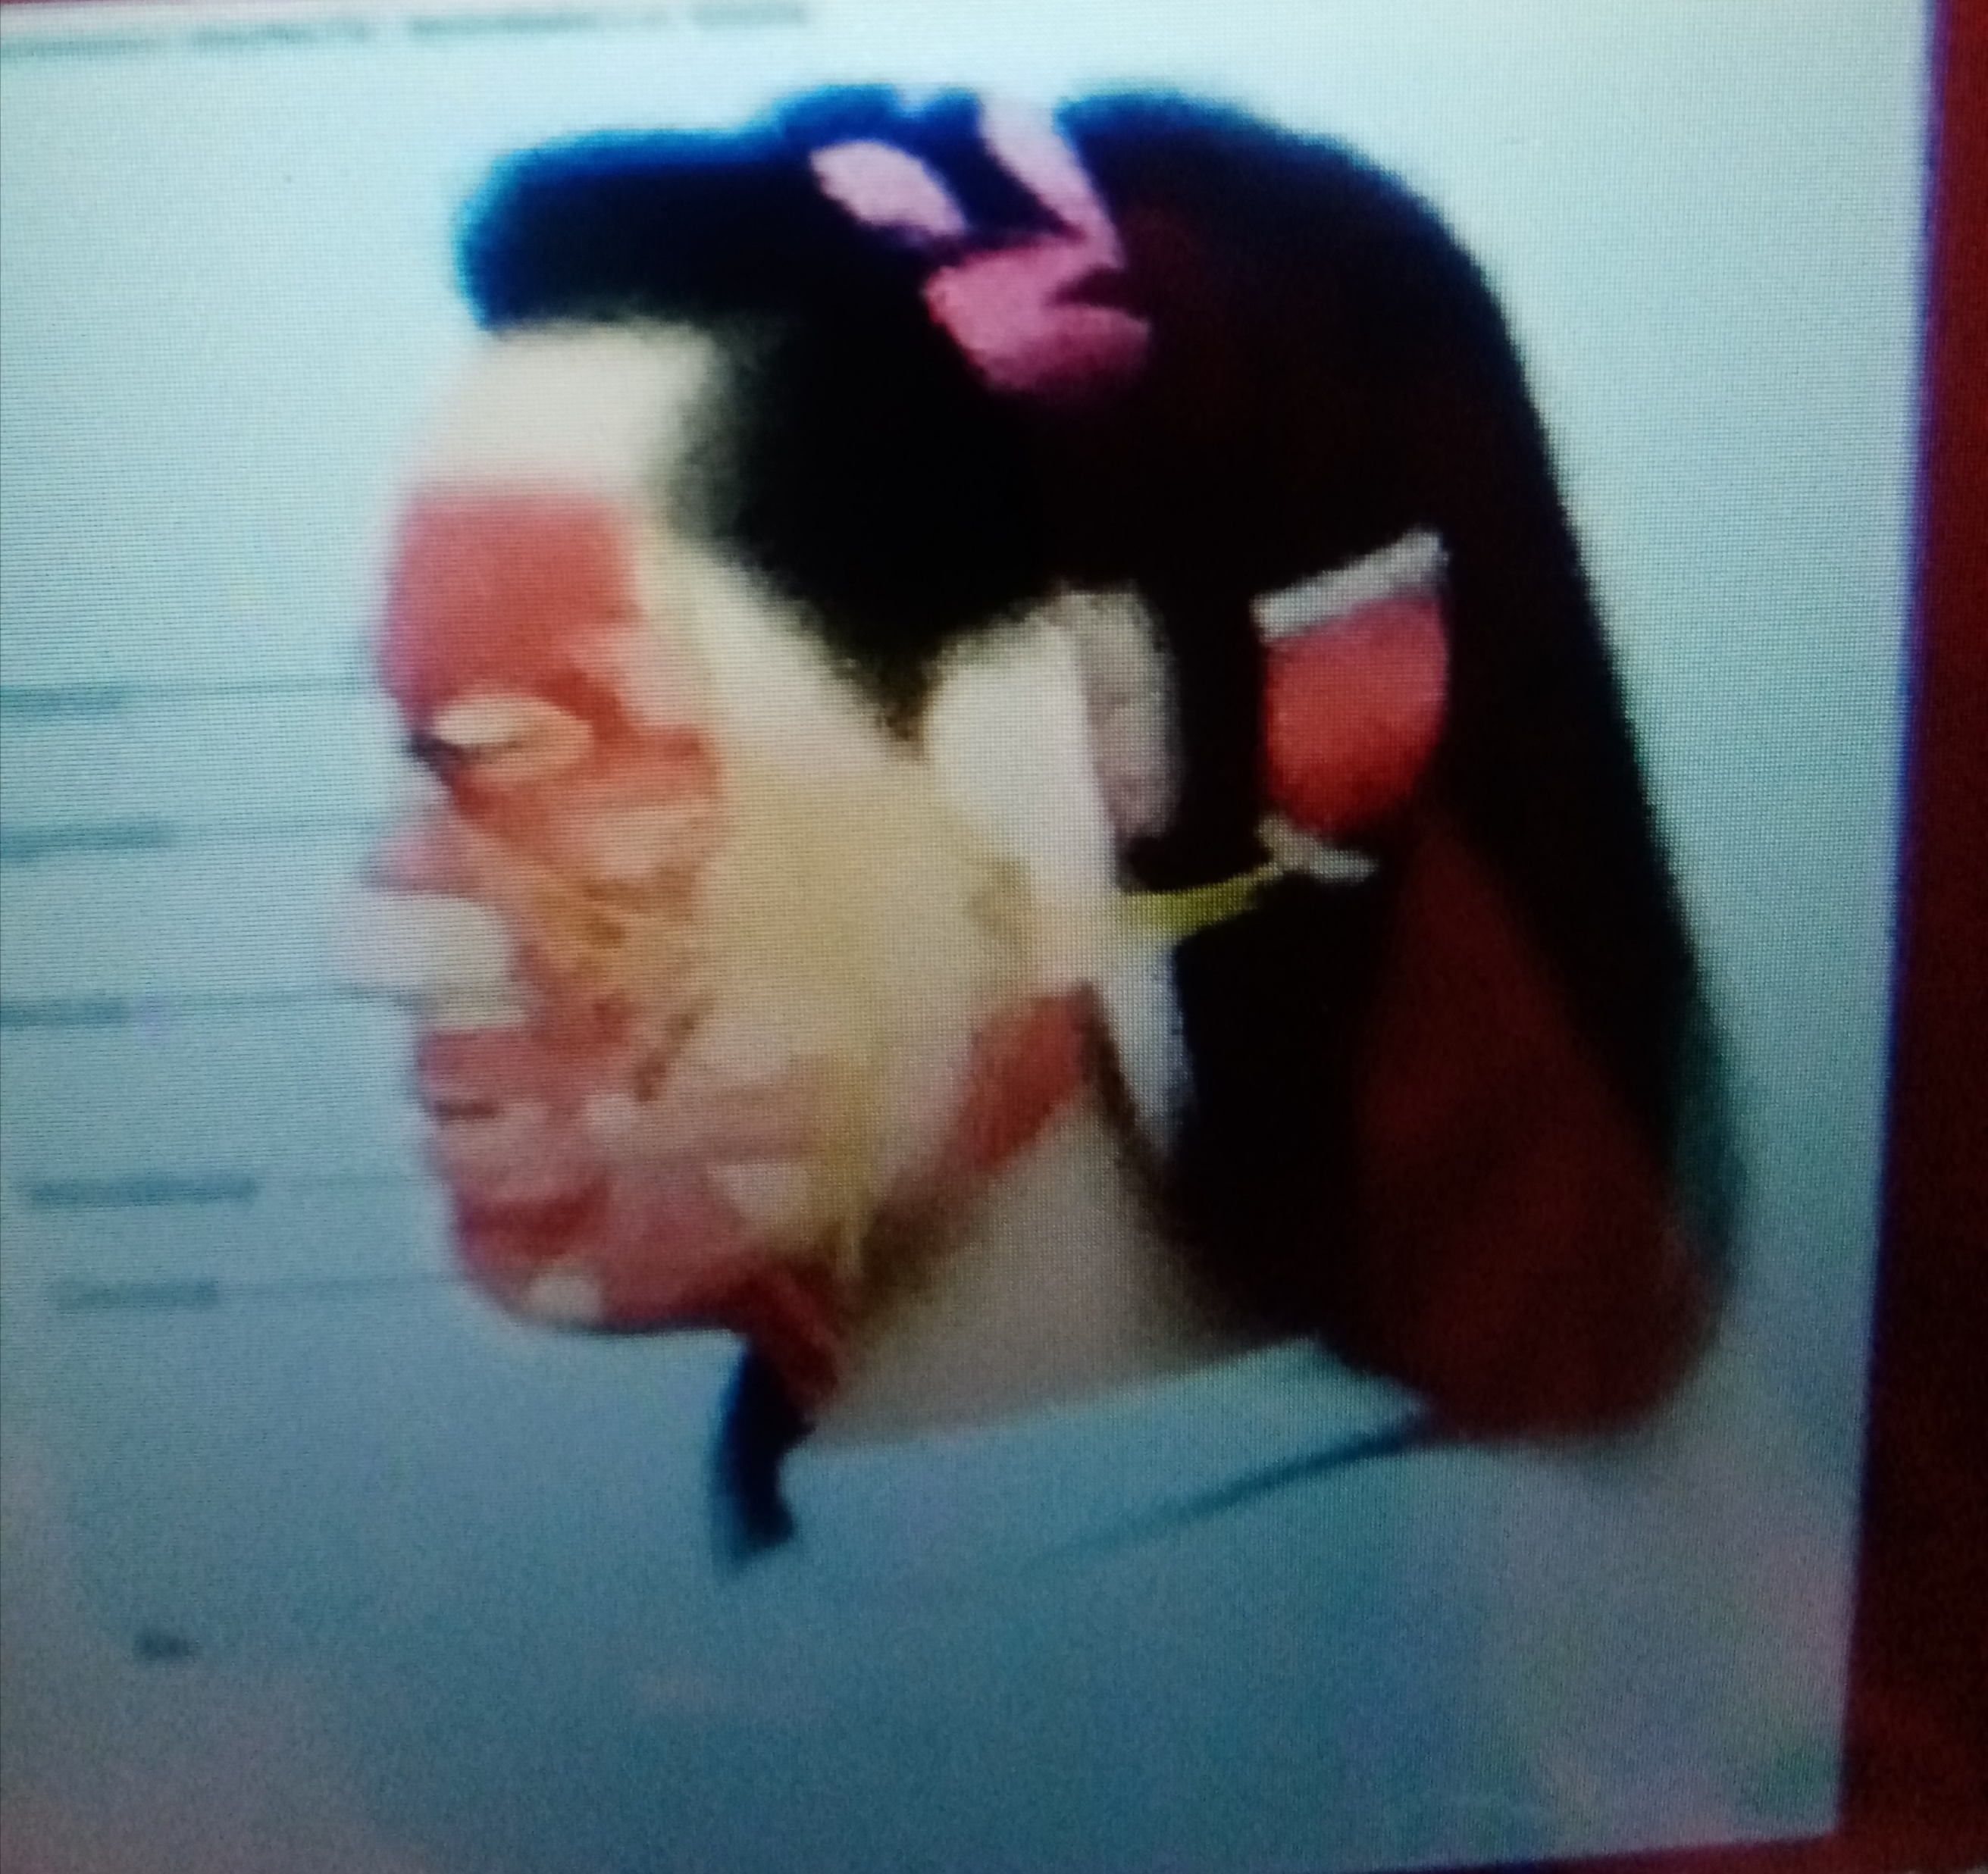
7 Facial Nurve
Somatic motor facial expressions. Special sensory tast on anterior 2/3 of tongue. Damage produces sagging facial muscles and disturbed sense test (no sweet and salty)
8 Vestibulocochlear nerve.
Special sensory. Provides hearing balance Vestibular damage produces deapence dizziness nausa loss of balance and ny stagumas.

Slide 7
9 Glossopharygeal nerve.
Somatic motor swelling and vice production.
Damage results in less of bitter and sour sour tast andimpartiaL. Blood pressure anomalies.
10 Vegus nerve.
Sensation from skin at back of ear extalnal acos tic and special sensory taste from natural normal or decreased heart rate. Damage Couses hor or loss ofvice.bLood pressure.

Slide 8
11 Accessory nerve.
Swell head neck and shoulder moment. Damage Couses Impaired head neck shulder moment
12. Hypoglossal Nerve.
Tongue moment for speech food manipulate and swelling.if both damaged can’t protrude tongue.

Slide 9
Questions no. 3. Write note on the salient features of normal frontals and norma occipital of skull?
Ans. Saint features of any online color measurement system are. Continues real time measurement of any products on a Process line which allows us to respond to product colors changees when they happen improment process while providing assurance that our product Is whitn specepic
Making decisions about allocating monitoring the process variables affect color helping control processes variables.
Pto..

Slide 10
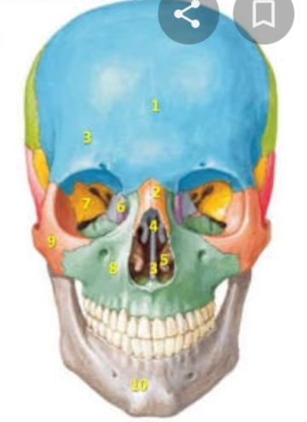
Norma frontals.
From the forehead orbit nasa
l region maxila & mandible are the prominent features of the skull.
Visible
The frontals bone.
Nasal bone
Vomer Spenoid bone
The maxila the zygomatic bone
The mandible.
Pto…

Slide 11
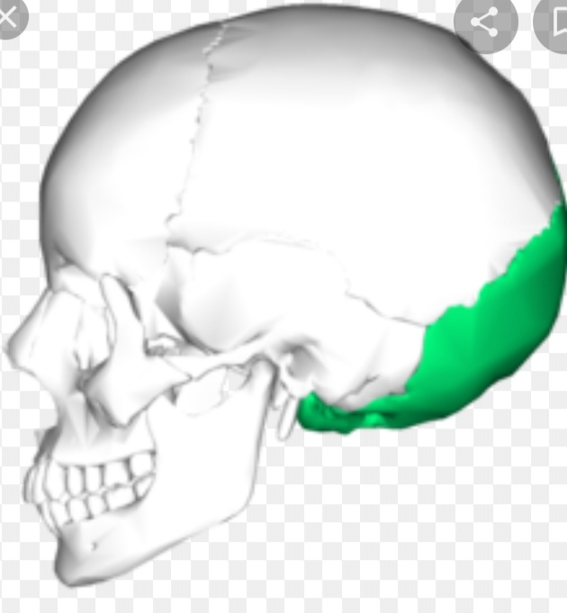
Occipital bone.
The occipital bone is the trapezoid shaped bone it the lower back area of the cranium. The occipital is cupped like saucer in order to house the back part of the brain. It’s one of seven bones that fuse together to from the skull and is directly next to five of the cranium bones. Of the skull and occipital grow fuse together later between the ages of 26 and 40.

Slide 12
Questions no. 4. What do you know about the muscles of hip and knee?
Ans. The hip acetabulam is a cup like depression located on the inferolotatral aspect of the pelvis it is cavity is depened by the precens of a collier. The acetabular labrum the head of femur is and fits completely into the concaity of the acetabulam. Both acetabulam and head of femur are covered in articular cartilage which is thinker at the place of weatght bearing.
Pto..

Slide 13
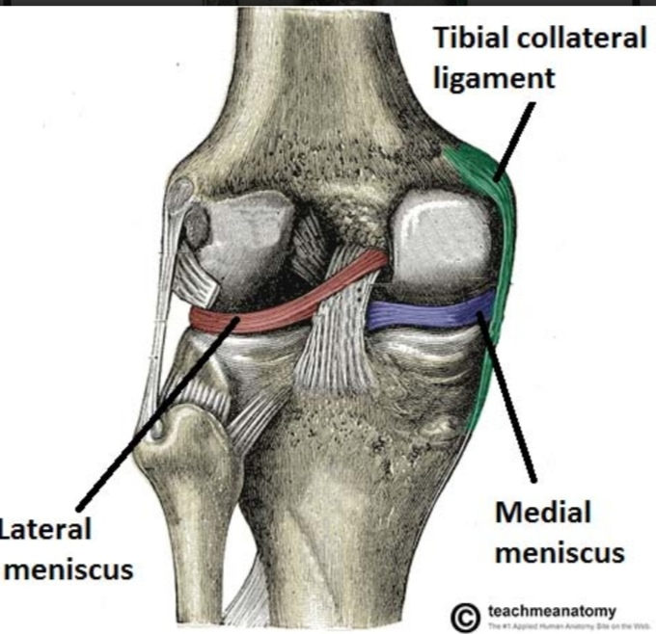
The muscle of knees including the quadri. Hamstring and the muscles of the calf. This muscle work in Groups to flex extand and stabilz the knee joint. This motion of the of the knee allow the body to for form such important moments as walking running kicking and jump ping
Extend along the inperior scarface of the thigh are the four musical of the quadriceps. Large muscle origanate in the ilium and femur and insert on the Tibia.

Slide 14
Write a comprehensive note on the femoral triangle?
Ans. The femoral triangle in the interiors superior third of the thigh asub facial space that appears as a tranulaglar depression inferior to the inguunal ligament the depression is visible when the thigh is abducted flexed and Latrally rotated.
The border of the femoral triangle ligament superiorly the aductor longus muscle medially and the sartorius the apex of the trigular is located distally and is formed by the inter section o-f the Latral border of the femoral triangle is composed sevra masale.
The floor of the femoral triangle is comprised of the adductor lungs pectin us psoas major and illacus muscles Tha shape of the floor is gutter shaped since all the muscle forming the floor pass to the posterior aspect of the femur.

Slide 15
The end. Thank you ❤️❤️❤️

