Slide 1
Name: Syed Taimoor Shah
ID 14832
Subject Design and analysis of Algorithm
Department BS CS
Semester 4th Assignment no 2
Submitted to Sir Muhammad Adil

Slide 2
Question 1:
Push and pop an elements in a queue

Slide 3
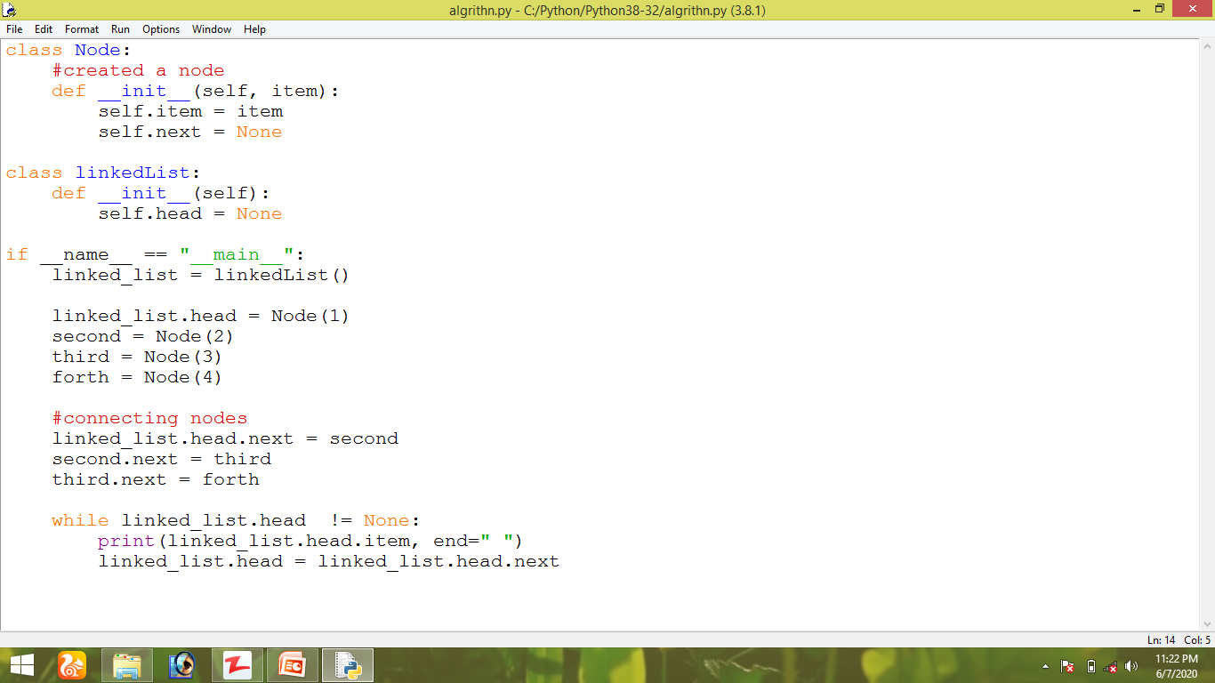

Slide 4
Result:

Slide 5
Question no 2:
Linked list and One way linked list:

Slide 6
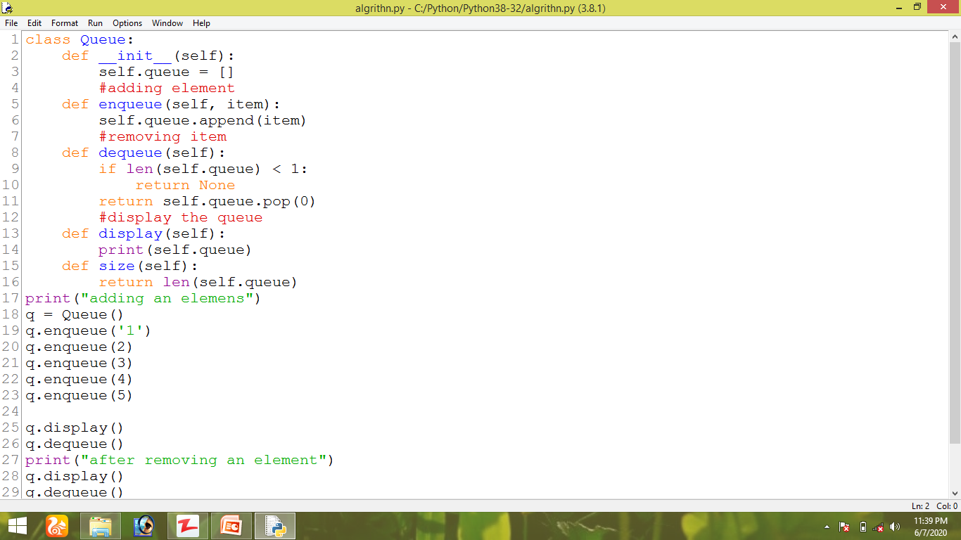

Slide 8
Result:

