Slide 1
WITH THE NAME OF ALLAH THE MOST MERCIFUL AND THE MOST BENEFICENT, MAY ALMIGHTY ALLAH PROTECTS US ALL FROM THE PANDEMIC SITUATION
AMEEN.

Slide 2
NAME: UMAIR ALI
IDE : 15874
SECTION: SE, A
SEMESTER: SECOND
COURSE: LINEAR ALGEBRA
INSTRUCTOR: SIR SHAKEEL
EXAMANATION: MIDTERM ASSIGMENT

Slide 3
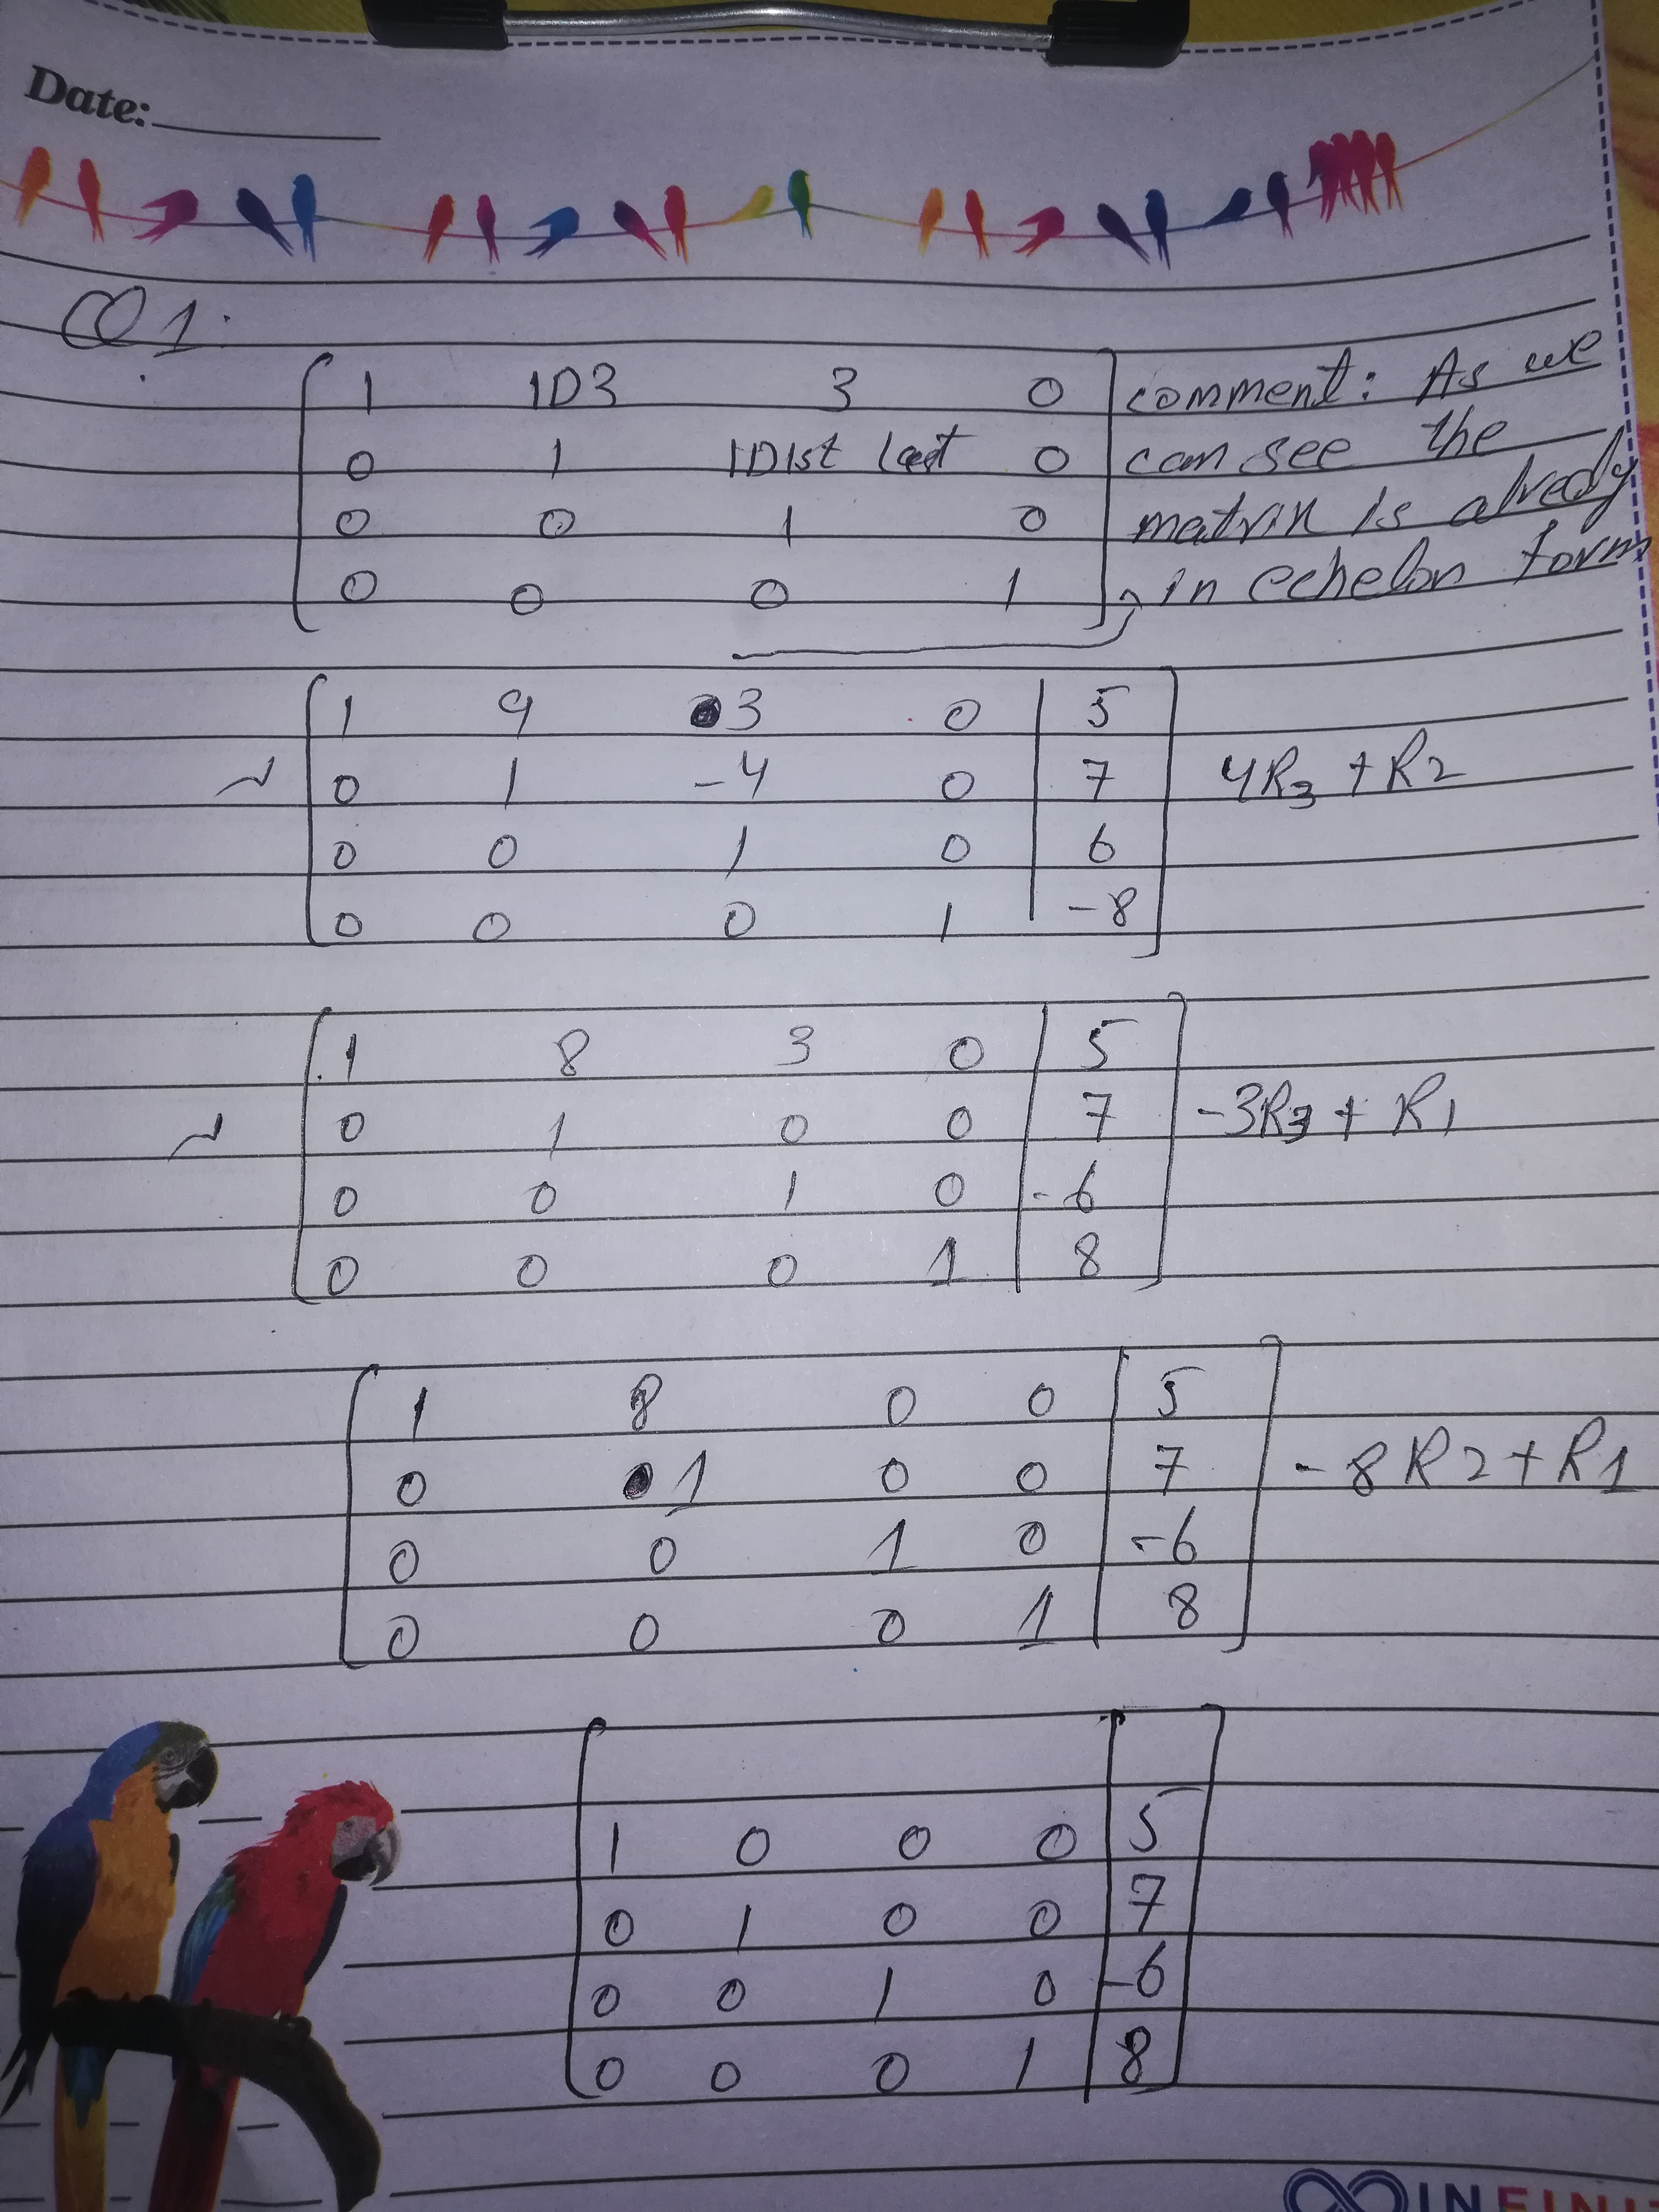

Slide 4
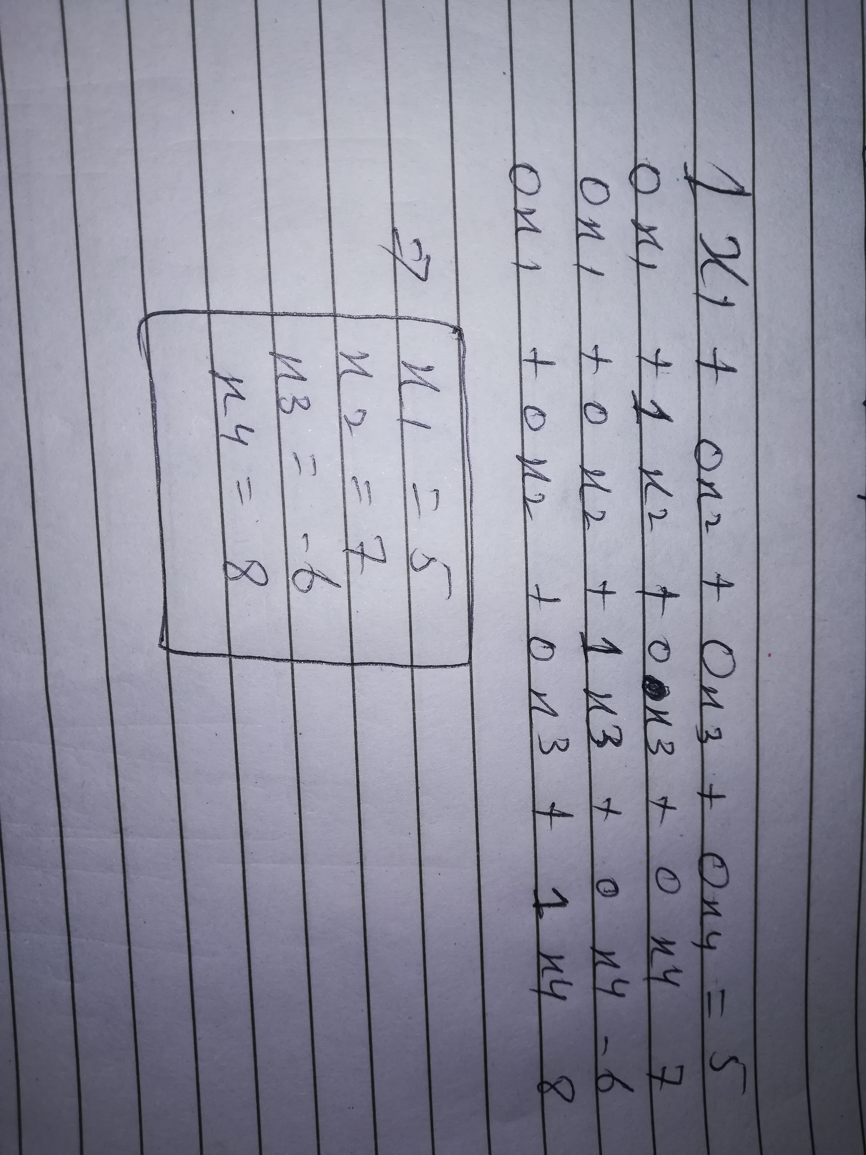

Slide 5
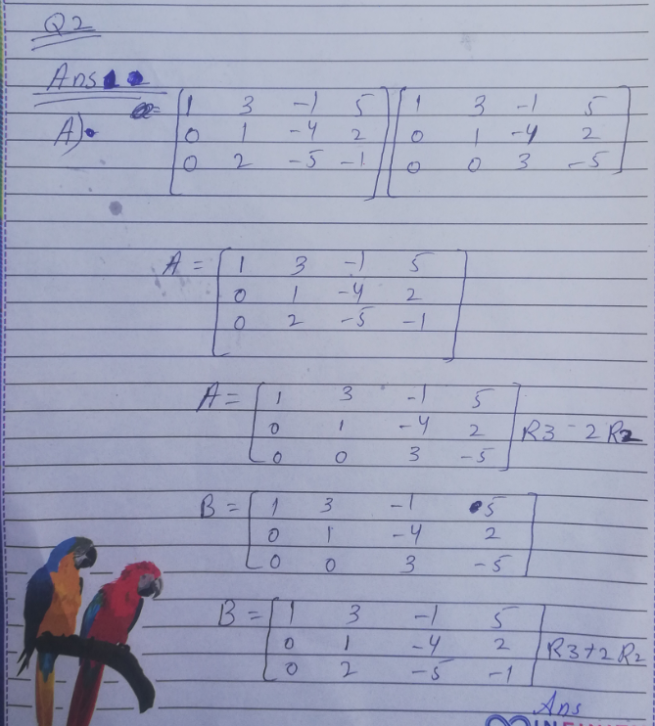

Slide 6
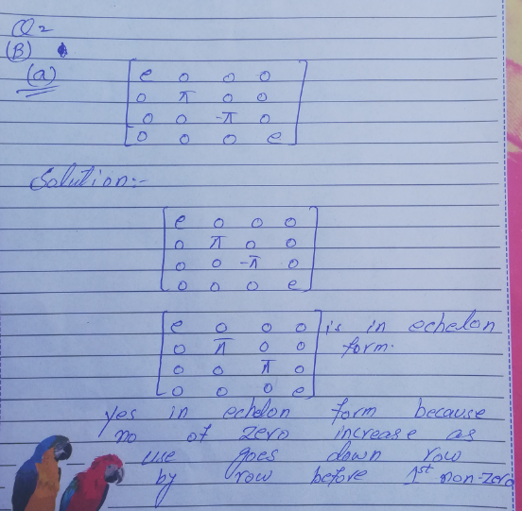

Slide 7
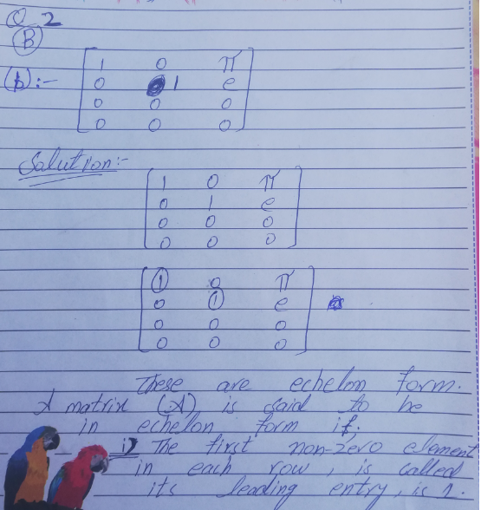

Slide 8
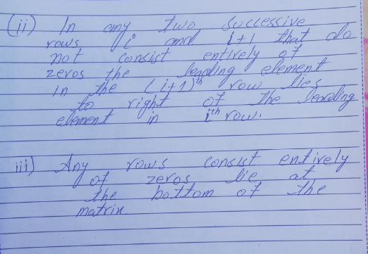

Slide 9
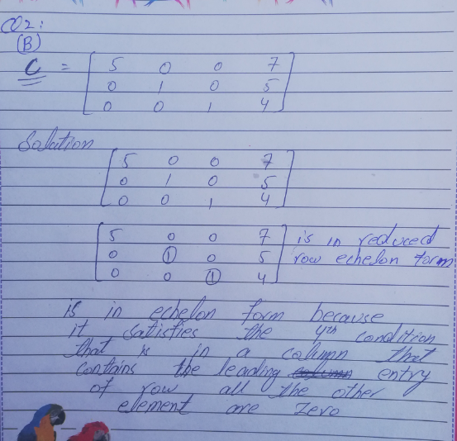

Slide 10
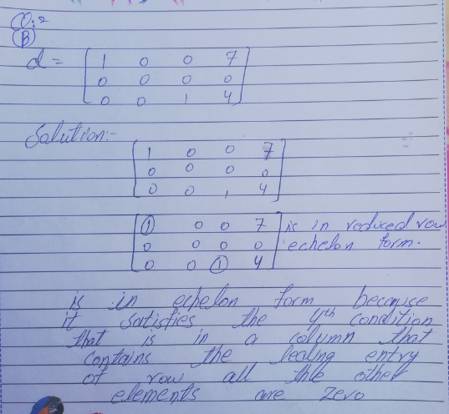

Slide 11
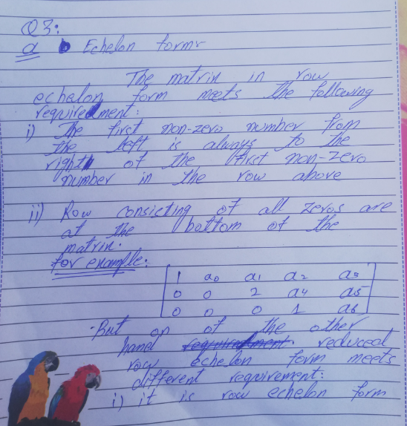

Slide 12
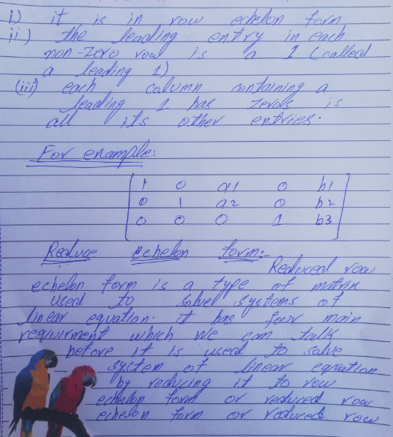

Slide 14
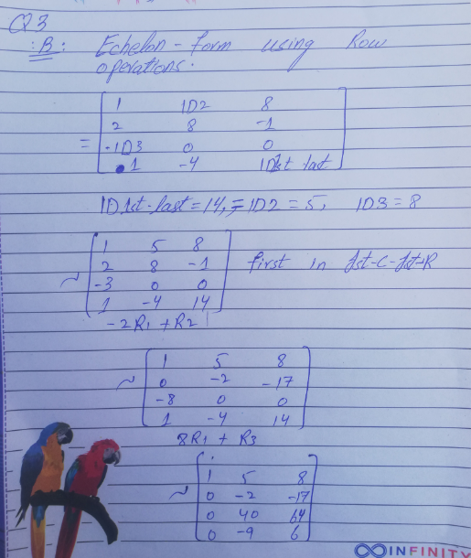

Slide 15
