Slide 1
Name Farkhanda jabeen
ID 14725
Subject Design and Analysis of Algorithm
Department BScs
Semester BScs 4th Assignment no 2
Submitted to SIR Muhammad Adil

Slide 2
Q1:
Push and pop an elements in a queue

Slide 3
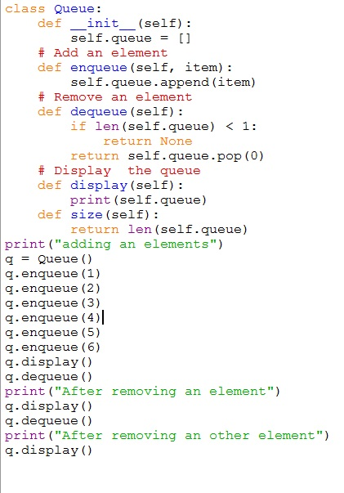

Slide 4
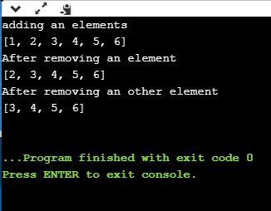
Result:

Slide 5
Q 2:
Linked list and One way linked list:

Slide 6
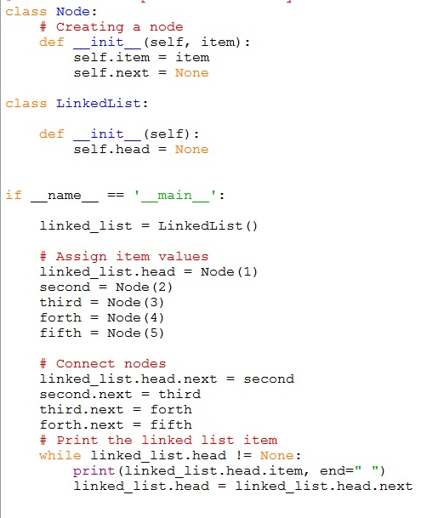

Slide 7
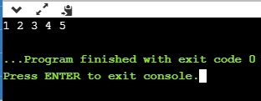
Result:

