Slide 1
Assignment: Anatomy BS Radiology 2nd Semester Section: A Name: Marwa ID : 16690

Slide 2
Endocrine System
Glands:
An organ in the human or animal body which secrets particular chemical substances for use in the body or for discharge into the surrounding.
Types of gland:
There are two types of glands in our body
Endocrine glands
Exocrine glands

Slide 3
Endocrine gland:
A glnad that secrets their products (hormones) directly into the blood rather than through a duct.
Example:
Pituitary gland
Thyroid gland
Adrenal glnad

Slide 4
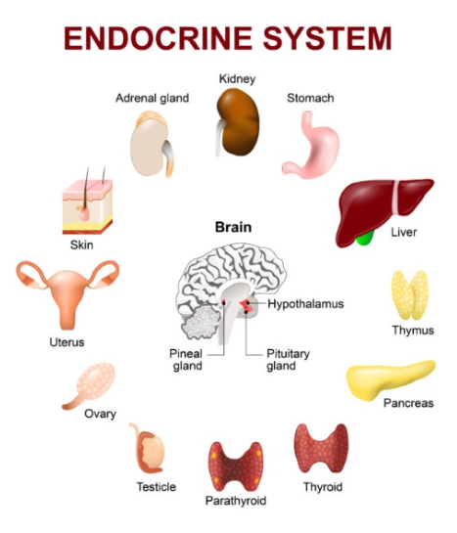
Endocrine System:
It consist of the following.
Pituitary gland
Thyroid gland
Parathyroid gland
Adrenal gland
Pancreas
Thymus gland

Slide 5
Pituitary gland:
The pituitary gland is often called the master gland because it controls several other hormone glands in your body, including the thyroid and adrenals, the ovaries and testicles. It secrets hormones both the front part (anterior) and the back part (posterior) of the glnad.
Hormones :
Anterior lobe:
Growth hormone (GH)
Prolactin
Thyroid stimulating hormone (TSH)
Adrenocorticotropic hormone (ACTH)
Follicle stimulating hormone (FSH)
Luteinizing hormone (LH)

Slide 6
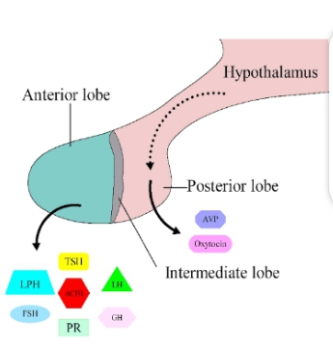
Posterior lobe:
Anti diuretic hormone (ADH) / Vasopressin
Oxytocin

Slide 7
Anterior pituitary:
Growth hormone (GH)
Action of growth hormone
The major role of growth hormone in stimulating body growth is to stimulate the liver and other tissues.
Increase calcium absorption from GIT.
Decrease sodium, potassium, calcium and phosphorus excretion from kidney.

Slide 8
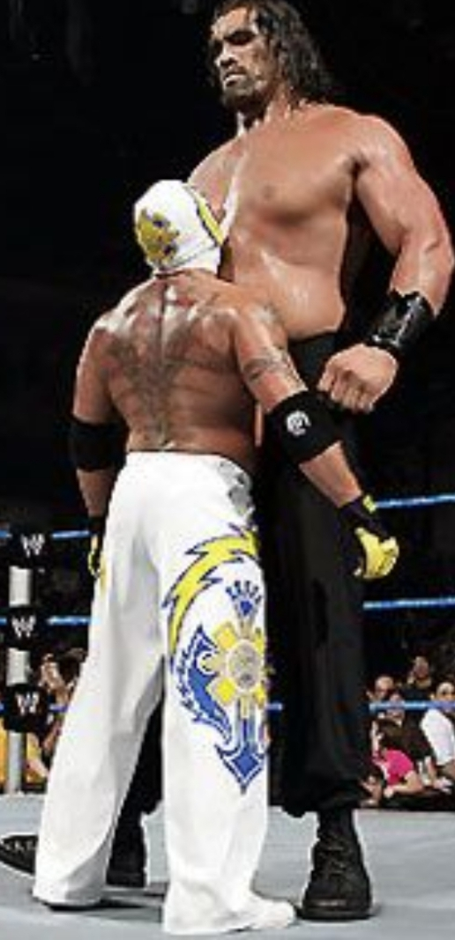
Diseases related to growth hormone:
Gigantism:
Gigantism is a rare condition that causes abnormal growth in humans.
This change is most notable in terms of height, but growth is affected as well.
Syptoms:
Tall stature
Large hand and feet

Slide 9
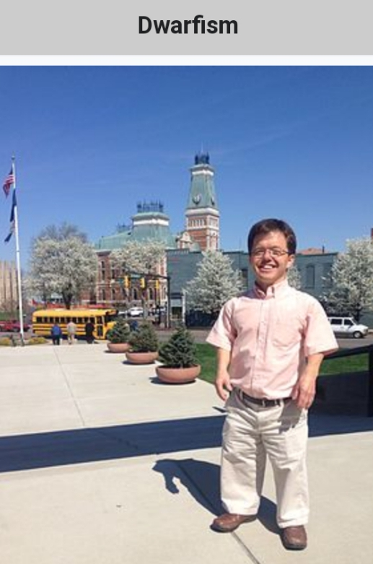
Dwarfism:
Is also know as short stature, occur when an organism is extremely small.
Syptoms:
Small genitalia
Delicate extremities

Slide 10
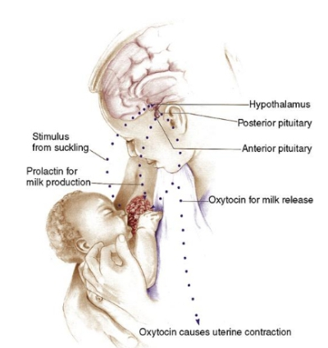
Prolactin:
Action of prolactin
Prolactin palys an important role in the development of
the mammary glnad and in milk synthesis.

Slide 11
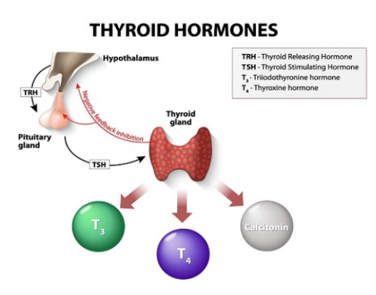
Thyroid stimulating hormone:
It stimulate the thyroid gland to produce.
Thyroxin (T4) and
Triiodothyronine (T3)

Slide 12
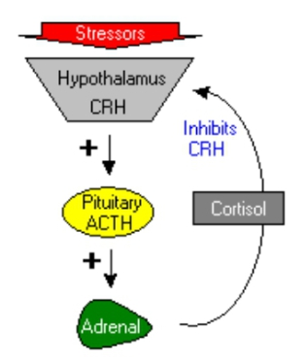
Adrenocorticotropic hormone (ACTH) :
A hormone secreted by the pituitary gland and stimulating the adrenal cortex.
It’s principal effects are increased production and release of corticosteroids.

Slide 13
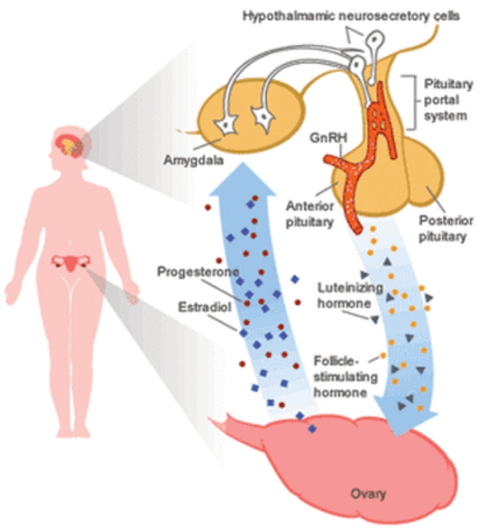
Follicle stimulating hormone (FSH):
FSH regulates the development, growth, pubertal maturation
and reproductive processes of the body.

Slide 14
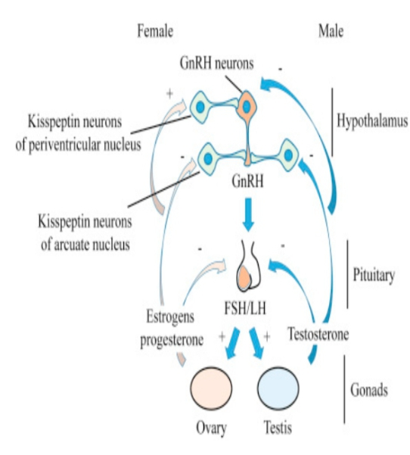
Luteinizing hormone:
In females:
In female an acute rise of LH triggers ovulation.
In Males:
In males it stimulates the production of testosterone.

Slide 15
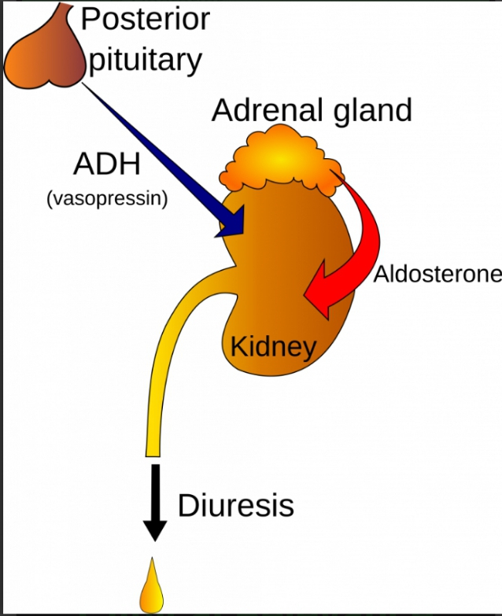
Hormones of posterior pituitary :
Anti diuretic hormone (ADH)/ Vasopressin
It retain water in the body.
ADH constantly regulates and balances the
Amount of water in your body.

Slide 16
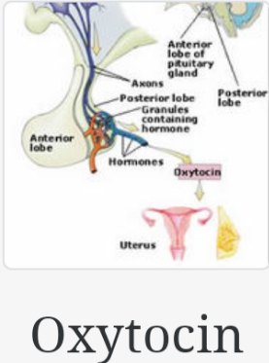
Oxytocin:
Oxytocin is synthesis in the hypothalamus.
Stored in the posterior lobe of pituitary gland.
Action of oxytocin:
Oxytocin stimulates contraction of mammary gland to
Produce milk.
It stimulates contraction of the smooth muscles of the
Uterus.

Slide 17
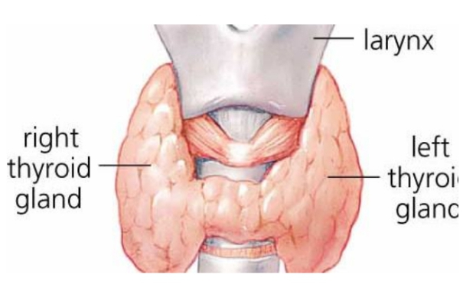
Thyroid gland:
The thyroid gland is an endocrine gland in your neck.
It makes two hormones that are secreted in to the blood.
Thyroxin (T4)
Triiodothyronine (T3)
These hormones are necessary for all the cells in your neck
To work normally.

Slide 18
Thyroid hormones:
Triiodothyronine (T3)
It effects almost every physical processes in the body.
Growth and development
Metabolism
Body temperature and
Heat rate
Thyroxin (T4)
Contol development and maturation.
Excess thyroxin results rapid development.
Deficiency of thyroxin result in delayed development.

Slide 19
Calcitonin:
It is an hormone secreted by the C cells of the thyroid gland.
It’s main action are :
To increase bone calcium.
To decrease blood calcium levels.
Calcitonin opposes the effects of parathyroid hormone, which acts to increase the blood level of calcium.

Slide 20
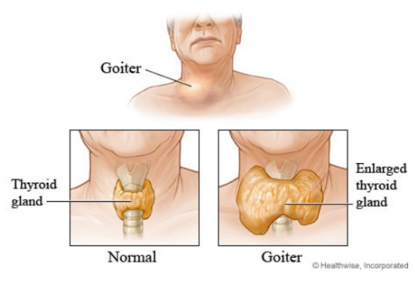
Diseases related to thyroid gland:
Goiter:
Any enlargement of the thyroid gland is called goiter.caused by iodine deficiency.
Charasteteristic features:
Swelling in the neck
Breathing difficulties
Cough
Hoarseness
Swallowing difficulties

Slide 21
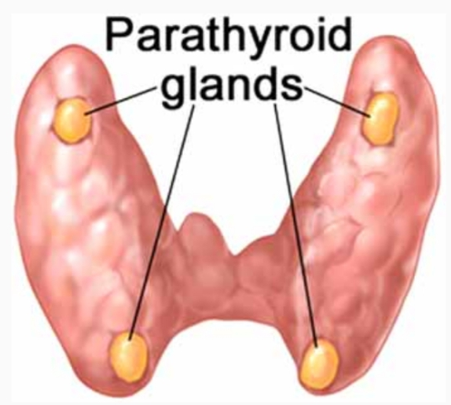
Parathyroid gland:
In humans there are 4 parathyroid glands. The main
function of parathyroid hormone is to increase the
blood calcium level.

Slide 22
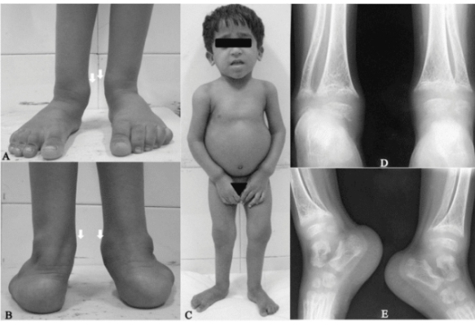
Diseases related to parathyroid gland:
Rickets:
It is a disease characterized mainly by bone deformities in young children’s.
The disease of children sets in about 6th month of life.
Characterized features:
Deformed bones
Thick wrist and ankle
Retarded growth

Slide 23
Osteomalacia:
Osteomalacia is a disease characterized by the softening of the bones caused by impaired bone metabolism primarily due to inadequate levels of available phosphate, calcium, and vitamin D.
The disease is mainly found in females, usually appears after multiple pregnancies and lactation.

Slide 24
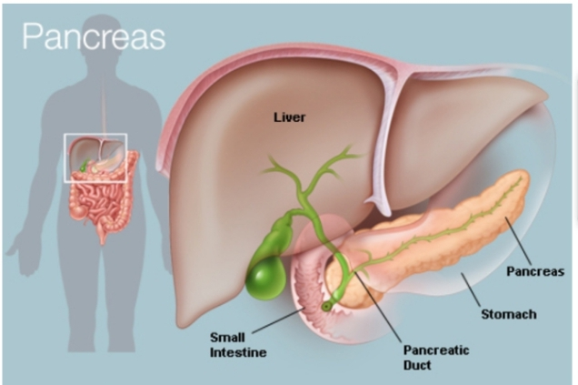
Pancreas:
Pancrease is an organ located in the abdomen. It plays an essential role in converting the food we eat into fuel for the body’s cells.
The pancreas has two main function an exocrine
function that helps in digestion and an endocrine
function that regulates blood sugar.

Slide 25
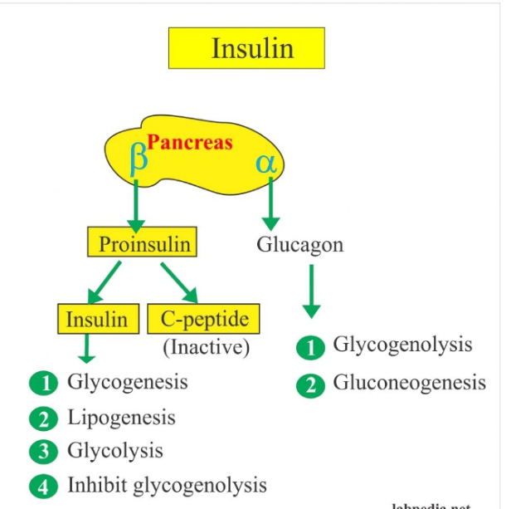
Pancreatic hormones:
Insulin:
Action:
On carbohydrates metabolism:
Insulin stores glucose into most of the cells.
Insulin produce hypoglycemia.

Slide 26
Diseases related to Insulin:
Diabetes mellitus:
It is a group of metabolic disease in which there are high blood sugar over a prolonged period. This high blood sugar produces the symptoms of :
Increased thirst and
Increased hunger
Glucagon:
Glucagon act mostly on the liver and adipose tissues where it antagonize the action of insulin.
Stimulate glycogenolysis
Promotes gluconeogenesis

Slide 27
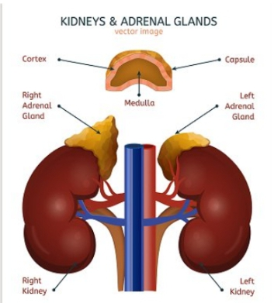
Adrenal Gland:
There are 2 adrenal gland.
About 4cm long and 3cm thick.
It has two parts
Outer part is cortex and
The inner part is medulla

Slide 28
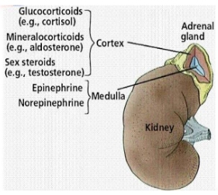
Adrenal cortex:
It produces three hormones:
Glucocorticoids
Mineralocorticoids
Sex hormones (androgens)
These are collectively called as adrenocorticoides.

Slide 29
Glucocorticoids:
Cortisol, is the main glucocorticoids.
They are essential for life regulating metabolism and stress.
Mineralocorticoids:
Aldosterone is the main mineralocorticoids.
It maintain water and electrolyte balance.
Sex hormone:
Androgens are the main sex hormone.
They contribute to the onset of puberty.

Slide 30
Adrenal Medulla:
It is surrounded by cortex .
It produces 2 hormones
Adrenaline
Non Adrenaline
Adrenaline and Nor Adrenaline:
They are released into the blood.
They are structurally very similar and have similar effects e.g
Increasing metabolism rate.
Delicating the pupils.
Increasing blood pressure.

Slide 31
Difference between Adrenal cortex and Adrenal Medulla:
Adrenal cortex:
It is outer firm part of the adrenal gland.
It forms about 75% part of the gland.
It is enclosed by a fibrous capsula.
It is stimulated to release it’s hormones by ACTH from anterior love of pituitary gland.
It develops from mesoderm.
It secrets three types of hormones.
Glucocorticoids
Mineralocorticoids
Sex hormones

Slide 32
Adrenal Medulla:
It is central soft part of the adrenal gland.
It form about 25% part of the gland.
It is not enclosed by a fibrous capsule.
It develops from ectoderm.
It consists of chromaffin cells.
It is stimulated to secrete it’s hormone by nerve impulses reaching through sympathetic nerve fibers.

Slide 33
Thank you!

