Slide 1
Name najeeb ullah ID 15779
Class bs DT
SECTION B

Slide 2
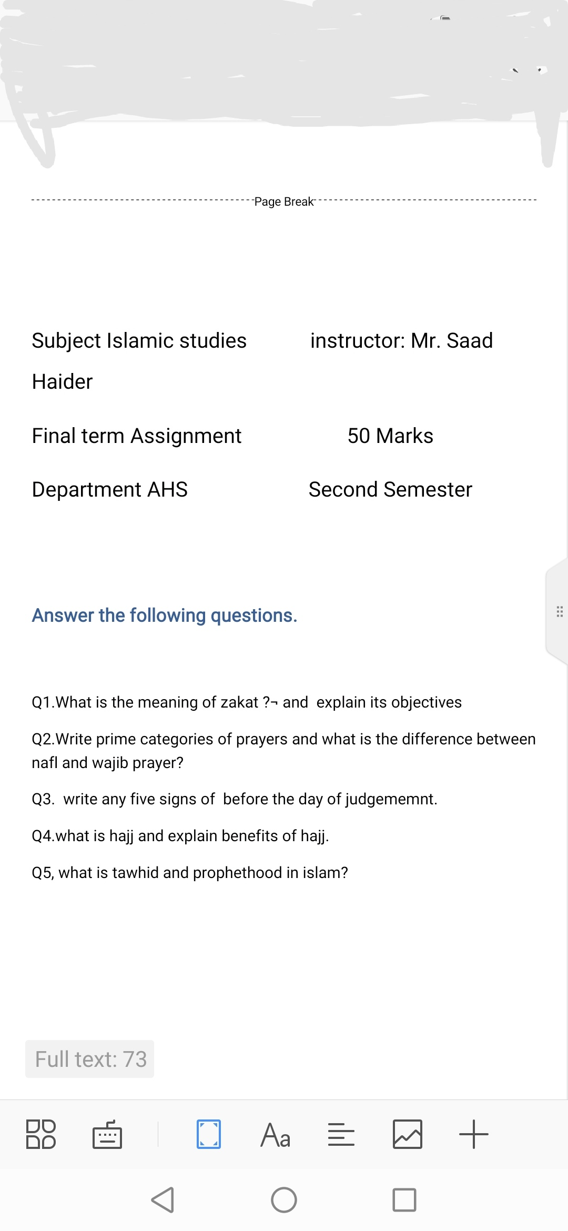

Slide 3
Questions no 1
What is the meaning of zakat?and explain it's objective?
Answer
The meaning of zakat is to clean

