Slide 1
NAME: BILAL AHMAD
ID :16843
MLT SECTION B
INSTRUCTOR NAME ; ADNAN AHMAD
SUBJECT HEAMOTOLOGY

Slide 2
Q#1:STAGES OF ERYTHROPIOSIS
1 )PROERYTHROBLAST:
it is the earliest erythroid element
basophilic cytoplasm with a perinuclear halo
in this process cytoplasm buldges to form “ Ear shaped “ process
nuclear chromatin is not homogeneous and nucleolus is seen.
2) BASOPHILIC ERYTHROBLAST:
Smaller than proerythroblast
nuclear chromatin shows sharp contrast between light and dark areas
cytoplasm is basophilic reflecting protien & RNA contents.
3) POLYCHROMATOPHILIC ERYTHROBLAST:

Slide 3
contd......
polychromasia means having many colours
In this step nuclous mature & condensed
cytoplasm have a gray hue derived from Hb.
4) ORTHOCHROMATIC ERYTHROBLAST:
Acidophilic erythroblast which is the last precursorwith nucloeous
nuceous is compact and situated near the membrane
cytoplasm is like mature red cell'reflecting a high Hb content.
5) RETICULOCYTE:
Young erythrocyte with granular or reticular filamentous structure makeup 0.5_2% of all erythrocytes
vital staining required to make this visible

Slide 4
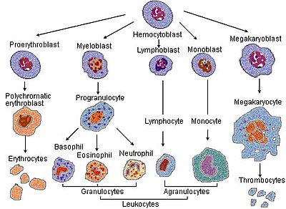
ERYTHROPOIESIS:

Slide 5
Q#2: Common causes of poor blood film (blood smear):
BLOOD SMEAR:
A blood film or peripheral blood smear is a thin layer of smeared on a glass microscope slide and the stained in such a way as to allow the various blood cells to be examined microscopically.
COMMON CAUSES OF BLOOD SMEAR:
As soon as the drop of blood is placed on the glass slide' there should be no delay in the making of the smear. Any delay ' whatsoever results in abnormal distribution of white cells with many of the white cells accumulating at the thin edge of the smear.Rouleaux of the red cells and clumping of the plateletes may also occur.

Slide 6
contd....
Drop of blood too large or too small .
Spreader slide push across the horizental slide in a jerky manner.
Failure to keep the entire edge of the spreader slide against the horizental side while making the smear.
Failure to push the spreader slide across complete horizental slide.
Exposure of slide to formaline interferes with stain quality of smear.

Slide 7
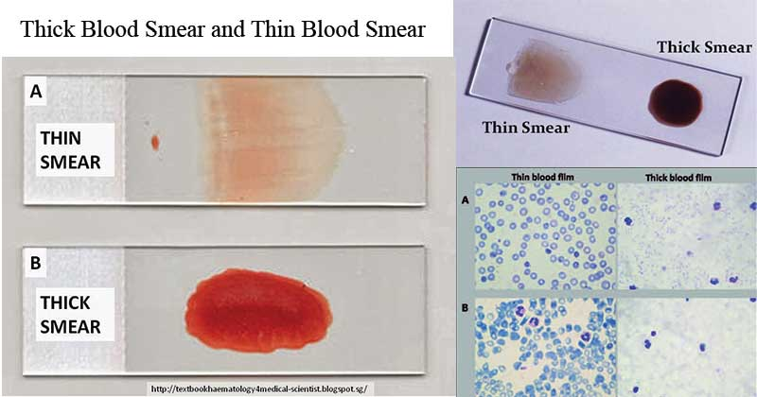
BLOOD SMEAR:

Slide 8
Q#3: GRANULOPOIESIS:
Granulopioses is a part of heamatopoiesis, that leads to the production of Granulocytes. A granulocyte also reffered to aspolymorphonuclear lymphocyte (PMN) is a type of white blood cell that has multi lobed nuclei ' usually containing three lobes,and has a significant amount of cytoplasmic granules within the cell. Granulopoiesis takes place in the bone marrow . It leads to the production of three types of mature granulocytes neutrophills'eosinophills and basophills . Even though heamotopiosis is usually presented in a form of hierarchically organized heamatopiotic tree' it is becoming evident ' that the cells are gradually progressing from one type to another'while remaining flexible and forming complex landscapes.

Slide 9
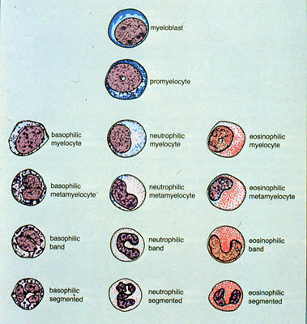
GRANULOPOIESIS:

Slide 10
Q#4:Iron deficiency anemia and its causes.
ANEMIA;
A decrease in haemoglobin level ( or total circulating red cell mass) for the age and sex of a person is called anemia.
CLASSIFICATION OF ANEMIA:
1) Iron deficiency anemia
2) Thalassemia
3) Sidroblastic anemia
4) Anema of chronic disorders.

Slide 11
Iron deficiency anemia:
Iron deficiency is the most commomn micronutrients defficiency in the world affecting 1.3 billion people i.e 24% of world ppulation
anemia is defined as a haemoglobin below the 5th percentile of healthy population
AT RISK GROUPS
Infants
under 5 children
children of school age
women of child bearing age

Slide 12
CAUSES OF IRON DEFICIENCY ANEMIA
1) Chronic blood loss
2) Uterine
3) Gastroentestinal ,peptic ulcer , eosophageal verices,aspirin ( other non steroidal anti inflammatory drugs) ingestion partial garactomy' carcinoma of the stomach , colon or rectum, hookworm, colitis ,piles, heomglobinuria, pulmonary haemosidrosis, cell -inflicted blood loss.

Slide 13
Q#5: Classify anemia on the basis of morphology and example;
Morphologically classification of anemia:
Anemia is classified in two ways either morpholigically or pathophysiological classification
the morphological classification is based on the size or volume of the red blood cells and may also be classified by the haemoglobin content of the red blood cell . A red blood cell of the nrmal size or volume is said to be normocytic
A morphologic classification of anemia also be normochromic ( normal heamoglobin content) or they could be hypochromic , meaning low heamoglobin content or hyperchromic , meaning high heamoglobin content .

Slide 14
contd....
The reasons is because categorizing an anemia is useful in determining what is going on in the body and therefore defining the underlying condition.
EXAMPLE:
If tests reveals small red blood cells microcytic and low heamoglobin content then the physician would have a good indicationthat this patient might be dealing with iron deficiency anemia and could prescribe an appropriate treatment plan.

