Slide 1
Name : Muhammad Owais Khan
ID Card No : 16802
Department : BS(MLT)2nd Semester
Section (B)
Paper : Basic Microbiology
Instructor : Mr. Fazli Zahir Mian
Exam : Final Term
Date : 25 / June /2020

Slide 2
Q1: Fill in the blanks .
1: Probiotics •
2: Synbiotics •
3: Antibiotics •
4: Bacteria •
5: Commensalism •
6: Conjugation •
7: Plasmid •
8: Normal Microbial Flora •
9: Transcription and Translation •

Slide 3
Q1: What is normal flora, advantages and disadvantages of flora?
Normal Flora :•
Normal flora are the microorganisms that live on another living oranism chuman or animal) or inanimate object with out causing diease , the human body is not sterile : we become colonised by bacteria from the the moment we are coverad with, and cotain within our intestines opproximately one hundred trillion bacteria that from the normal flora of our bodies this normal flora helps to prevent us becoming colnised with more dangerous bacteria which might lead to infection.

Slide 4
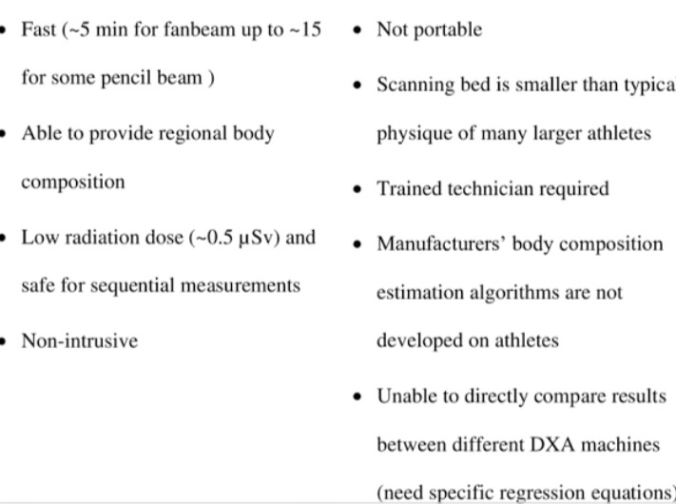
Advantages. Disadavantages.
•Suitabal for most athletes • Expensive equipment

Slide 5
Q3: Write in detail different stages of pathogenesis .

Slide 6
Q4: How the gene transfer for one bacterium to another .
Gene Transfer.
•Ways that bacteria can acquire new genetic info -transformation .
•Taking up of naked DNA from solution transduction .
• Tranfdr of DNA one to cell to another by a virus conjugation
•"Mating" , transfer of DNA from one bacterium to another by direct contact .

Slide 7
Q5: Write short notes of the following.
1: Symbiotic Relationship:•
Symbiosis is a close relation ship b/w two species in which at least one species benefits for the other species , the relation ship may be positive , negative , or neutral there are three basic types of symbiosis matualism , commensalism and parasitism.

Slide 8
2: Antimicrobial Drug:•
A drug used to treat a microbial infection " Antimicrobial" is a general term that refers to a group of drugs that includes antibiotics , antifungals antiprotozoals , and antivirals .

Slide 9
3: Antimicrobial Resistance:•

Slide 10
4: Probiotics :•
We usually think of bacteria as something that causes diseases But the body is full of bacteria , both good and bad
•Probiotics: are often called " good" or "helpful" bacteria because they help heep you gut healthy .
• Probiotics: are live bacteria and yeasts that are good for and have effact on the host by .

Slide 11
5: Prebiotic :•
• Non- disgestible food ingredients that beneficially affect the host by selectively stimulating the growth and / or activity of one or a limited number of bacteria in the colon , and thus improve host health" .
• Firts identified in 1995
• Typically oligosaccharides .

Slide 12
•Found in :
Breastmilk, ohicory root, lechs, onions, garlic, asparagus, whole grains, beans, banana ets.
• It should increase the number and / or activity of bifido bacteria and lactic acid bacteria .
Thank
You •

Slide 13
THE
END •

