Slide 1
Name Adnan khan
ID 14837
Subject Design and analysis of algorithm
Department BScs
Semester BScs 4th Assignment no 2
Submitted to SIR Muhammad Adil

Slide 2
Q1:
Push and pop an elements in a queue

Slide 3
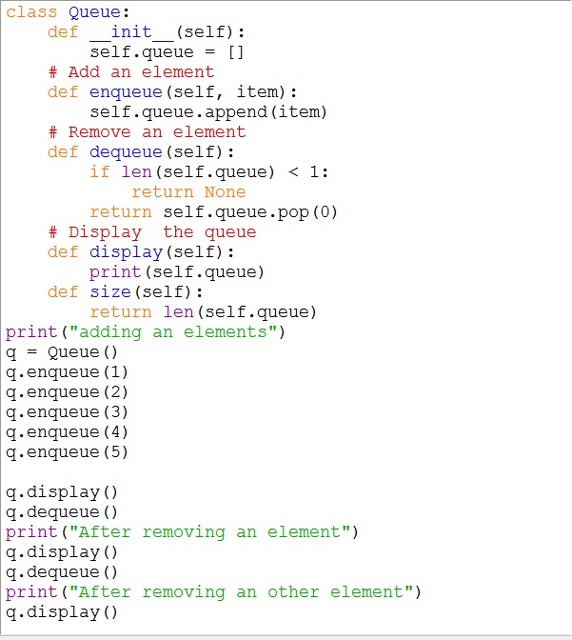

Slide 4
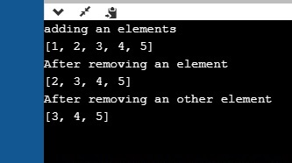
Result:

Slide 5
Q 2:
Linked list and One way linked list:

Slide 6
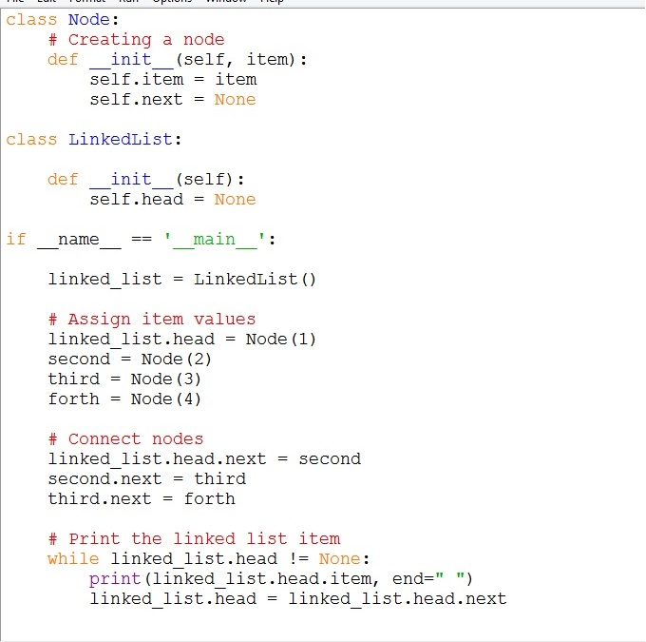

Slide 7
Result:

