Slide 1
NAME: M. BILAL
IDE : 15873
SECTION: SE, A
SEMESTER: SECOND
COURSE: PAKSTUDY
INSTRUCTOR: MAME BENISH
EXAMANATION: MIDTERM ASSIGMENT

Slide 2
pakistan study

Slide 3
Q1: A critical analysis of pakistan foreign policy post 9/11 ANS:

Slide 4
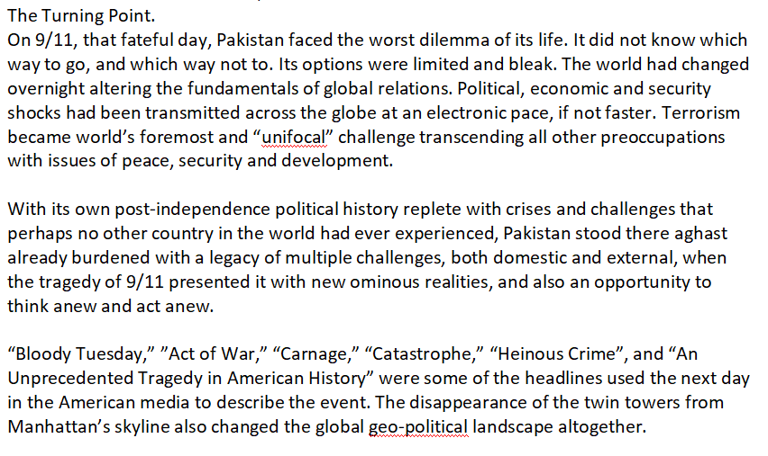

Slide 5
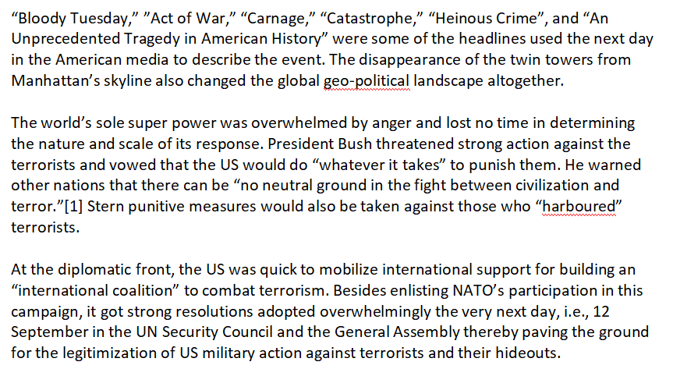

Slide 6
Q2:CPEC: prospects and challange?

Slide 9
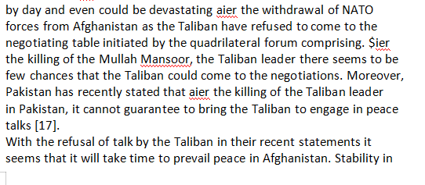

Slide 10
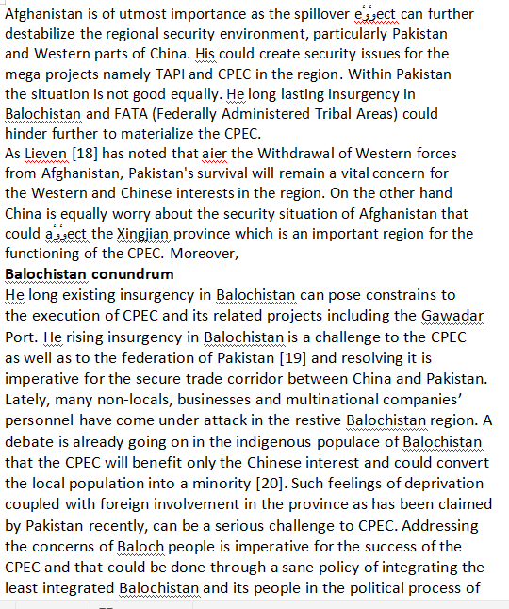

Slide 11
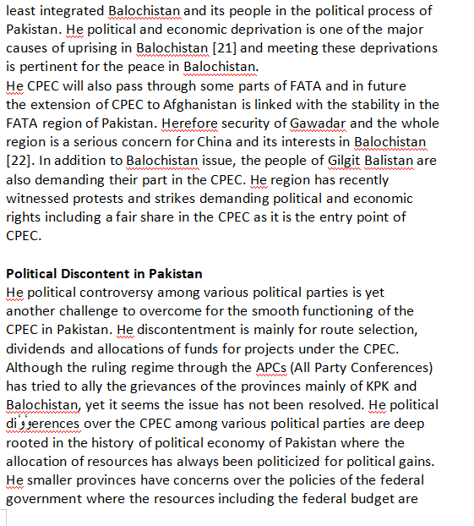

Slide 12
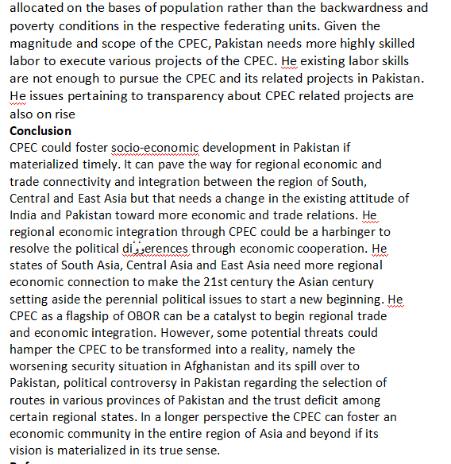

Slide 13
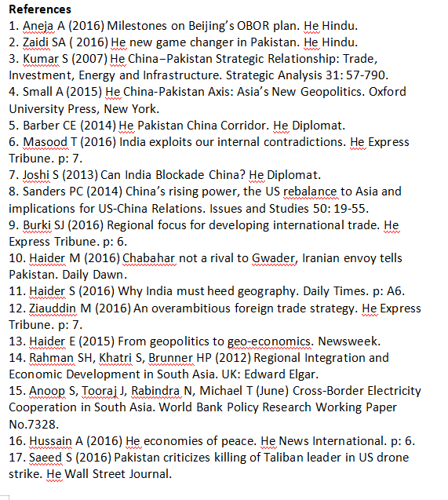

Slide 14
ISLAMIYAT

Slide 15
Q:1 Prophet (PBUH) as an educator, diploment, military strategist, and peace maker? ANS:

Slide 17
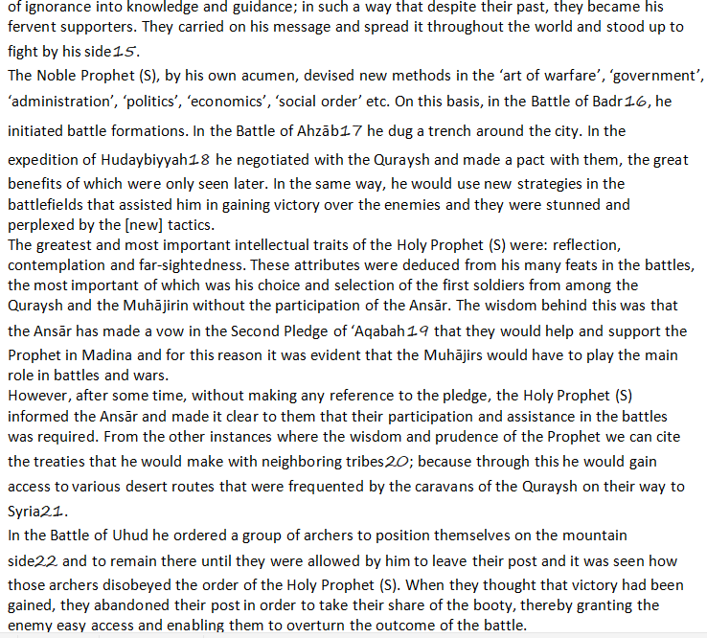

Slide 18
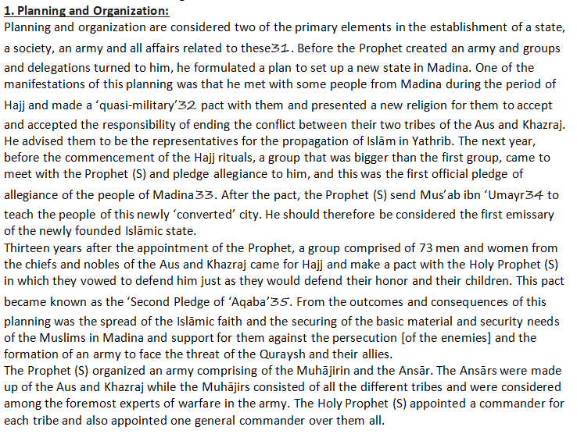

Slide 19
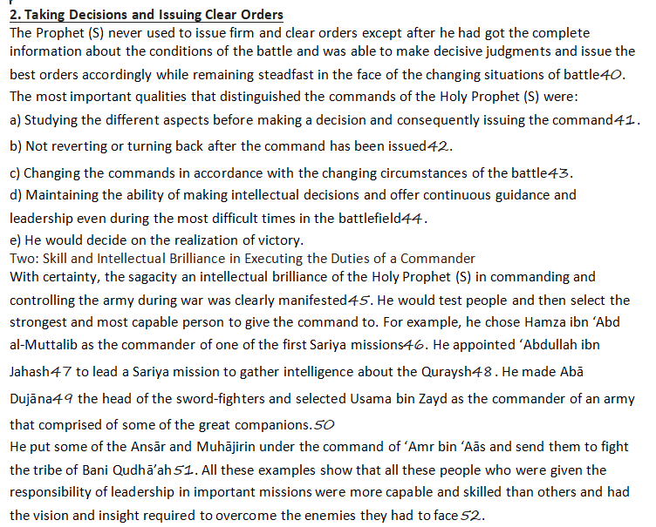

Slide 20
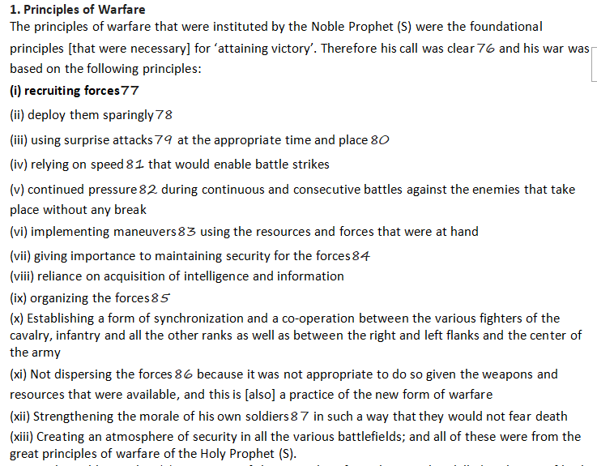

Slide 21
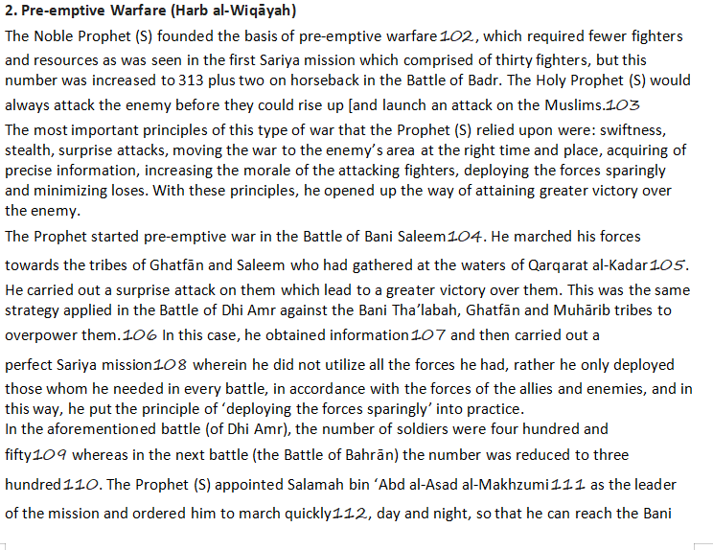

Slide 22
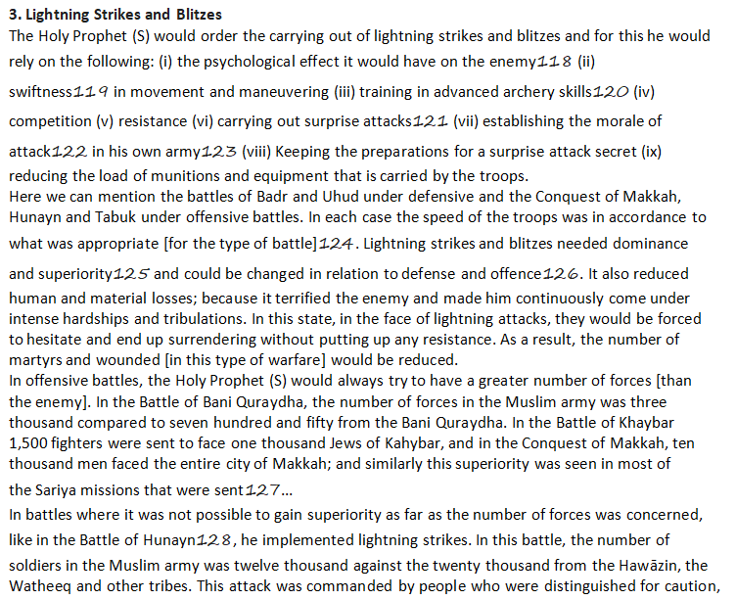

Slide 23
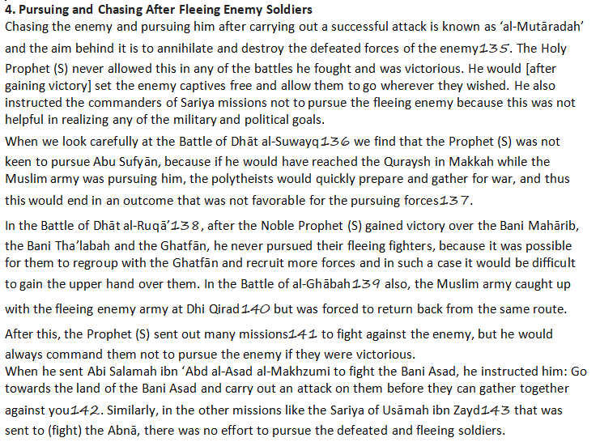

Slide 24
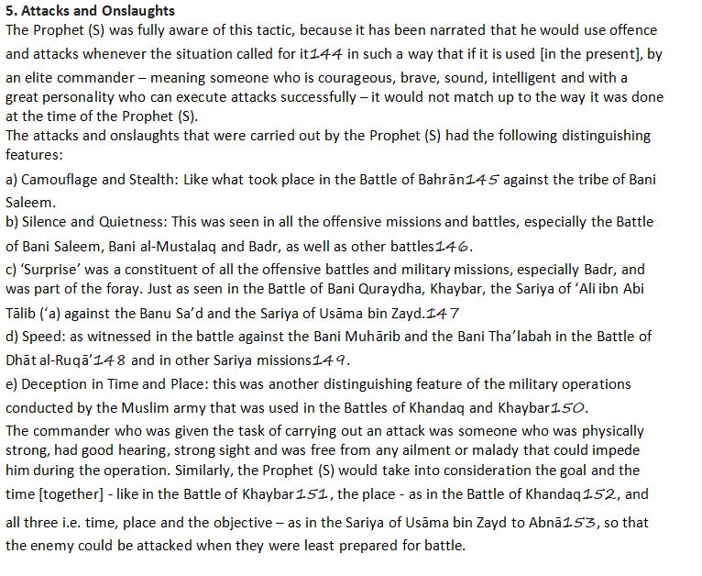

Slide 25
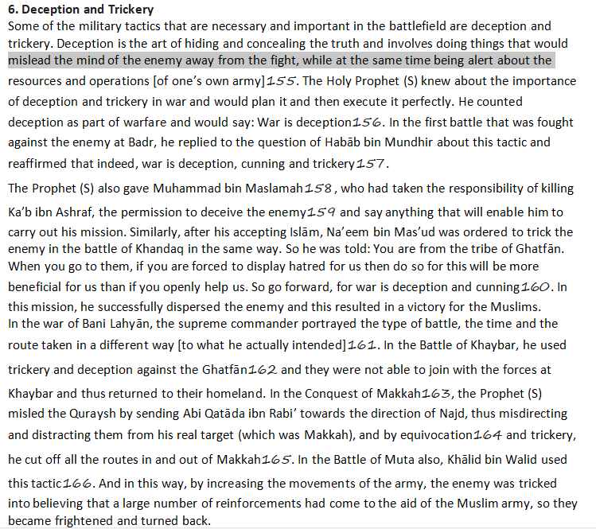

Slide 26
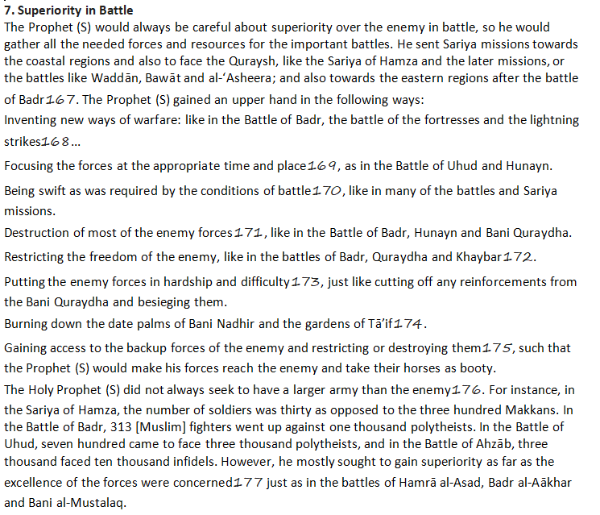

Slide 27
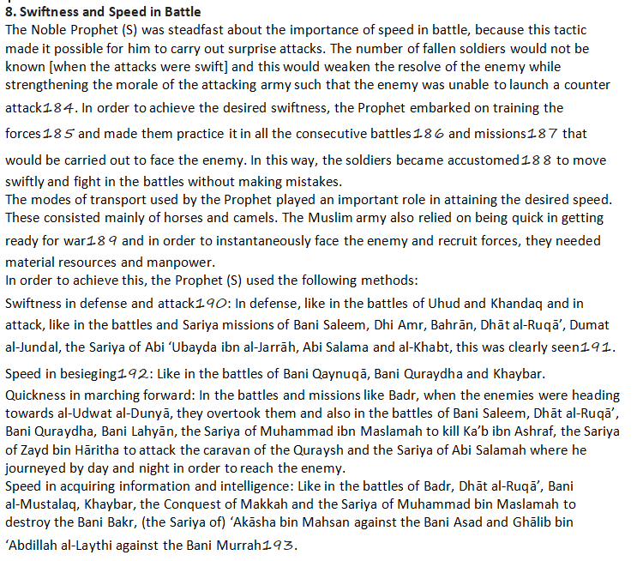

Slide 28
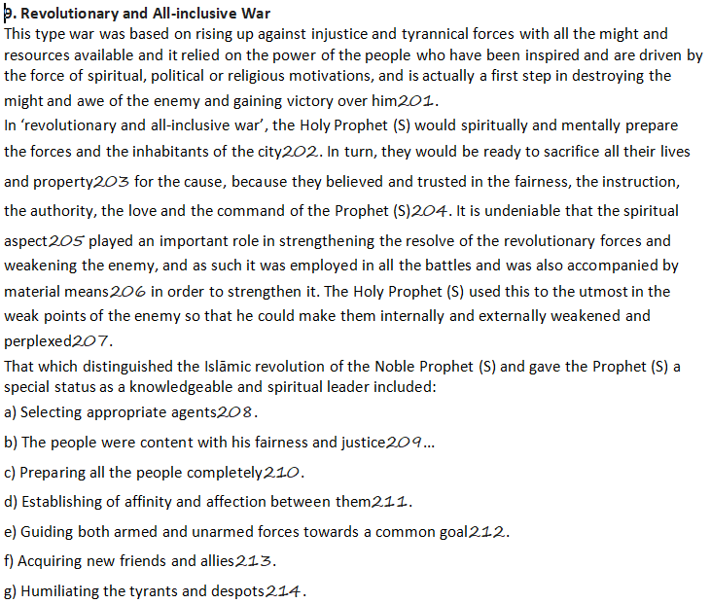

Slide 29
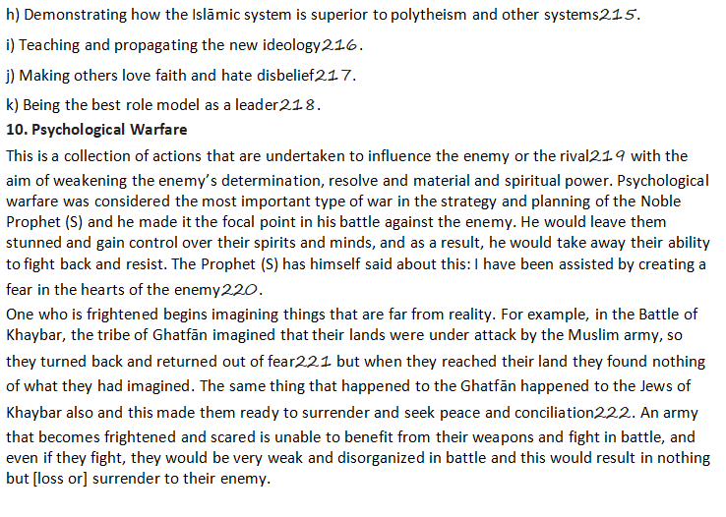

Slide 30
Q2: According to Quran and Sunnah define human rights? ANS:HUMAN RIGHTS IN ISLAM:

Slide 31
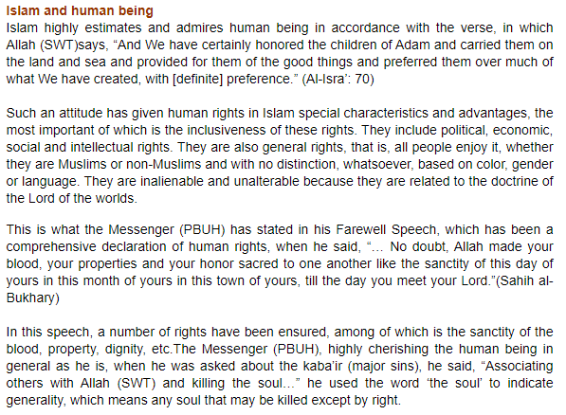

Slide 32
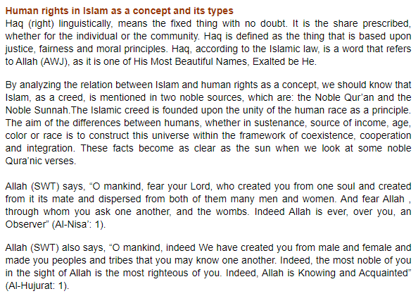

Slide 33
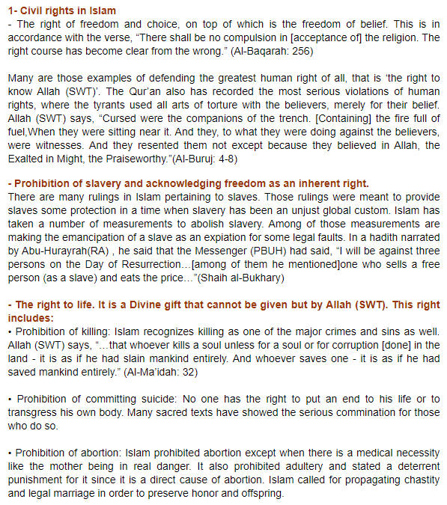

Slide 34
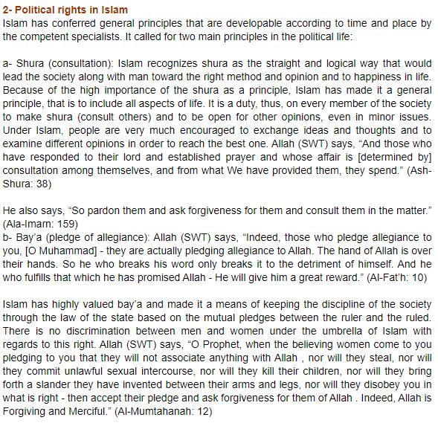

Slide 35
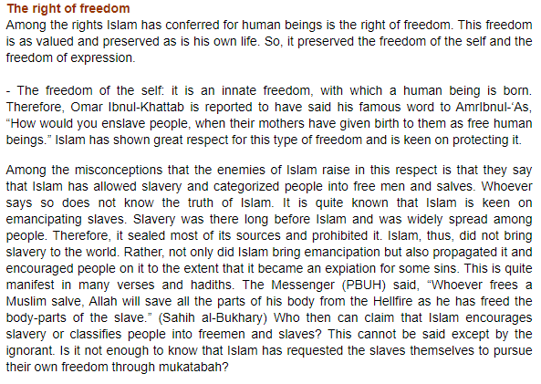

Slide 36
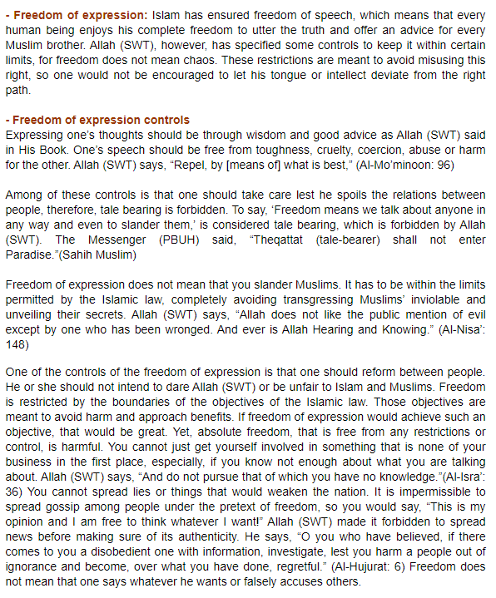

Slide 37
BUSINESS AND LABOR LAW

Slide 38
Q1: Negotiable instrument . draw a cheque, promisory note and bill of exchange? ANS:

Slide 39
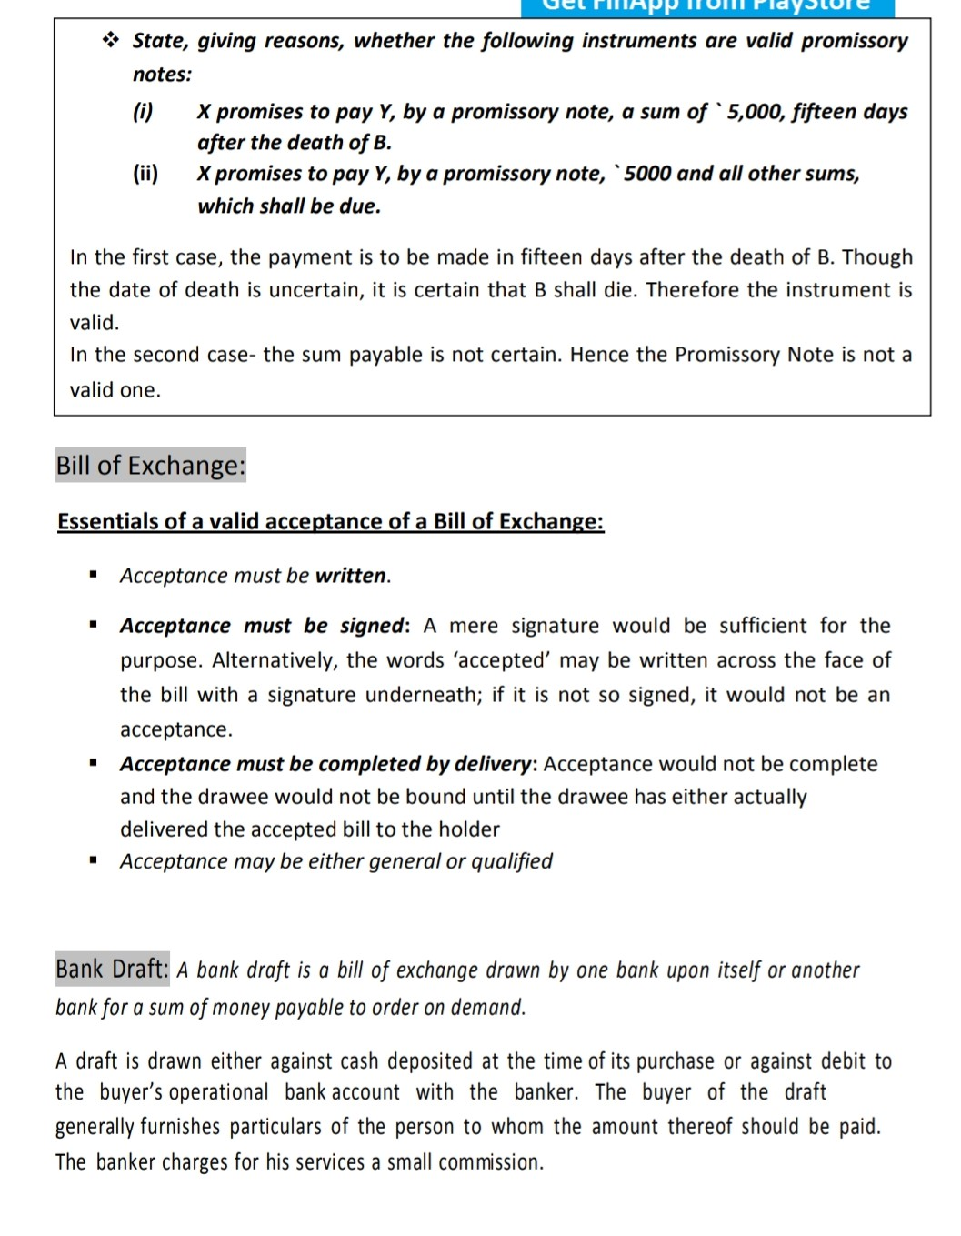

Slide 40
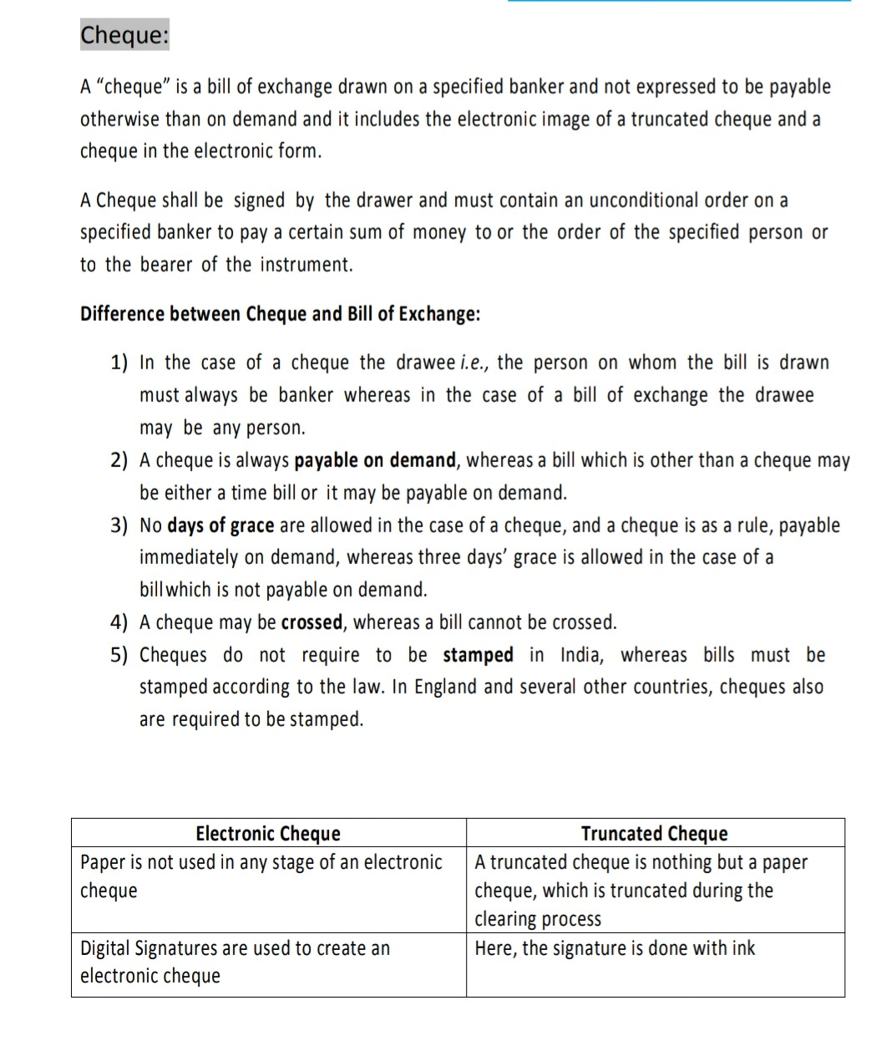

Slide 41
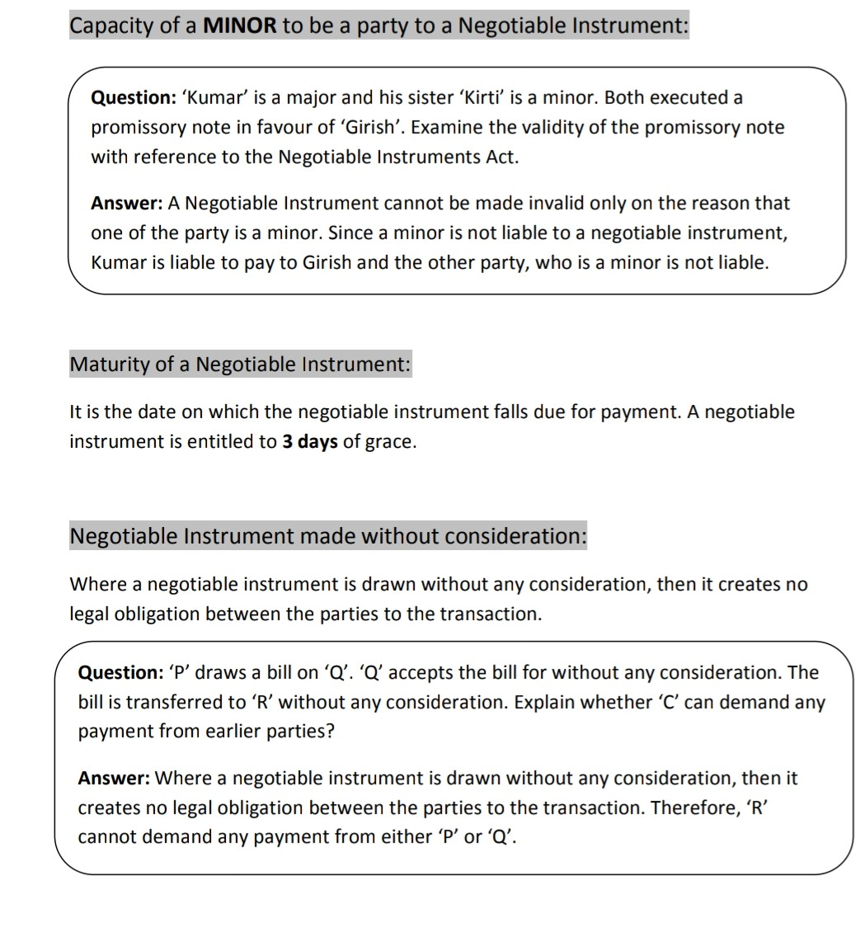

Slide 42
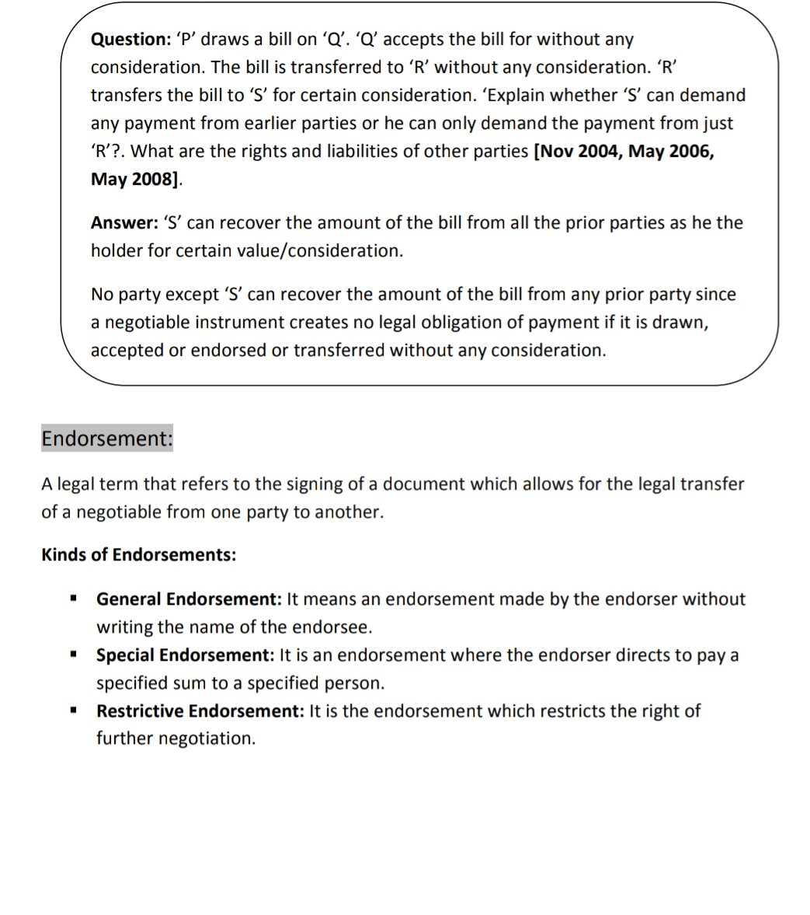

Slide 43
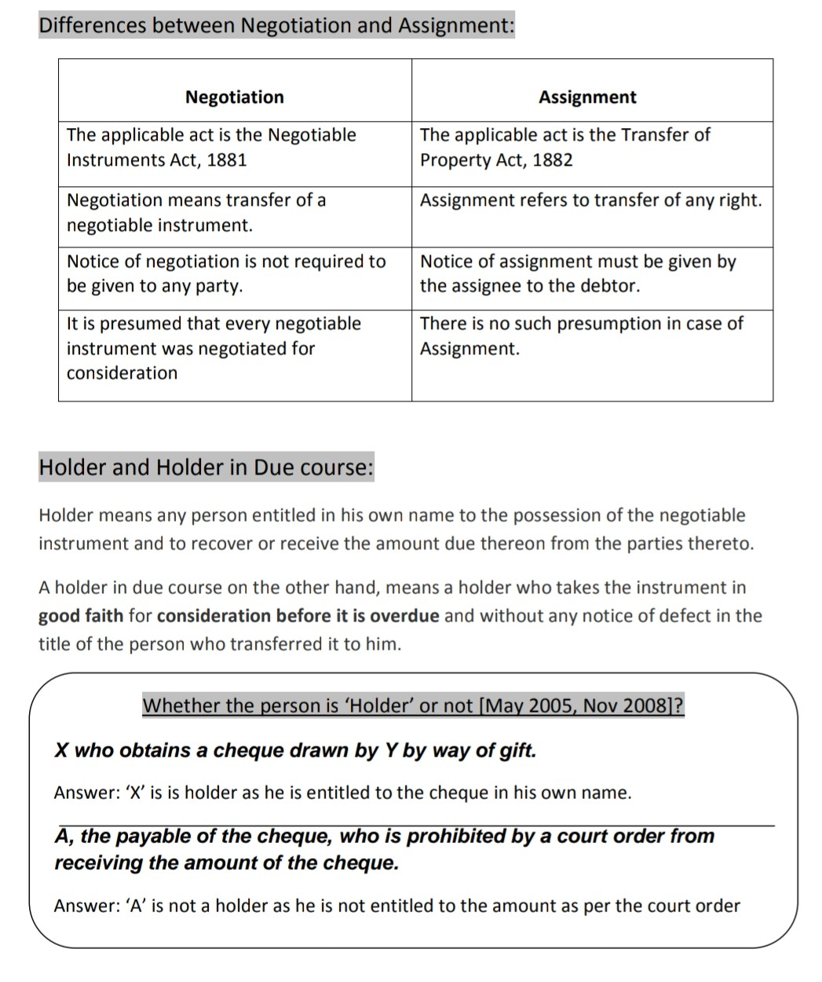

Slide 44
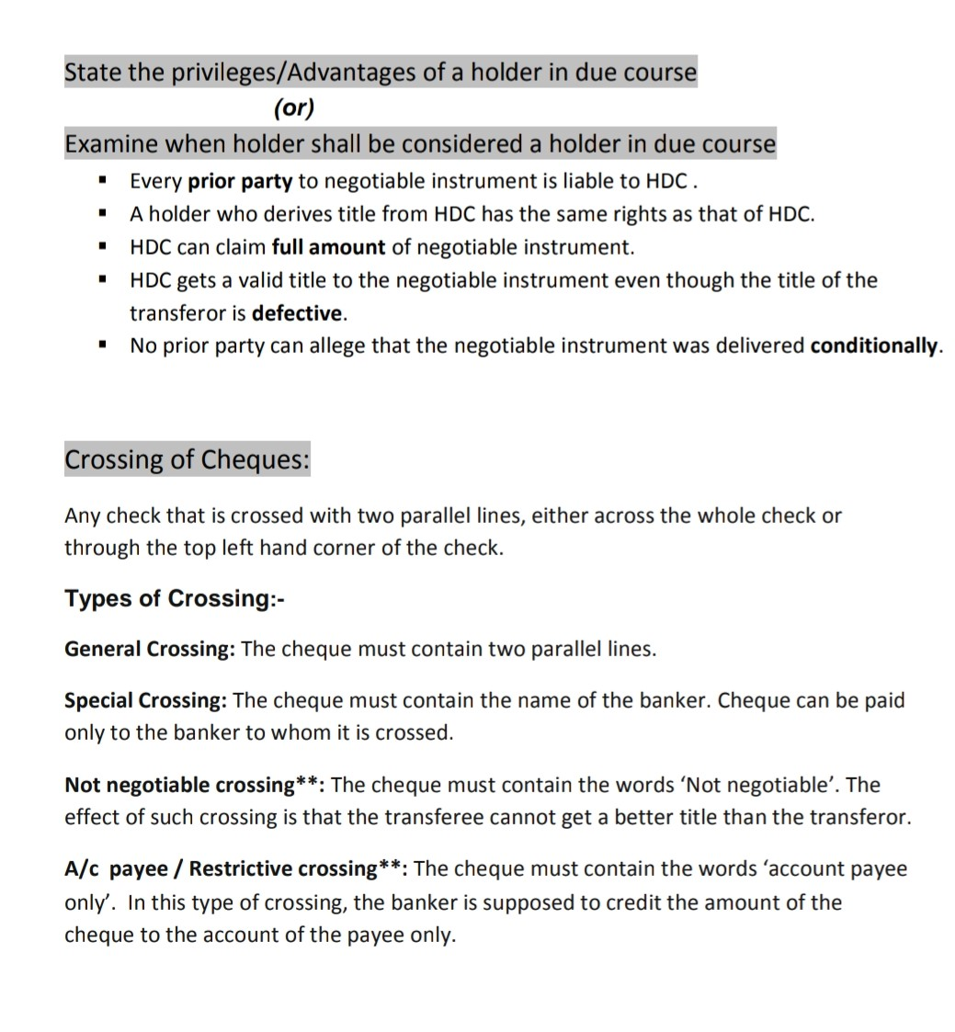

Slide 46
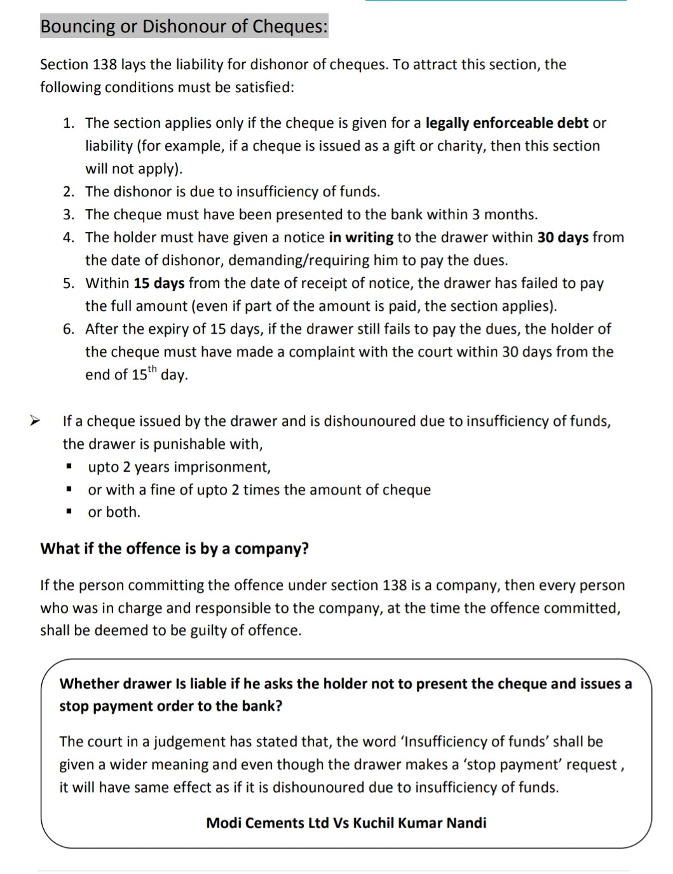

Slide 47
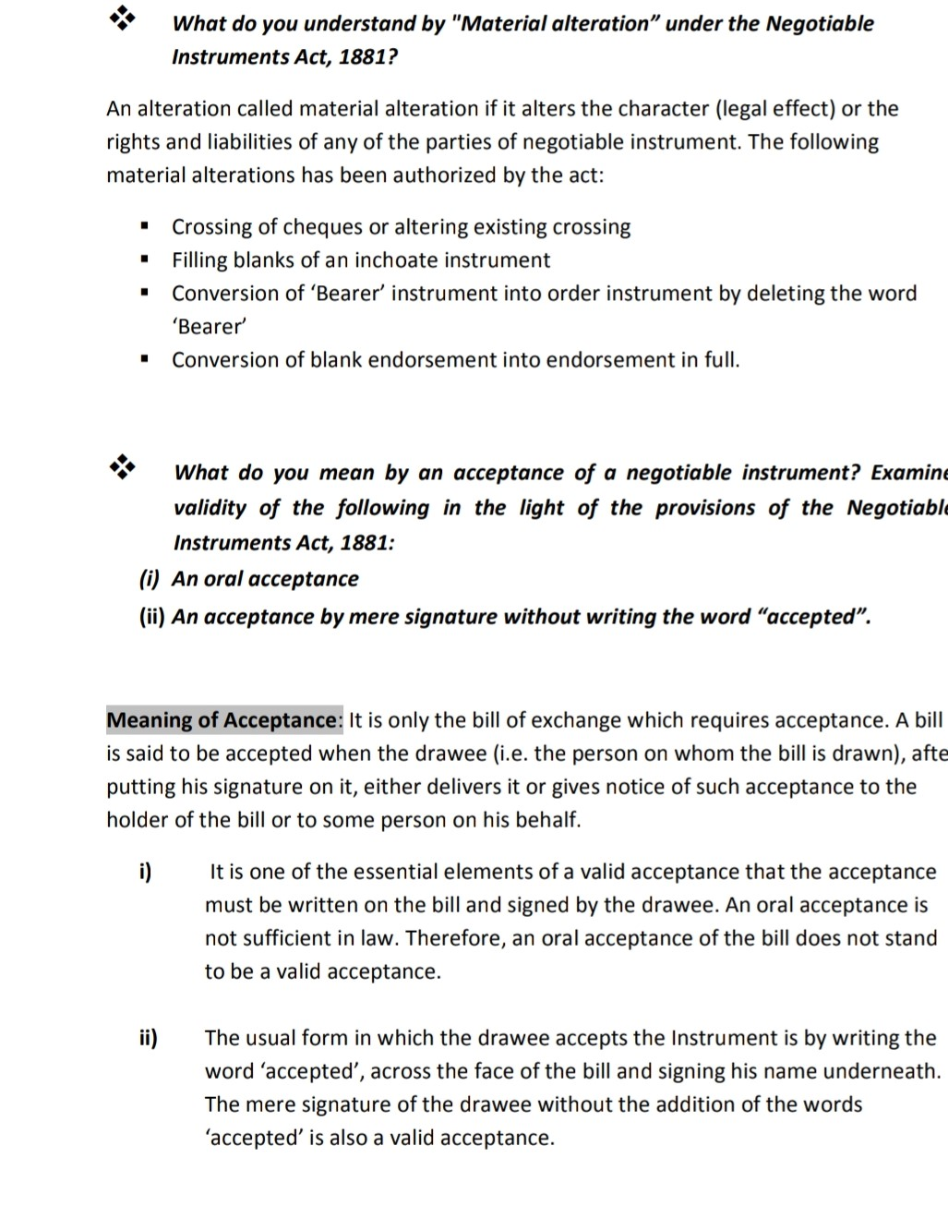

Slide 48
Q2:Function of labour count? Ans:

Slide 49
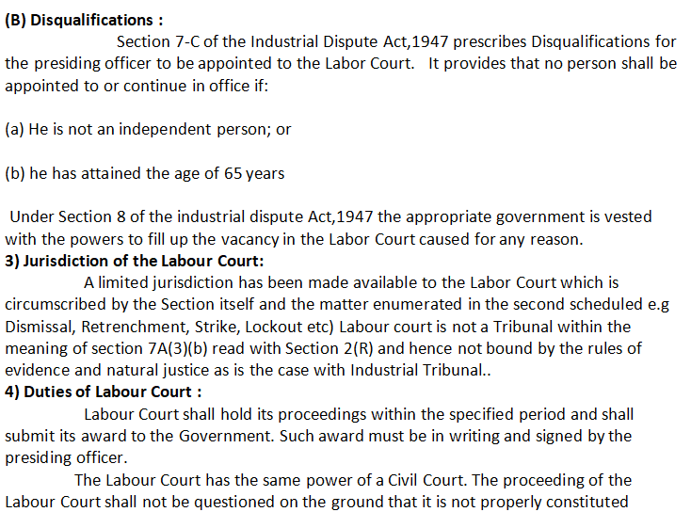

Slide 50
