Slide 1
Physiologi picture assiment
Raheela anmol
Id number 1b170

Slide 2
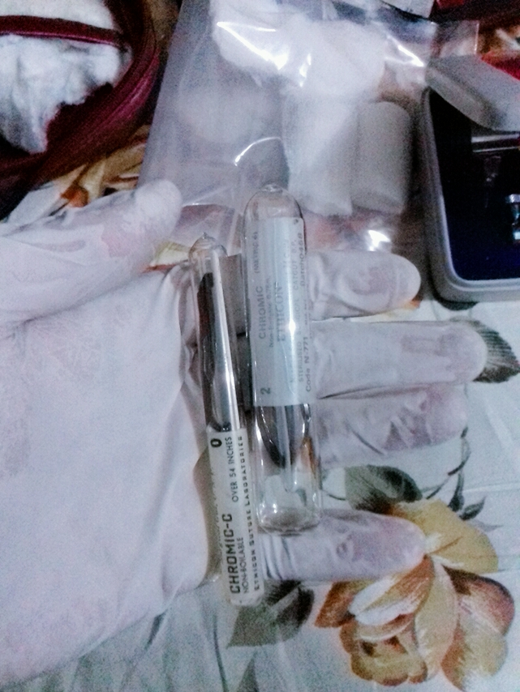
It is use for internal repairing rupture organs or as we can say that suture the internal organs

Slide 3
It is called surgical blade which is use for cutting the skine or internal organ during operation

Slide 4
Thermometer is use for the diagnosis of fewer and magnify glass also use as a magnifier

Slide 5
You also know about

Slide 6
It is use for cleaning the wound or as a germs killer

Slide 7
Surgical thread you know about its use

Slide 8
Its use for suture the wound

Slide 9
Disposable Latex Medical Examination Gloves

Slide 10
Surgical kit

Slide 11
Cutting tools

Slide 12
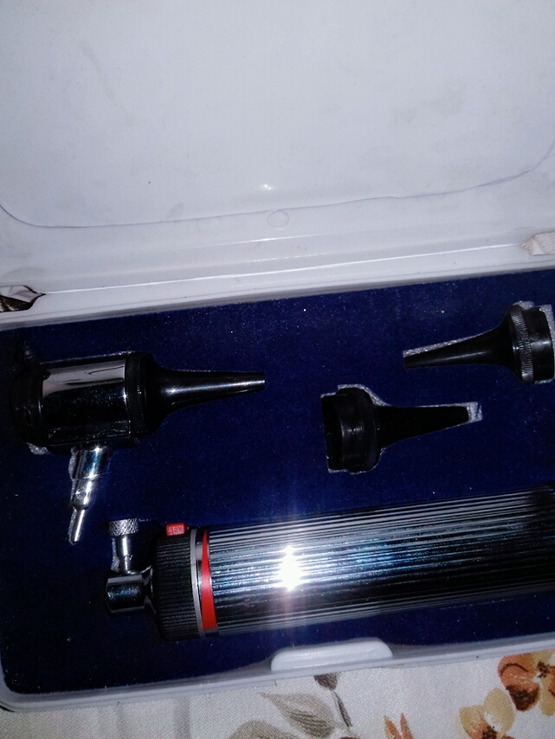
Otoskop use for diagnosis of ears

Slide 13
thanks

