Slide 1
Name: Muhammad Faiq id: 16451 Dpt 2^{ndsemester section B;} Biomechanics assignment

Slide 2
Question 1; Explain biomechanics of Articular cartilage?
Ans:
Articular cartilage is a smooth, soft, thin layer which has the function of lubrication and low friction between the joints and has the properties of viscoelastic.
Function of articular cartilage:
The main function of articular cartilage is to reduce friction and wear.
It also distribute load over a wide range of area to decrease the stress.

Slide 3
Composition of articular cartilage:
Articular cartilage is made of different matrix;
Proteoglyacan (25%)
Collagen (20%)
Ions.
The martial properties of articular cartilage depends upon its extracellular matrix.
Biomechanics of articular cartilage;
TO understand the biomechanical behaviour of articular cartilage we know that carilage is highly stressed material which is a viscoelastic material.
To understand the cartilage responses to the stress intrinsic mechanical must be determind.

Slide 4
The resistance, compression, tension and shear capacity permeability lubrication biphasic stress and relaxtion are biomechanical behaviour of articular cartilage.
It is of highly specilized connective tissue of diarthrodial joints.

Slide 5
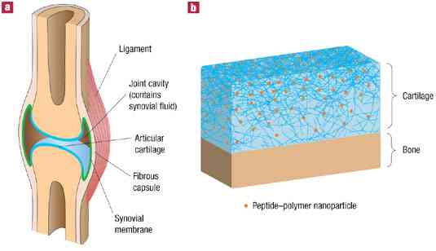

Slide 6
Question 2;
Lets define ligaments and tendons;
definition
Ligaments are elastic bundles with collagen fibre 2 and are present in between the bones to connect bone articulation.
The ligaments are plaint and fexaible and allows strong in’extensible to applied force.
BIOMECHANICAL BEHAVIOUR OF LIGAMENTS .
Ligaments are passive collagenous structures that act primarly as tensile restraints to control the distance between their attachment piont between their attachment point . Ligament normally transverse joints and so the act to control the relative separtion of the bones that they are attached.

Slide 7
Tendons
Tendon are bundle of collagenous fibers which are present in between muscle and bone and connect bone to muscles.
The dense regularly arranged collagenous tissue is made of fibers and are more flexaible than ligaments.
Tendons contain a prteoglycan matrix
Tendons contain fibroblast that are are arranged parallal rows

Slide 8
Biomechanical behaviour of tendons:
Tendons carry tensile force from muscle to bone.
They carry compressive force wrapped around bone like a pulley.
They facilitate skeltal muscle movement .
Proprioception
Secondary function storage of energy

Slide 9
